Slide 1

Netw211- Fundamentals of Cloud computing
Amber Palmer
Final Project
Linkedin: https://www.linkedin.com/in/amber-wilkins-998519220/

Slide 2
agenda
Creating Azure for student’s account
Virtual Machine Instances
Azure VNet and Subnets
Azure VM Security
Cloud Storage
Cloud Monitoring

Slide 3
Introduction
Cloud computing is a technology that has revolutionized the IoT industry by delivering computing services such as servers, data storage, networks, databases, analytics, intelligence, and software over the internet (hence “Cloud”). Enterprises have gone from bearing the cost of physical servers (data centers), training staff to maintain the servers, and footing the cost of maintaining these servers to storing their data in the cloud. Throughout this project, I will be demonstrating the process of building a system in Azure Cloud.

Slide 4
Creating Azure for Students’ Account
Microsoft Azure offers free accounts for students and educators. To create a free student account, navigate to Azure or complete a quick Google search for “Azure for students”. Once registered for the student account a $100 dollar credit is provided. The welcome page will show the school email address in the top right corner. There is a “discover free services on Azure option” that shows what services are included for free with this subscription and do not use any of the credit given. Usage hours on new VMs will start immediately and continue to accrue until the VM is stopped or deleted so it is important to terminate or delete the VM when it is no longer needed. (A deleted VM will remain visible for a while, but it can no longer be connected to and therefore will not accrue any more charges.)

Slide 5

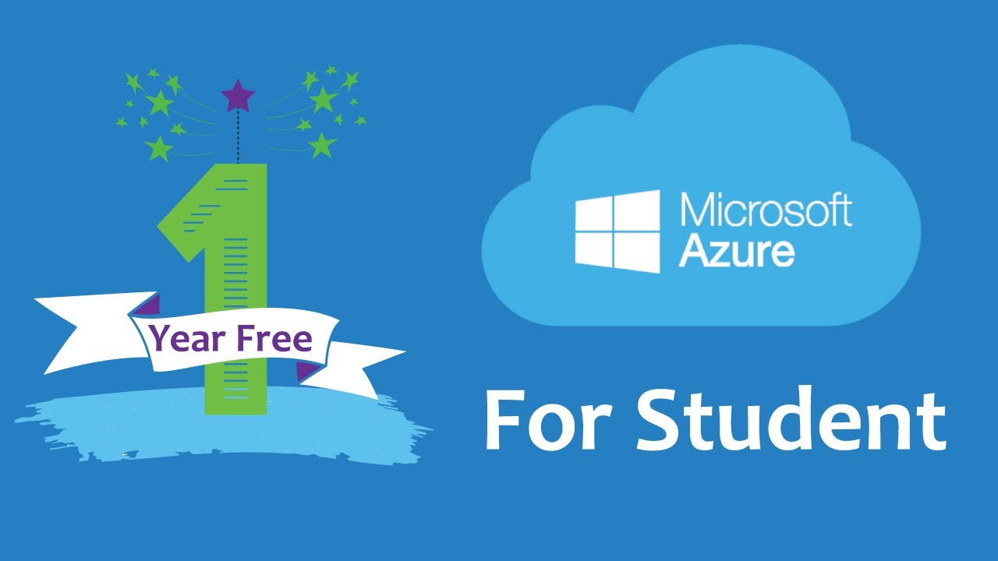
Student Email Login

Slide 6
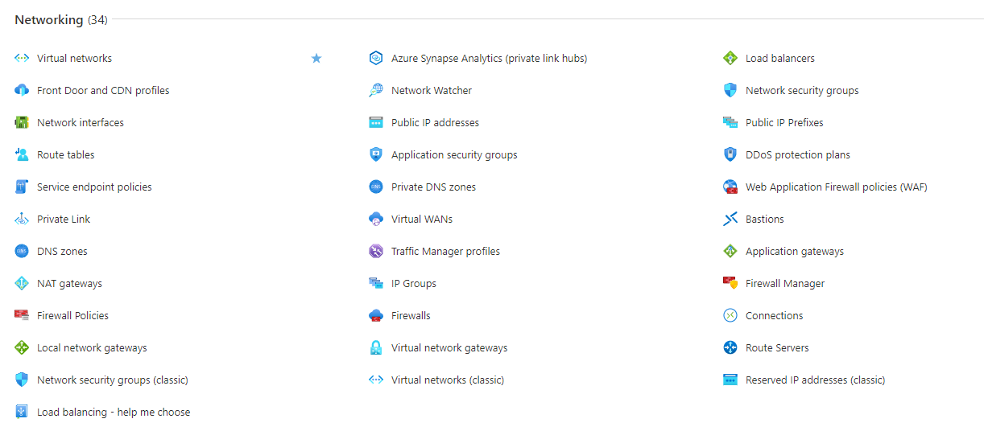
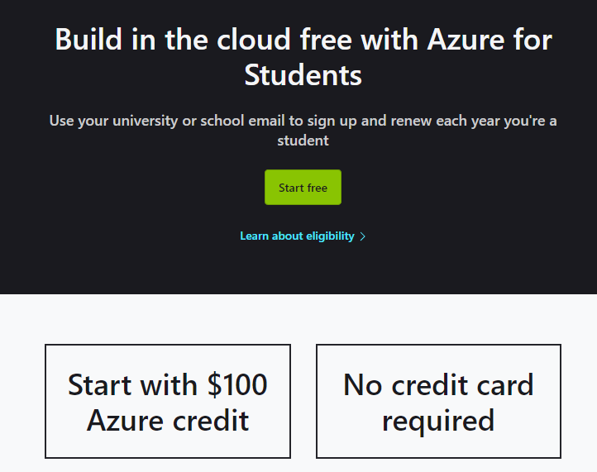
The start free button below will bring you through the sign-up process. Make sure to use your school or educator’s email to qualify.
This is just a fraction of the services available with a student account. These are the options that fall under Networking. There are plenty more options available under all services found in the menu tab. (The hamburger icon in the upper left corner of Microsoft Azure lab.)

Slide 7
Virtual Machine (VM) Instances
A VM is a virtual server that can run applications. Along with software configurations, such as an operating system and applications, a VM can also have various combinations of CPU, memory, storage, and networking capacity. The operating system of the local computer determines the options for connecting to a VM in the cloud. Azure allows you to use SSH (Secure Shell) to connect to a Linux VM. Remote Desktop Protocol (RDP) can also be used to connect to a Windows VM.

Slide 8
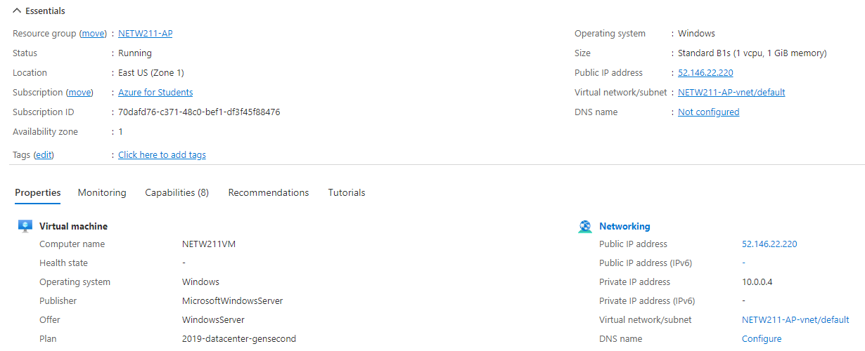
Deploying a VM in Azure will look like the image below that shows the NETW211 VM page with information such as the resource group name, subscription, public IP address, etc.

Slide 9
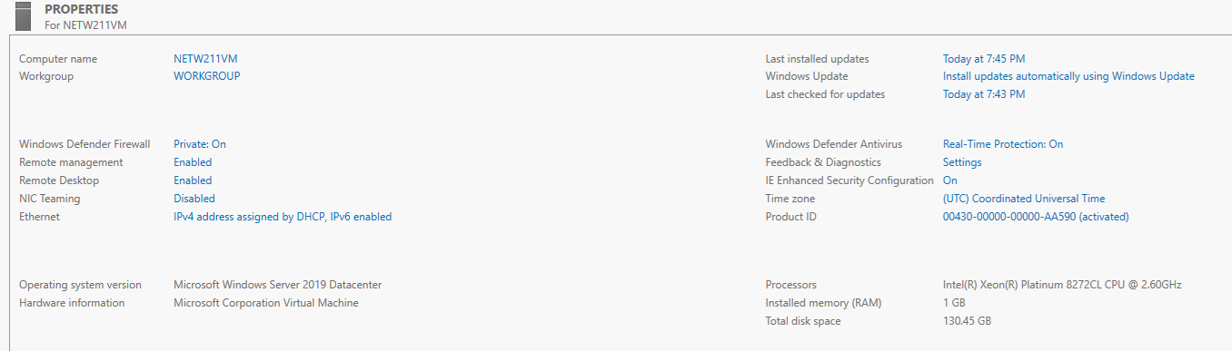
The below image shows the PROPERTIES for the NETW211 VM page, with the computer name, operating system version, hardware information, etc.

Slide 10
After the resources for the VM is deleted under the Resource groups tab, you will receive a “No resource groups to display” message. Below shows the resource that needs to be listed to be able to complete the rest of the project.

Slide 11
Azure Vnet and subnets
The Azure Virtual Network (Vnet) allows customers to provision a logically isolated section of the Azure cloud and launch resources into a virtual network. A VNet resembles a traditional network, with the benefits of using a scalable cloud infrastructure. A subnet is a range of IP addresses in the virtual network. A VNet is limited to a single region, but there are different availability zones. Multiple subnets can be created within each VNet and a subnet only belongs to one particular zone. The subnet in that zone will be connected to a NIC. NICs connected to the same or different subnets within the VN can communicate with each other without needing extra configurations.

Slide 12
Questions
1. With a /24 network prefix, how many usable IPv4 host addresses are there?
There are 254 usable host addresses.
2. Given the answer above, why is the number of available IP addresses for Subnet0 (10.0.0.0/24) or Subnet1 (10.0.1.0/24) shown as 251?
Azure reserves the first four and last IP addresses as follows
10.0.0.0 is the Network address, 10.0.0.1 is Reserved for the default gateway, 10.0.0.2 and 10.0.0.3 are reserved to map the DNS IPs to the Vnet space, and 10.0.0.255 is reserved for Network broadcast address.

Slide 13
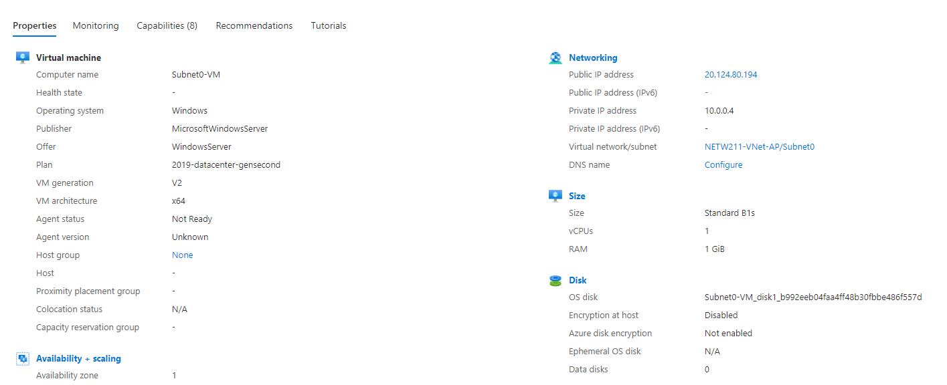
Deploying VMs into subnets. Below is the Properties section of the Subnet0-VM page, showing the network size information of the VM.

Slide 14
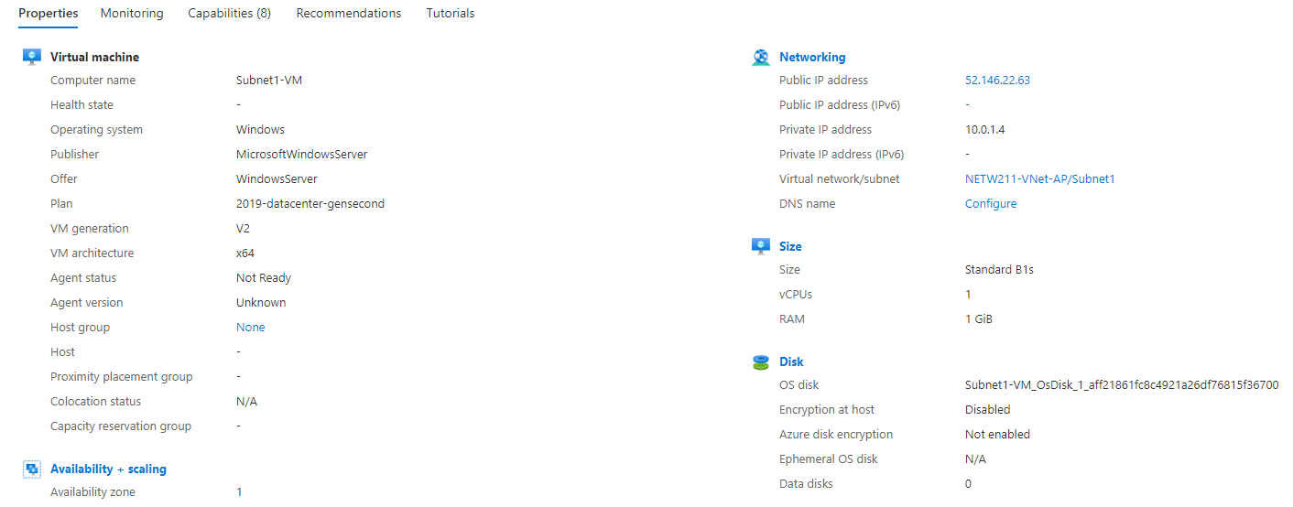
This image is the Properties section of the Subnet1-VM page, showing the networking and size information of the VM.

Slide 15
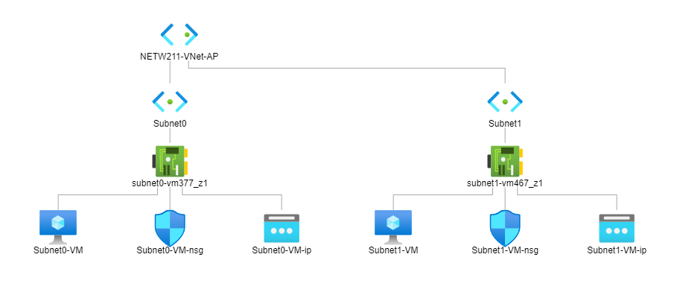
This is the topology diagram of my VNet with two subnets (Subnet0 and Subnet1) and one VM in each subnet.

Slide 16
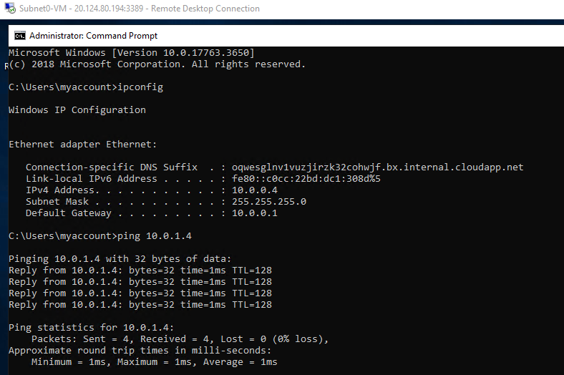
Here is the ipconfig command reflecting the Subnet0 IP address and the ping command results show connectivity to the Subnet1 machine.

Slide 17
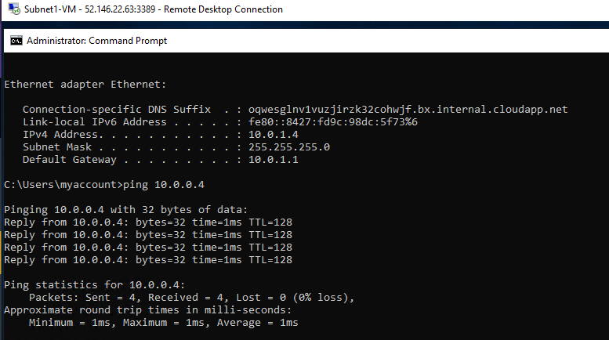
Here is the ipconfig command reflecting the Subnet1 IP address and the ping command results show connectivity to the Subnet0 machine.

Slide 18
Azure VM security
Previously when I created and connected to the Windows Server VM, I connected through RDP. For this VM I will create and launch a Linux VM with Ubuntu. A Linux VM in Azure automatically launches into a default VNet and subnet. The operating system on my local computer determines what options are available to connect to the Linux VM in the cloud such as SSH using a pair of public and private keys. To filter inbound network traffic to and outbound network traffic from several types of Azure resources, an Azure network security group (NSG) will be used. Each rule can specify the source and destination, port, and protocol.

Slide 19
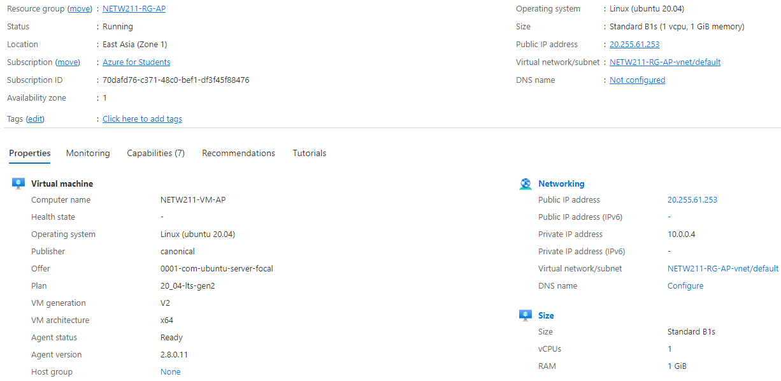
Here is the Ubuntu 20.04 Linux VM information page showing the resource group name, subscription, public IP address and more.

Slide 20
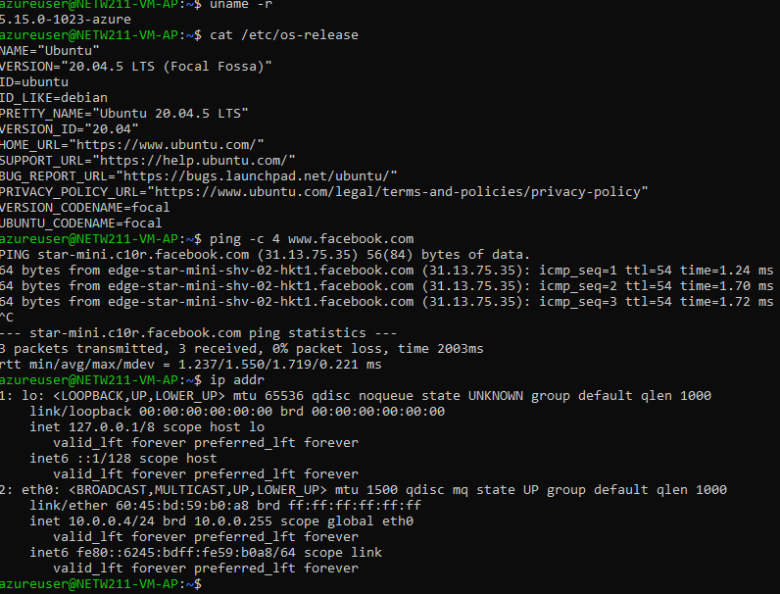
Using the command prompt on my local computer, I was able to make a connection to the Linux VM in the cloud through SSH by downloading the private key before creating the VM resource.

Slide 21
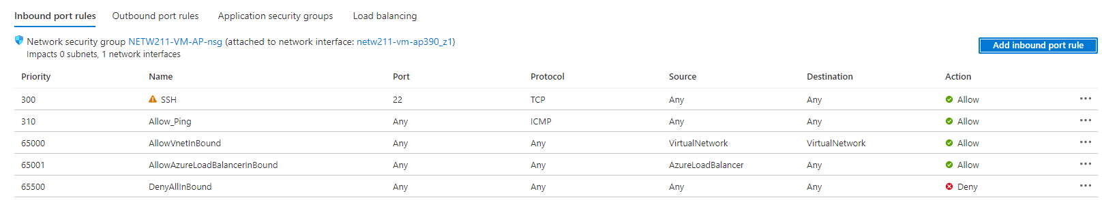
The Inbound rule with priority 300 allows SSH traffic in and Outbound rule with priority 65001 allows traffic out. Since NSG does not allow ping or ICMP traffic, priority 310 Allow__Ping was also added.

Slide 22
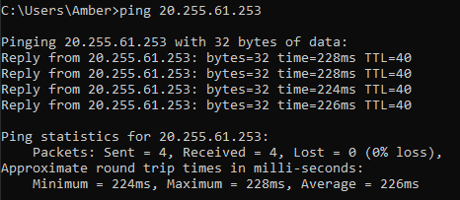
Since the exception was added for ping, I was able to successfully ping the IP address of the Azure VM from my local computer.

Slide 23
Cloud Storage
Azure Blob storage is an object storage used to store and protect data for use cases such as mobile applications, websites, backups, IoT devices, and big data analytics. Azure Blob storage offers three types of resources, a storage account, a container in the storage account, and a blob in a container. The base address for the objects in a storage account is formed from a combination of the storage account name and the blob endpoint. A container organizes a set of blobs just like a directory in a file system. A storage account can have an unlimited number of containers, and a container can store an unlimited number of blobs.

Slide 24
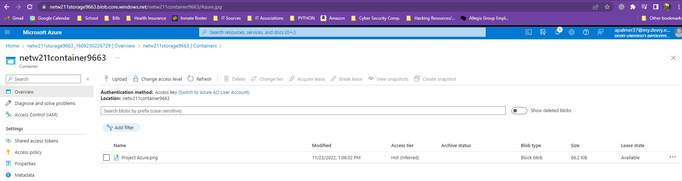
Azure Blob storage employs block blobs. Block blobs are blocks of data that are assembled to make a blob. Block blobs are ideal for storing text and binary, data such as files, images, and videos in the cloud. The image below shows the container with a Block blob containing a file uploaded from my local computer and the URL to access the file.

Slide 25
question
1. What does the access tier setting do? What are the Azure blob storage access tiers?
The access tier setting allows you to select which tier would like the uploaded data to be placed in. There are three access tiers for blob data, hot, cool, and archive. Azure storage offers different access tiers so that you can store your blob data in the most cost-effective way. The hot tier is optimized for storing data that is accessed or modified frequently, it has the highest storage cost, but the lowest access cost. The cool tier is optimized for storing data that is infrequently accessed or modified. Data in the cool tier should be stored for a minimum of 30 days, and it has lower storage costs, but higher access costs compared to the hot tier. The archive tier is an offline tier optimized for storing data that is rarely accessed and has flexible latency requirements, on the order of hours. Data in the archive tier should be stored for a minimum of 180 days.

Slide 26
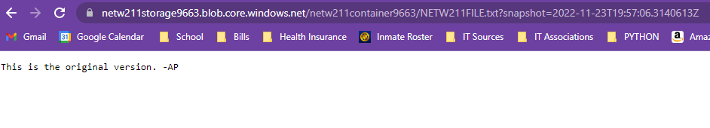
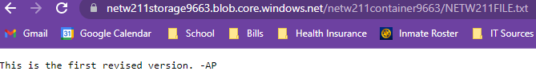
The original version of the file with the URL to access the file.
The revised version of the file with the URL to access the file.

Slide 27
Cloud Monitoring
Azure resources generate logs and metrics. Metrics are used to describe some aspect of a resource at a particular time, and Logs are used to provide insight into the operations performed within Azure resources or on Azure resources from the outside. Azure Monitor is enabled and starts collecting metrics and activity logs when an Azure resource is created. To proactively respond to critical conditions identified in the collected data, a text or email can be sent to an administrator. An automated process could also be launched to correct the error condition. Notification preferences are stored in an action group. Azure Monitor uses action groups to notify users that an alert has been triggered.

Slide 28
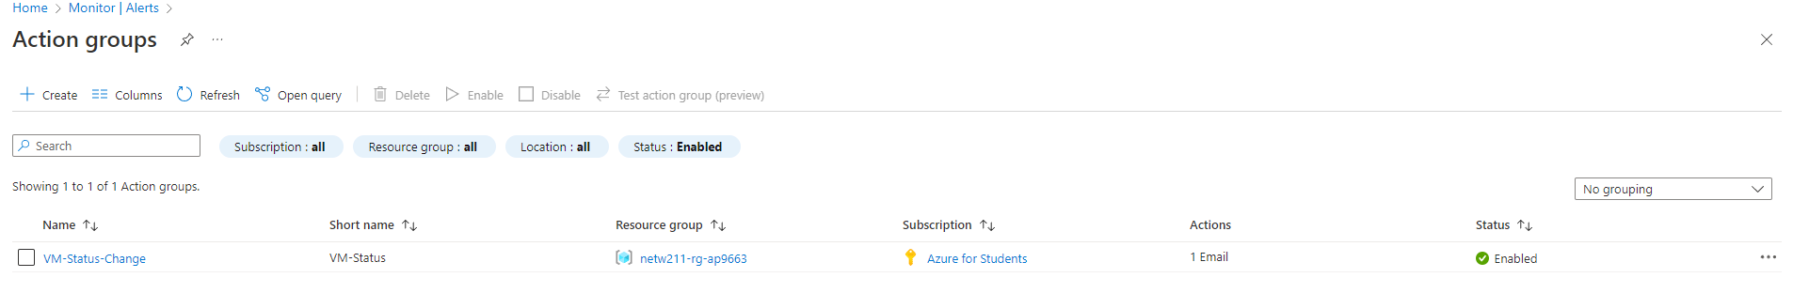
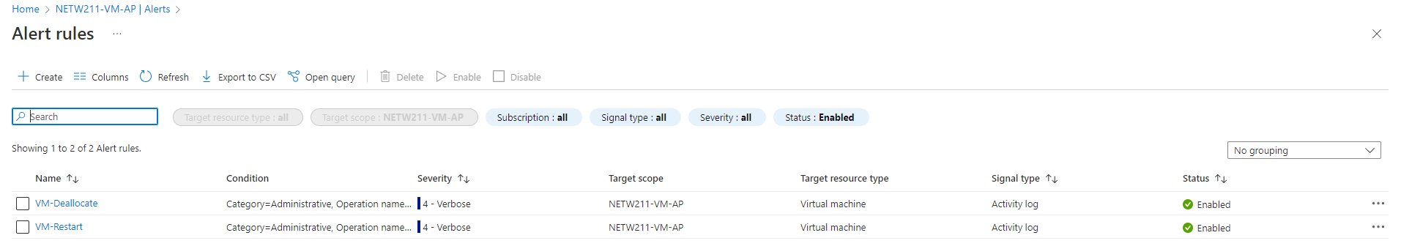
A newly created action group on the action group page.
Alert rules window showing the VM-Deallocated and VM-Restart rules.

Slide 29
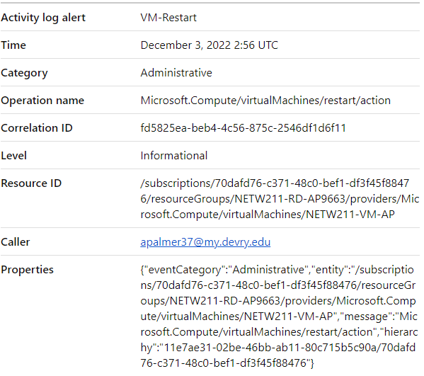
Email notification received for ‘VM-Restart’ was activated with the date and time of the alert.

Slide 30
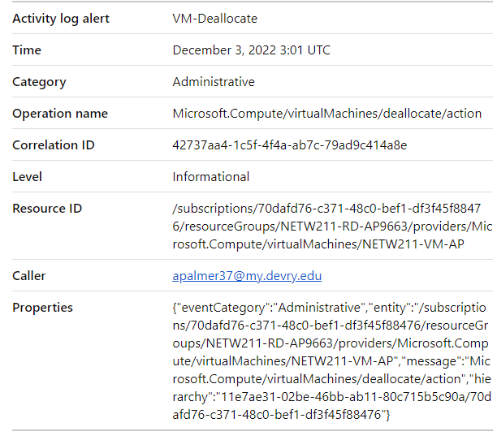
Email notification received for ‘VM-Deallocate’ showing the date and time of the alert.

Slide 31
challenges
The biggest challenge I faced when completing the individual projects would have been in Module 6, creating the action group. I received an error because the Azure Student account was not registered. To solve the error, I was able to locate a FAQ page with common errors and solutions to those errors. The solution provided steps to register the account by utilizing the command line interface for the lab. Once the account was registered, I was able to complete the rest of the Module 6 project without any more issues.

Slide 32
Career skills
This project allowed me to develop skills in creating an Azure account, Microsoft Server Virtual Machines (VM) instances, VNet and subnets for the Microsoft VMs, creating and launching Ubuntu Linux VMs and security rules, creating cloud storage and containers, and creating cloud monitoring alerts by setting alert rules.

Slide 33
conclusion
This project covers the fundamentals of cloud computing that complements IoT. The design and development process of building a system in the Azure Cloud includes Virtual Machine (VM) launch, Virtual Network (VNet) configuration, VM instance security, cloud storage, and cloud monitoring. This foundation empowers the learning of emerging technologies, including IoT, and prepares me for my future career in Information Technology.

Slide 34
References
1. IP Subnet Calculator, https://www.calculator.net/ip-subnet-calculator.html
2. Azure Virtual Network frequently asked questions, https://docs.microsoft.com/en-us/azure/virtual-network/virtual-networks-faq
3. All Information included in this project was pulled from course project guides.
4. Hot, Cool, and Archive access tiers for blob data, https://docs.microsoft.com/en-us/azure/storage/blobs/access-tiers-overview
5. Azure Blob Storage Access Tiers, https://devry.percipio.com/courses/c7ef0333-8560-403f-a004-9c5c843866b0/videos/2658bbe6-ee97-438b-a376-fbb079c3b3a0

