Slide 1
CEIS150
Final Project
Module 8
</
/>
Amber Wilkins
Objective Software Environment Setup

Slide 2
</Introduction
This project provides experience in creating applications in Python. Object-oriented techniques were used to develop a stock tracking application that has both a console and GUI interface (Graphical User Interface). This system utilizes Python libraries to create charts and get historical stock data from web sites that when processed will generate profit and loss reports.

Slide 3
</ Module 1 objectives:
Install Anaconda
Choose IDE for the project
Create Python Script
Ensure the Python script is running correctly

Slide 4
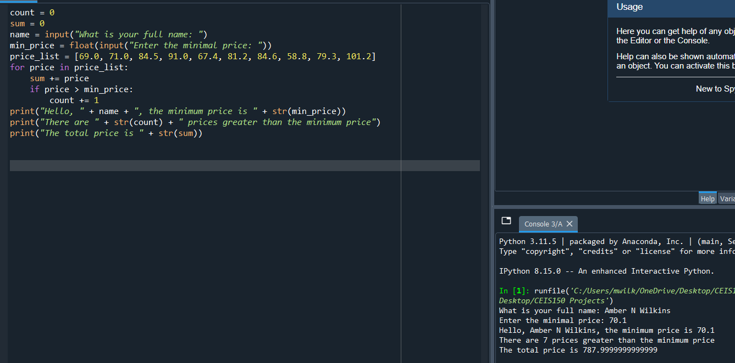

Slide 5
</ What was Learned:
How to install the Anaconda Programming that allowed the user to select the IDE they wished to utilize from multiple options.
How to use add-ons with the IDE selected.
How to code a Python script that required input from the user.
How to save the code to a designated folder specific to this project.

Slide 6
</ Module 2 Objectives:
Create class diagrams using Stock and Daily Data
Create a class using __init__()
Run unit test on the code added

Slide 7
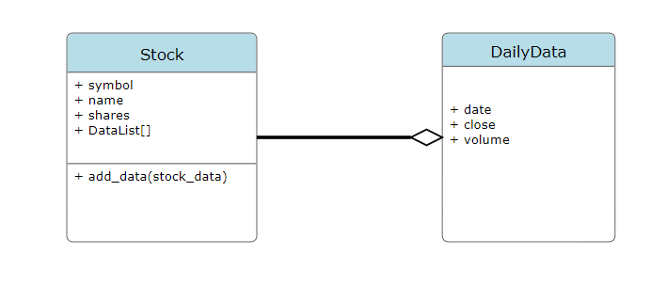

Slide 8
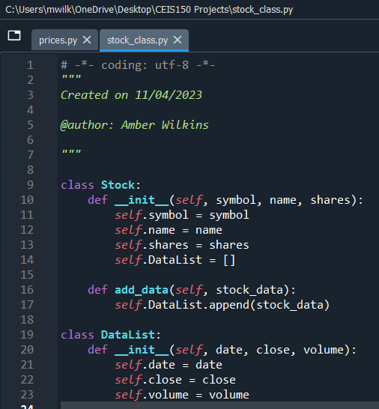

Slide 9
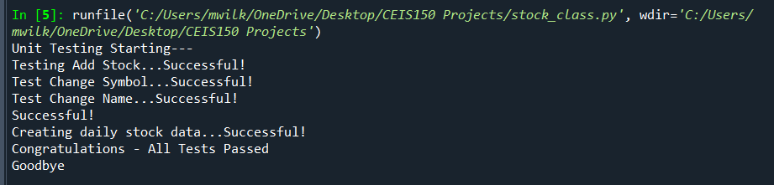

Slide 10
</ What was Learned:
How to create classes in Python.
How to create data diagrams.
The importance in running unit test on sections of completed code.
How to identify mistakes made in the code within the IDE and correct them so the code will run correctly.

Slide 11
</ Module 3 Objectives:
Create a menu-driven user interface to add, list, and delete stocks to track price and volume history.
Create functions to handle menu items.
Create Daily Data to create a daily record that reflects the date, price and volume.

Slide 12
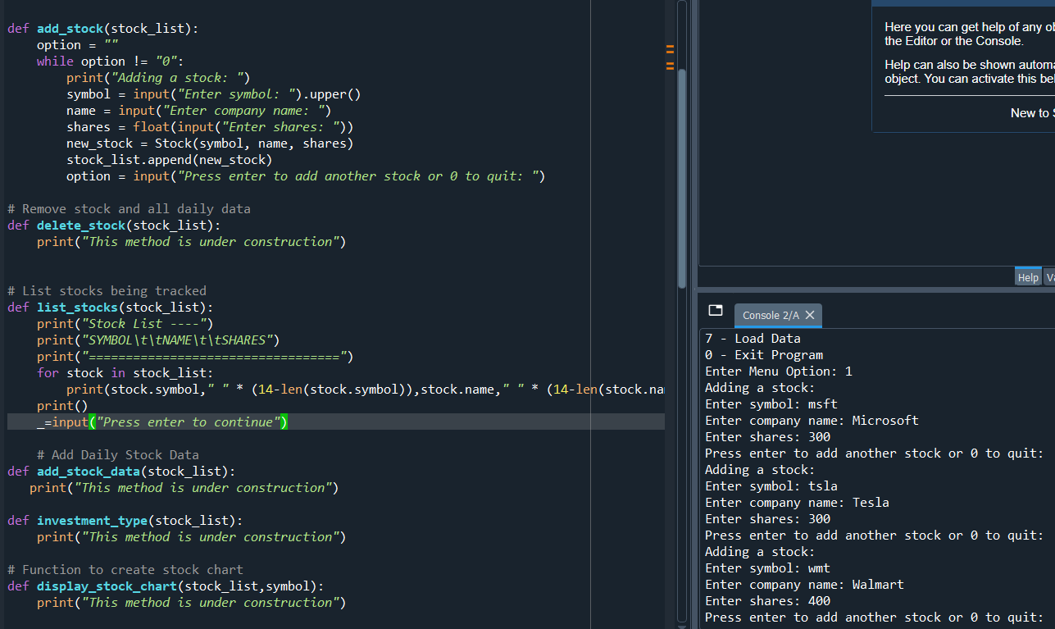
Adding a stock

Slide 13
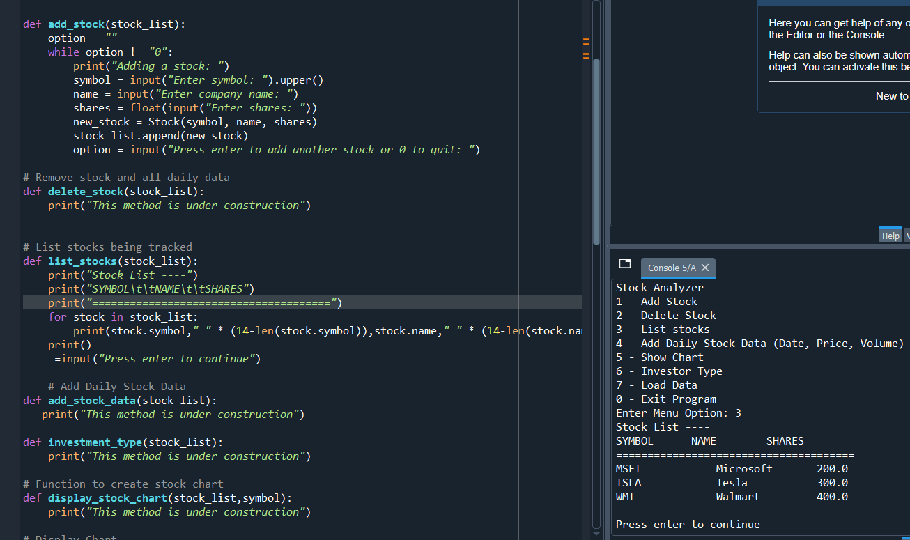
Listing 3 Stocks

Slide 14
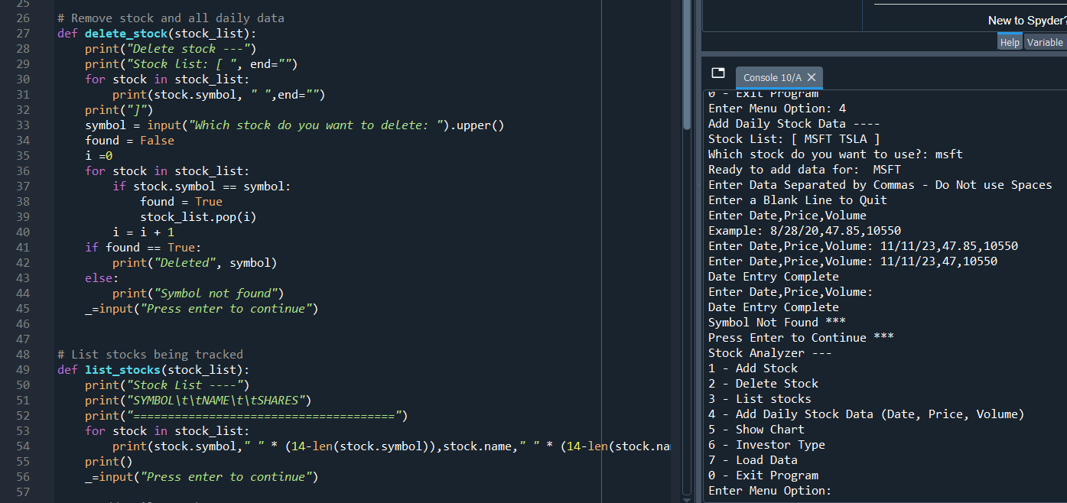
Daily Data

Slide 15
</ What was Learned:
How to add functionality to the program to make it work.
That stubs are incomplete functions that are in the process of being developed. (In the project they were marked as “This sections is under construction”)
How to create a variable that does not need to be kept. ( _=input() )
You can create string multiplication to create extra spaces to align data in columns.

Slide 16
</ Module 4 Objectives:
Implement inheritance in the stock program.
Create three classes and show the unit test of the classes working.
Run unit test on the newly created classes.
Show the input in the program is successful and functional.

Slide 17
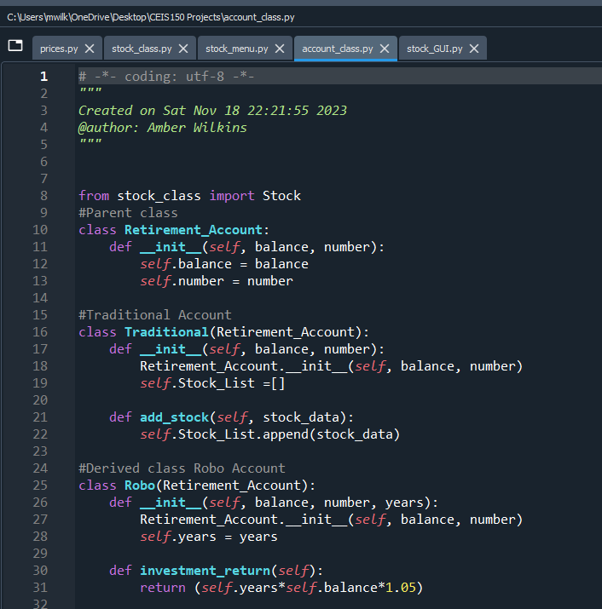
Inherited Classes:

Slide 18
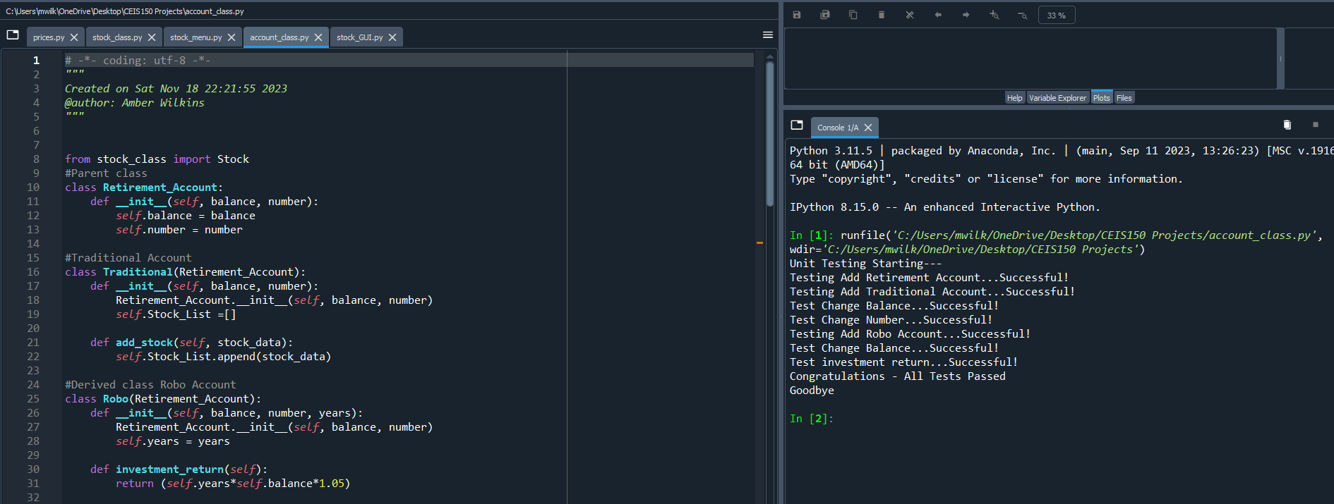
Unit Test:

Slide 19
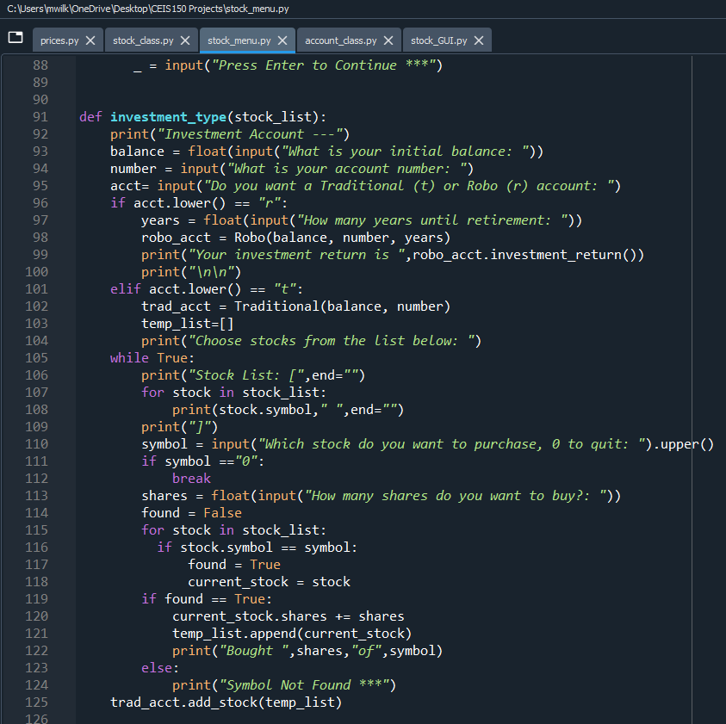
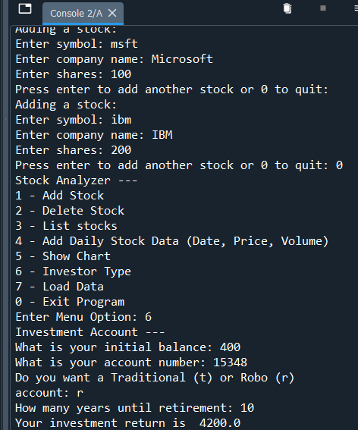
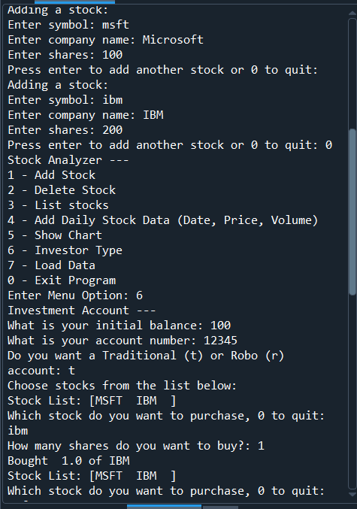
Stock Menu Program:

Slide 20
</ What was Learned:
Inheritance is a key part of object-oriented programming.
How to implement two different style accounts, traditional and automatic.
How to correctly use self when creating classes. (def__init__(self)
How to correctly add and execute the different retirement account options.

Slide 21
</ Module 5 Objectives:
Use the pyplot class in the matplotlib library to create a simple stock chart.
Test to ensure the chart works.

Slide 22
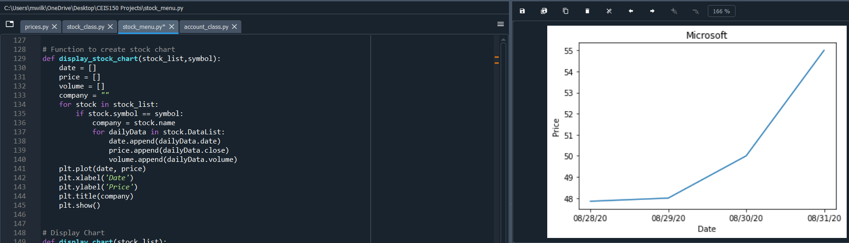
Working Chart

Slide 23
</ What was Learned:
Matplotlib makes it easier to create many types of visualization from simple line charts to more complex and interactive graphics.
How to add x,y data to the chart.
Running the code to enter data to be added to the chart on both axis.

Slide 24
</ Module 6 Objective:
Download historical data to specified file for the project from Yahoo! Finance.
Use the CSV Library to import data from Yahoo! Finance that was downloaded.
Read the data from the file and show the imported historical data.

Slide 25
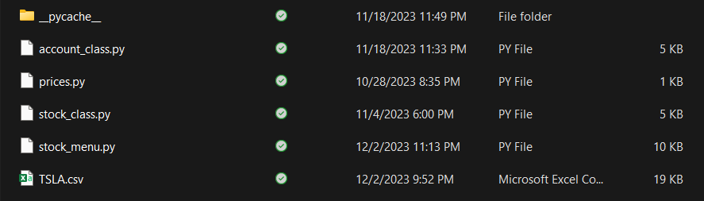
Saved File

Slide 26
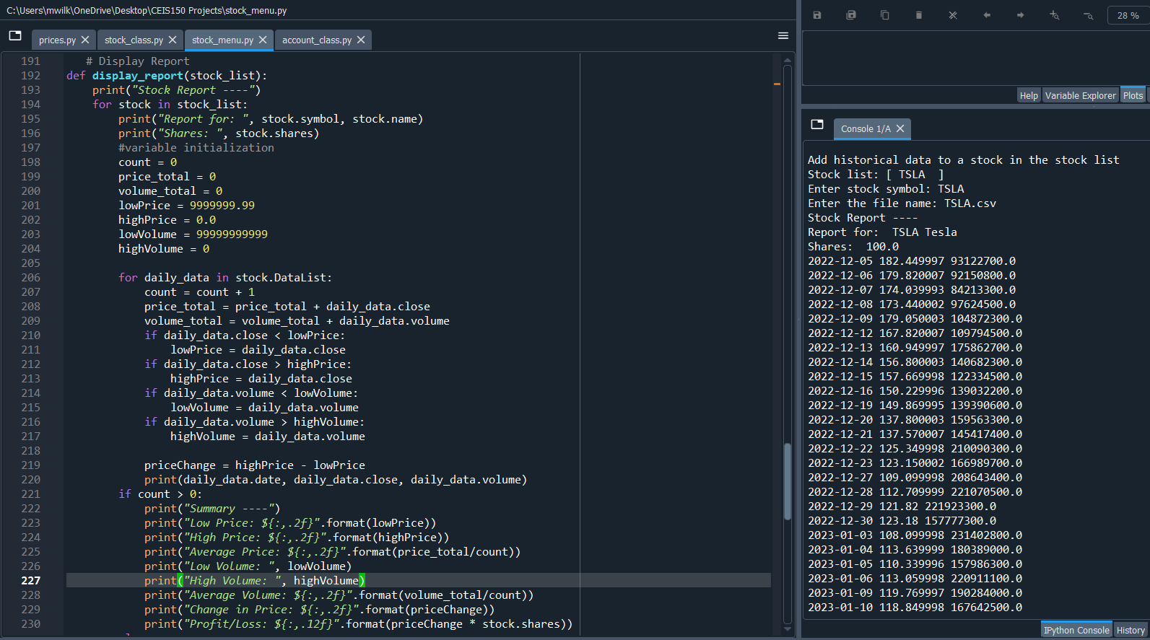
Imported Historical Data

Slide 27
</ What was Learned:
The fact that Yahoo! Finance offers downloadable stock data.
CSV stands for Comma Separated Value which is why the string multiplication was added to the project to ensure the uploaded data is professionally shown.
Using the with statement to open the file and it will automatically close the file when all records are finished being read.
How to generate the report by uploading the data to the program from the folder the data was saved in.

Slide 28
</ Module 7 Objective:
Use tkinter to implement a graphical user interface.
Add multiple stocks in the GUI.
Import the saved CSV file to the GUI.
Show import working in history tab.

Slide 29
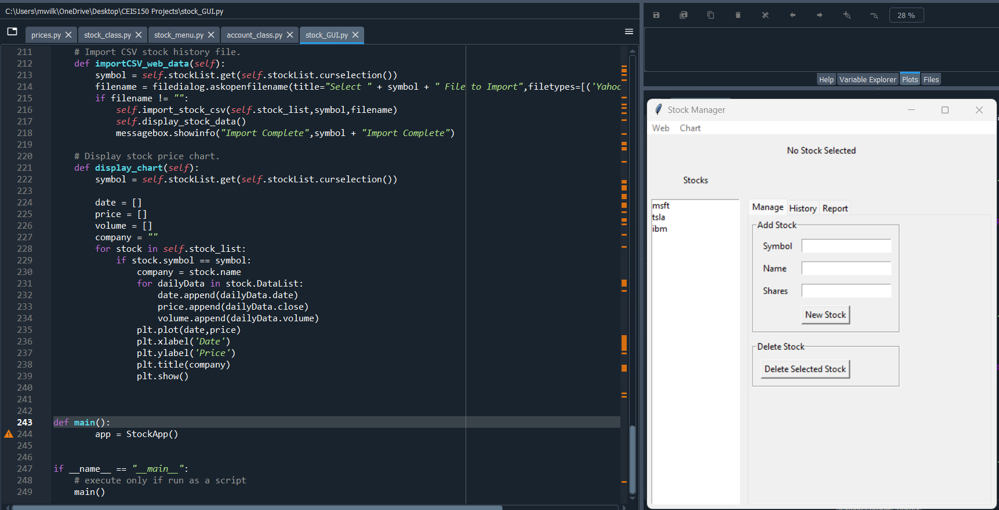
Stocks in GUI

Slide 30
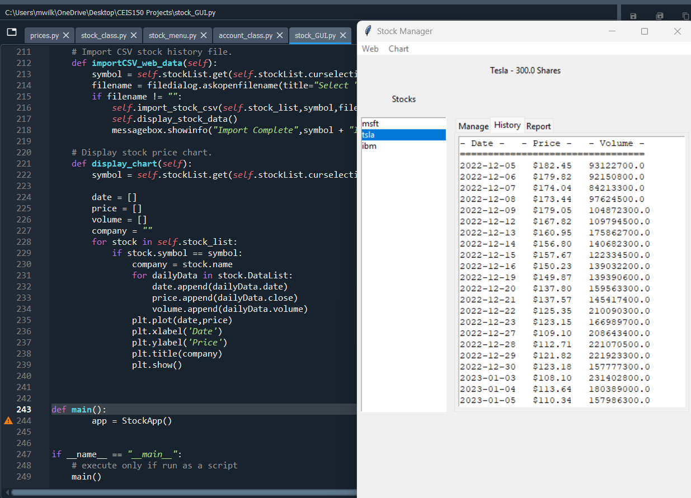
History Tab

Slide 31
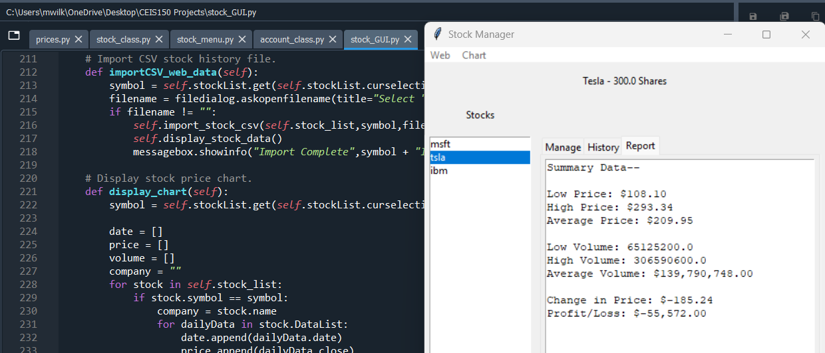
Report Complete

Slide 32
</ What was Learned:
There are several libraries and frameworks that can be used to develop GUIs for Python programs.
How to build the program to add functionality to the buttons in the GUI from the “Under Construction” message that shows when the button is pressed.
These buttons are called widgets, and are the user interface elements.
Some widgets can be containers for other widgets.

Slide 33
</ Conclusion:
Throughout the creation of the project we created classes were needed to work with our stock and history data, focused on creating a console-based interface, worked with inheritance, and imported the matplotlib library to create a graphical interface. After the successful completion of console-based interface we started working on creating the GUI by implementing the ability to load data from a CSV file and completing the code to replace the “under construction” widgets of the graphical user interface. The successful completion of the project is represented through the ability to successfully upload the file to GUI and have the correct data listed in columns of the history section.

