Slide 1

Netw191 final project
Amber Palmer

Slide 2

Introduction
This project covers the fundamentals of Networking which plays a vital role in the world of IoT. The design and developmental process of building a network including interacting with a virtualized network environment to build, test, and maintain a IoT based system. The following slides will give a visual representation of conducting, analyzing, and interpreting the results of standard test, measurements, and/or experimentation relevant to this field.

Slide 3
Preparation
Starting the virtual network and machines in the correct order are very important to the functionality of the system. Once logged into Infosec and the VM is started, I utilized the student account with the student password. Next, I double clicked the Hyper-V Manager icon to start the SOHO Router first, and then Computer 1 and/or Computer 2. Once the desire machines are started, I would right-click on the machine and select connect. The following picture shows the options available once you right-click the desired machine.

Slide 4
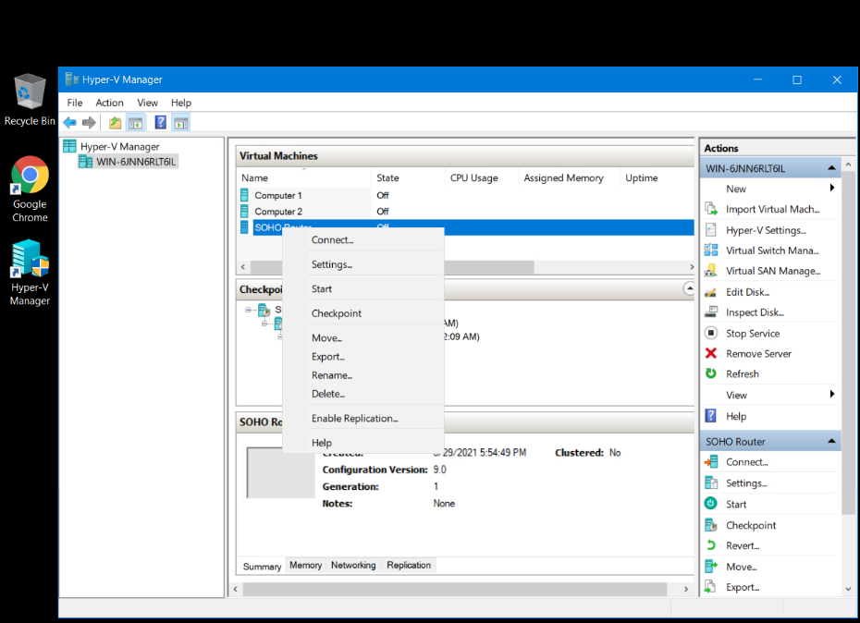

Slide 5
Shutting Down
Shutting down the machines is also very important as not shutting them down properly will cause the machines to continue to run in the background. The following image shows you can right-click on the machine and select shut-down or you can select the shut-down option on the right under the listing for SOHO Router. You must shut-down all VM and then also click the stop button next to the timer and a box will open confirming the session has ended and give you the option to return.

Slide 6
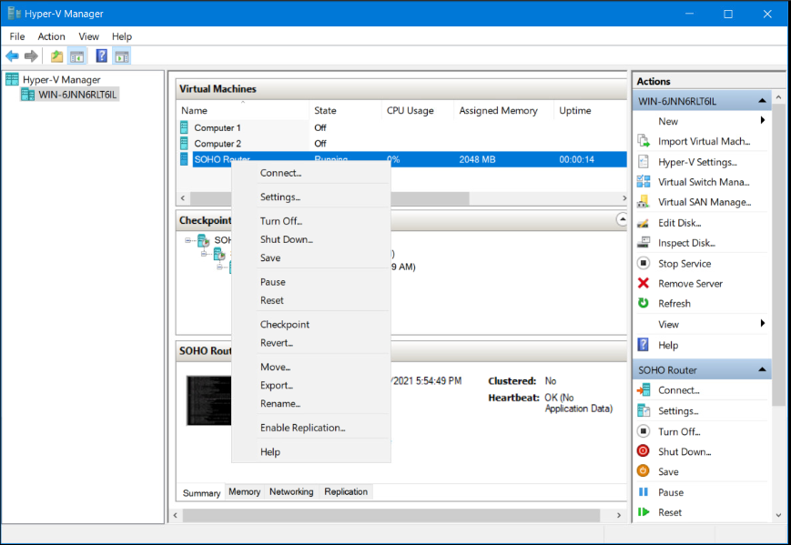


Slide 7
Set up the network
The next slide represents changing the SOHO Router IP address from the default setting of 192.168.1.1 to the new IP address of 192.168.105.1 by entering the IP address into the search bar of Firefox search engine in order to access the routers settings. In this block of IP addresses the first address 192.168.105.0 represents the network itself and therefore can not be used. The same goes for the last address of the block, 192.168.105.255, because that represents the broadcast address. The first valid IP address available is 192.168.105.1 and will be the one assigned. The following images shows the originally assigned IP address and the newly assigned IP address listed under the Routers Interface. Performing these changes also changed the Protocol field from DHCP client to static address. The router will act as the DHCP server.

Slide 8
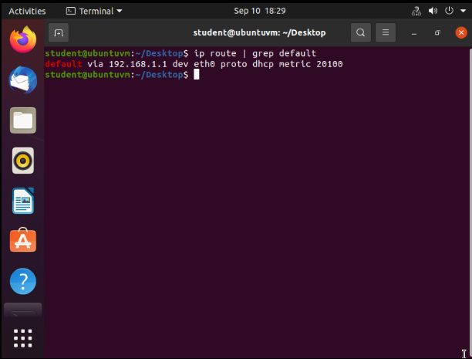
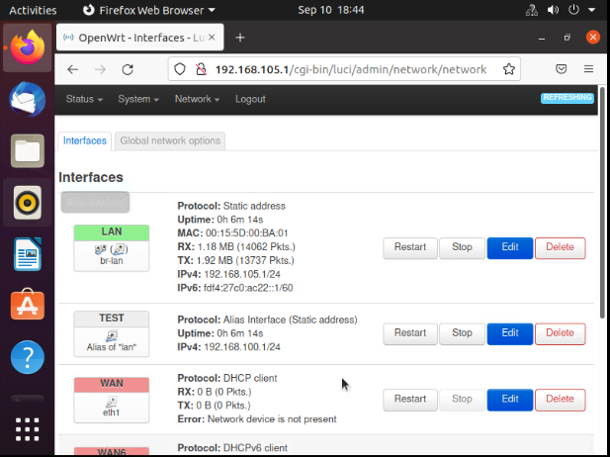
IPv4 addressing scheme implemented on the SOHO Router device and the Interface page showing the new IPv4 address on the LAN interface.

Slide 9
Connectivity test
The following slides show the results of computer 1 and computer 2 IP address changes after changing the SOHO router from Dynamically allocated to Static allocated. The original address of the SOHO router was 192.168.1.1 and computer 1 and computer 2 was configured to these settings. Once I updated the changes to the router, computer 1 and computer 2 IP addresses also changed. The first slide below shows connectivity through a ping test between the SOHO router with IP address 192.168.105.1 and computer 2 with the IP address of 192.168.105.230. The second slide shows the same ping test for the SOHO Router first and computer 1 with the IP address of 192.168.105.228.

Slide 10
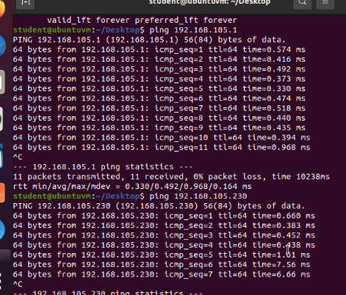
Connectivity test of SOHO Router and Computer 2

Slide 11
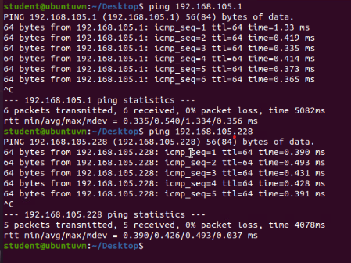
Connectivity test for SOHO Router and Computer 1

Slide 12
Creating and testing Loopback Interfaces
For the IP Network to be functional, a host requires a unique identifier known as the Internet Protocol Address. These identifiers are used as blocks of IP addresses. A network can be divided into smaller subnets, but the IP address block must also be divided into smaller blocks to accommodate the number of addresses required by the subnet. The first IP address of a subnet block represents the subnet itself. Routing devices use this address in their routing tables to reach the destination network. The last IP address of the block represents the broadcast address which broadcast a packet to all host on the same subnet. The graph on the next slide represents dividing the IP address 192.168.5.0/24 into two equal-sized subnets. The first usable host address of the first subnet 192.168.5.1/25 is assigned to Loopback 1 and the first usable host address of the second subnet 192.168.5.129/25 is assigned to Loopback 2. The second slide reflects Loopback 1 and Loopback 2 in the Routers Interface with the above assigned IP addresses and the results of a ping test to these IP addresses.

Slide 13
Performing various system tests and experimentation by creating 2 loopback interfaces by dividing an IP address block in half. The graph represents the results of the IP addresses and the subnets.
Subnet | Subnet Notation | Network Address | First Usable Host Address | Last Useable Host Address | Broadcast Address
The First Subnet | 192.168.5.0/25 | 192.168.5.0 | 192.168.5.1 | 192.168.5.126 | 192.168.5.127
The Second Subnet | 192.168.5.128/25 | 192.168.5.128 | 192.168.5.129 | 192.168.5.254 | 192.168.5.255

Slide 14
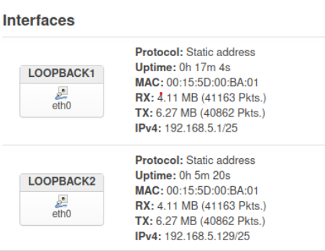
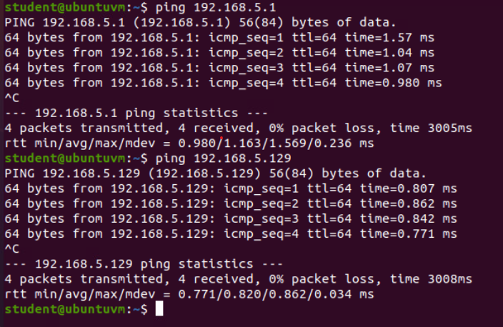
Once the settings for both Loopback Interfaces are configured their correct IP addresses with reflact next to the IPv4 listings and to confirm the changes was successful a connectivity test was performed.

Slide 15
Exploring router configurations to add protection to the SOHO Router
The next three slides show the importance of checking the default router configurations and the references show a router emulator, that allows you to experience certain product features, and the other listing is for Router default login and passwords. The next two slides are questions and answers representing different categories such as finding the default login and password of the TP-Link router, changing default IP assignments from Dynamic to Static so there are not a lot of unused IP addresses that hackers can access, MAC filtering to allow access to a group of devices or block access to all devices except for the ones specified, and listing what wireless security protocols are available.

Slide 16
SOHO Wireless Network Security
1. What are the factory default username and password of a TP-Link router? Why is it important to change the default username and password of a SOHO router?
Answer: admin:admin
It is important to change the default settings because the default user name and passwords are easily found. Hackers would be able to access your home network easily and could make changes to the network without you even knowing.
2. To protect a SOHO wireless network with a small number of devices, which address management method provides more control, configuring the device IP addresses manually (static IP) or using a DHCP server (dynamic IP)? Why?
Answer: The static IP addressing allows for more control as you would need to manually assign each device their IP addresses and can restrict the number of allowed IP addresses in case a hacker does get access in the network. DHCP is the easier method as it automatically assigns IP addresses to devices from the range that is set by default and it also gives more flexibility, but it also leaves a set of unused IP addresses that hackers could easily take advantage of.
3. What does MAC filtering do? If needed, when would you use deny filtering rules and when would you use allow filtering rules? What happens to devices that want to connect, if the “Allow the stations specified by any enabled entries in the list to access” function is enabled but there are no entries in the list?
Answer: MAC filtering allows the admin to specify which devices can or can not connect to the AP by using the MAC address of the device. If you wanted to restrict a device from connecting to your network, you could enter the devices MAC address under the deny table. If you wanted to block all devices from connecting except for certain ones you could list the devices you want to have the access under the allow table. If you select the allow option and do not list any entries in the table, then your router will not allow for wireless connection as there are no listed devices and all devices will be blocked.

Slide 17
SOHO Wireless Network Security
1. What wireless security settings are displayed on the Wireless Security page? Which one is recommended by the vendor? Why?
Answer: The one recommended from the vender is listed at the top pf the page in nice red letters; Note: WEP security, WPA/WPA2 - Enterprise authentication and TKIP encryption are not supported with WPS enabled.
For network security, it is strongly recommended to enable wireless security and select WPA2-PSK AES encryption.
The wireless security settings that are displayed on the page are:
Disable Wireless Security
WPA/WPA2 – Personal – this is the recommended setting
WPA/WPA2 – Enterprise
WEP
For encryption purposes the AES option offers longer lengths such as 128-bit, 192-bit, and 256-bit. The longer lengths make them harder to crack.
2. Among the configurations you explored in this module, which one is a true security function? Why?
Answer: The combination of using multiple security measures such as using authentication and encryption protocols to protect the wireless access passwords such as the one recommended by the manufacturer, WPA2-PSK AES encryption. Changing the default admin user name and password. MAC filtering to allow or deny specific devices. And controlling the range of IP addresses that are assigned by configuring static IP assignments instead of allowing the DHCP auto configurations.
3. What would you do to protect your wireless network at home? Why?
Answer: Change the default admin user name and password for starters. Then static assign IP addresses to my devices that are connected to my network so there isn’t anything extra lingering. I would also check the settings of my firewall and install a VPN. I recently set up the guest network option for visitors to connect to as well to cut down on the password to my router being over shared.

Slide 18
References
1. https://www.routerpasswords.com/
2. https://www.tp-link.com/us/support/emulators

Slide 19
Visio Network Diagram
Microsoft Visio was used to create a network diagram that depicts the interconnection of Computer 1 VM, Computer 2 VM, Loopback 1, Loopback 2, Default Gateway for the SOHO Router, and a virtual switch that is responsible for connecting the three network devices together.

Slide 20
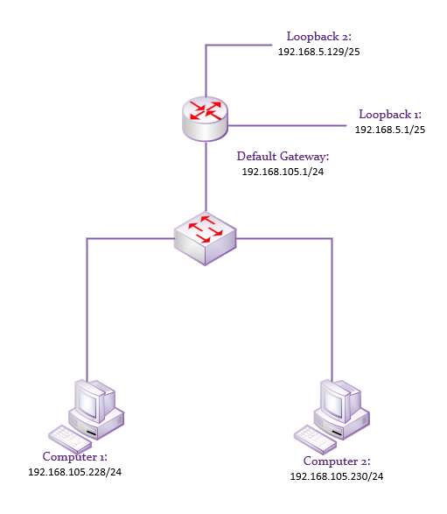

Slide 21
Career Skills
The skills I learned from completing this project are Interacting with a virtual environment, setting up a SOHO Router in a virtual environment, performing system configurations, creating loopback interfaces, and identify unknown problems and solve them using scientific methods, software, and equipment.

Slide 22
Challenges in the Project
I experienced numerous challenges when working through this project. Dividing the subnet into two equal parts was the biggest challenge for me. Understanding the octets and how they are represented by binary. Answering the questions based on the router default settings and putting this final project together. I rewatched the videos and googled somethings and now I have a much better understanding of what I am doing and feel a sence of accomplishment now that this is completed.

Slide 23

Conclusion
To have a home network that is protected beyond the default settings of Router there are some necessary steps that must be taken. Changing the default password and password is an absolute must since there are websites that are available to anyone with those listed. Changing the DHCP to Static can cut down on having a lot of unused IP addresses for hackers to get access to, and using encryption for Wi-Fi such as the WPA2 AES to add longer options for passwords. Adding a VPN for extra measures after changing these settings was also give a little extra sence of security.

