Slide 1
Wired, Optical and Wireless Communications Final Project
Amber Wilkins
NETW310 – DeVry University
Professor Gary Giomi

Slide 2
Title and Content Layout with List
Introduction
Challenges in the Project
Baseband Signals and AM/FM Signals
Pulse Code Modulation (PCM) and Line Codes
Cables and Structured Cabling
Antenna Gain and Free Space Path Loss
Bit Error Rate of Fading Channels
Career Skills Obtained
Conclusion

Slide 3
Introduction
The project introduces students to modulation mechanisms, encoding schemes, characteristics of wireline and wireless transmission media that make digital transmission possible. The implementation and analysis of simulations involve baseband signals, AM/FM signals, Pulse Code Modulation (PCM), line codes, antenna gain, free space path loss, and fading channels. This experience enables the integration of IoT technologies and prepares students for our future career in Information Technology.

Slide 4
Challenges In the Project
In completing these projects, I faced several challenges that tested my technical acumen and problem-solving skills. Grappling with complex concepts, such as antenna gain, free space path loss, and modulation techniques, required a deep understanding and application of theoretical knowledge to practical scenarios. Additionally, interpreting and analyzing data, especially from simulations and measurements like BER performance and power spectral densities, demanded advanced analytical abilities. These hurdles not only tested my technical skills but also my resilience, time management, and communication abilities, highlighting the multifaceted nature of these projects.

Slide 5
Baseband Signals and AM/FM Signals
In the following slides I will delve into the functionalities of the Multisim application, harnessing the power of a spectrum analyzer and an oscilloscope to scrutinize both time and frequency domain attributes of baseband, Amplitude Modulation (AM), and Frequency Modulation (FM) signals. The tasks at hand encompass: examining the prowess of these tools in analyzing the time and frequency domains of a square wave signal; employing the spectrum analyzer to ascertain the frequency components of the square wave; and investigating the time and frequency domain features specific to AM and FM signals.

Slide 6
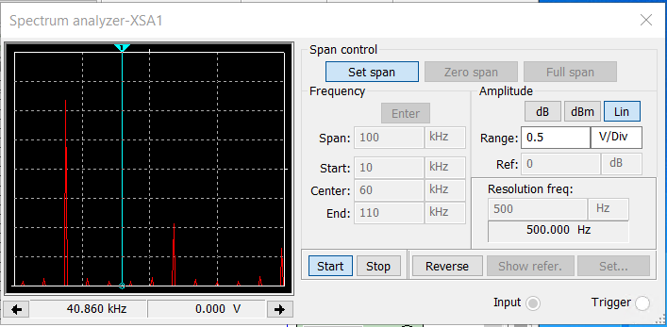
Baseband Signals
Spectrum Analyzer displaying the signals harmonic spectrum and its panel settings.
Harmonic Frequency | Signal (Volts)
20 kHz | 2.427 V
40 kHz | 2.160 V
60 kHz | 2.605 V
80 kHz | 3.054 V
100 kHz | 2.872 V
Signal Voltage at each of the frequencies listed on the graph.

Slide 7
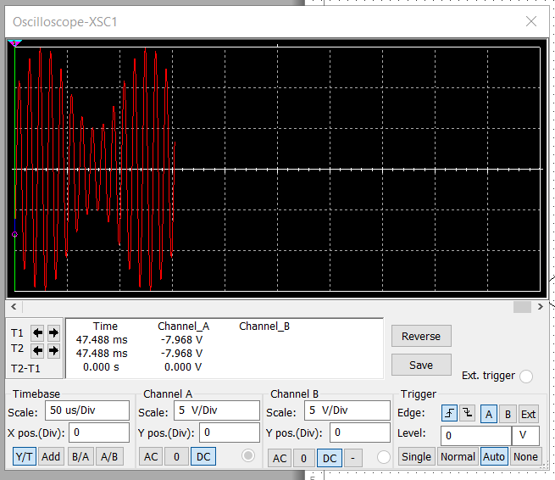
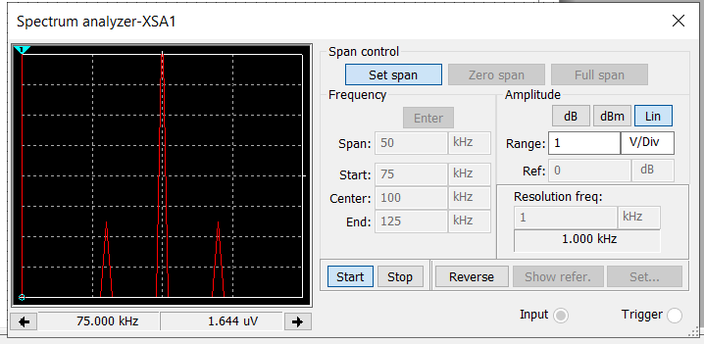
AM Signals
AM Modulation | Frequency (kHz)
Lower side band | 90.035 kHz
Carrier | 100.000 kHz
Upper side band | 109.965 kHz
Oscilloscope includes the signal and the panel settings of the oscilloscope.
Spectrum Analyzer includes the signal and the panel settings of the analyzer.

Slide 8
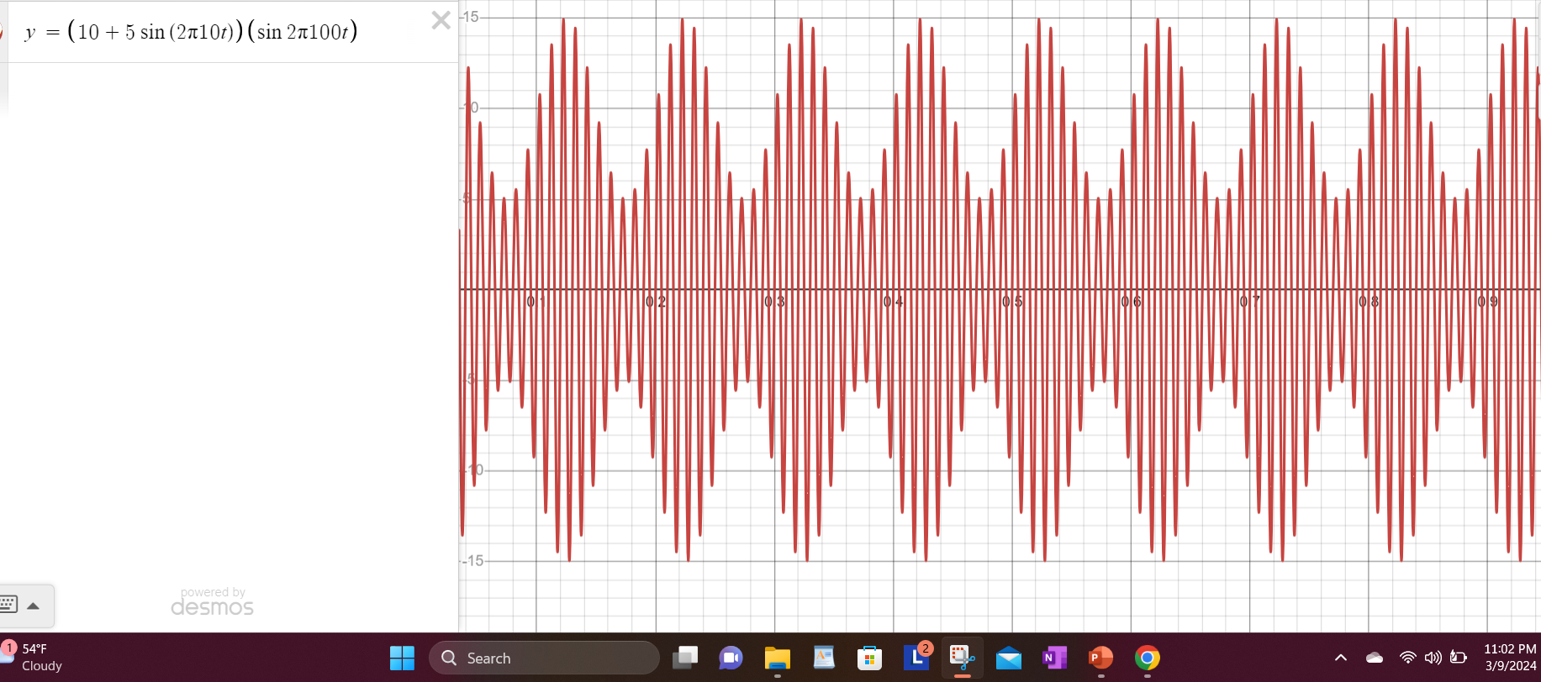
AM Signals Continued
Developed Equations for the carrier and modulating signals and the plotted equation for the composite modulated signal VAM.
Equations here:
Carrier Signal: V=10sin(2 π (10^5)t + θ)
Modulating Signal: V=5sin(2 π (10^4)t + θ)
VAM=[10+5sin(2π10t)][sin2π100t]

Slide 9
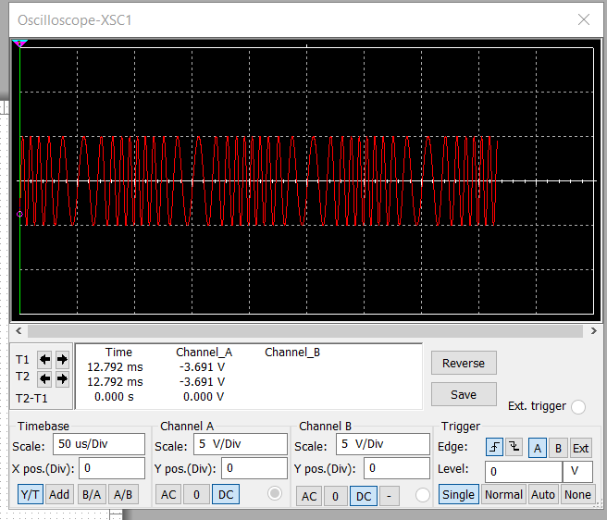
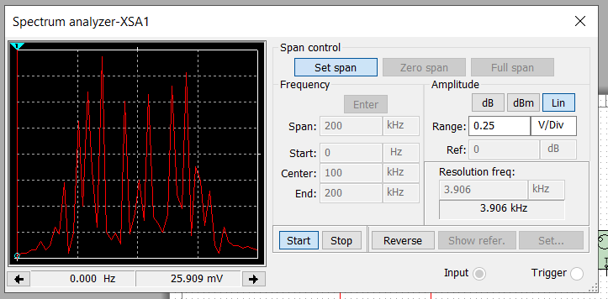
FM Signals
What’s the carrier frequency? 100.000 kHz
The Oscilloscope screenshot that includes the signal and the panel settings of the Oscilloscope.
The Spectrum Analyzer screenshot that includes the signal and the panel settings of the analyzer.

Slide 10
Pulse Code Modulation(PCM) and Line Codes
In this segment, I will delve into the fundamental components of a Pulse Code Modulation (PCM) codec and scrutinize the signal spectra associated with prevalent line coding techniques. The assigned tasks encompass simulating a PCM system to juxtapose the original input signal at the transmitter with the recovered signal at the receiver. Additionally, participants will plot the power spectral densities of common line codes, facilitating a comparison of their respective frequency spectrum requirements.

Slide 11
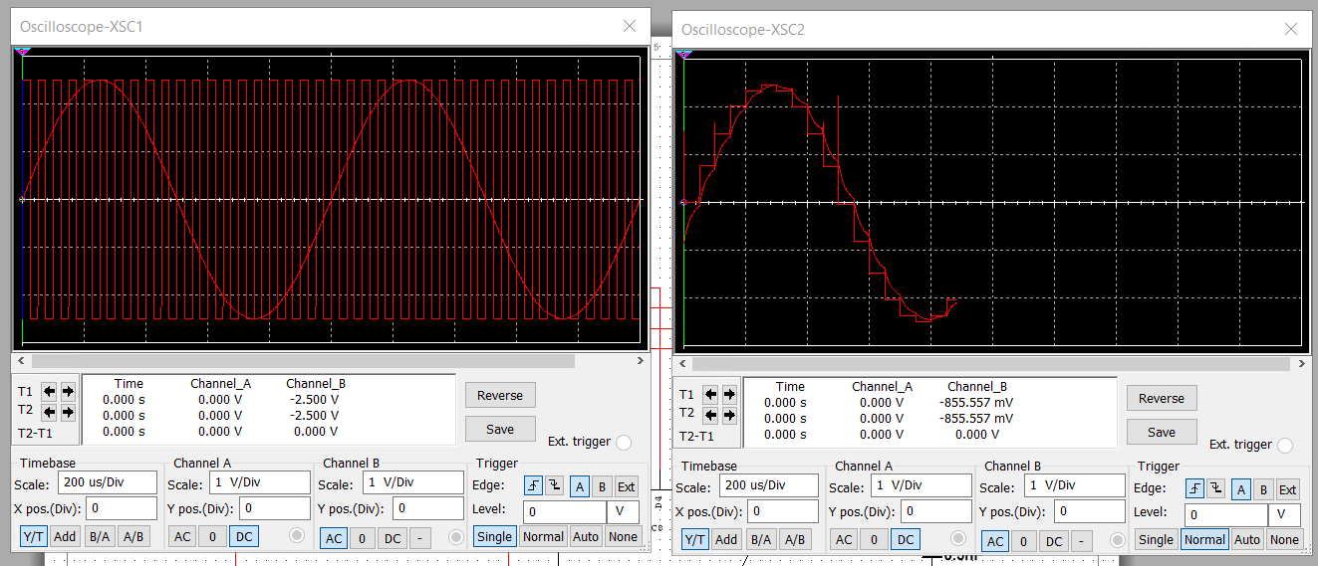
Pulse Code Modulation(PCM)
Screen shot of the Oscilloscope-XSC1 display with the analog input signal and sampling clock at the input to the ADC.
Screenshot of the Oscilloscope-XSC2 display with the output of the DAC.

Slide 12
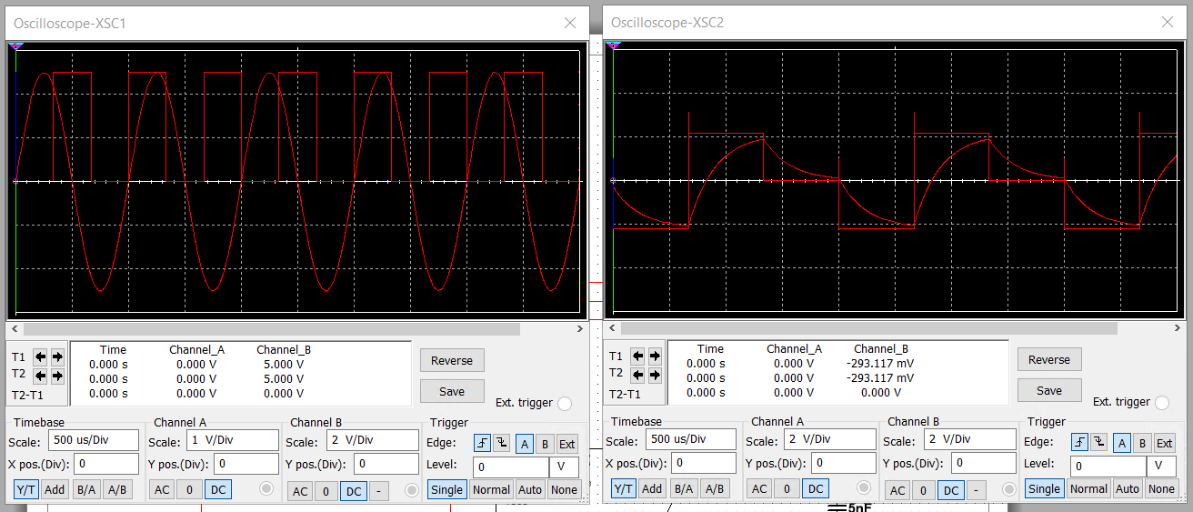
Pulse Code Modulation(PCM)
Oscilloscope-XSC1 with analog input signal and sampling clock at the input to the ADC.
Oscilloscope-XSC2 with output of the DAC.
What are the effects of increasing or decreasing the sampling rate?
Increasing the sampling rate leads to better signal fidelity, improved resolution, and reduced aliasing. Decreasing the sampling rate can result in lower resolution, increased aliasing, and limitations in bandwidth. It’s essential to select an appropriate sampling rate based on the characteristics of the signal being measured and the requirements of the measurement application.

Slide 13
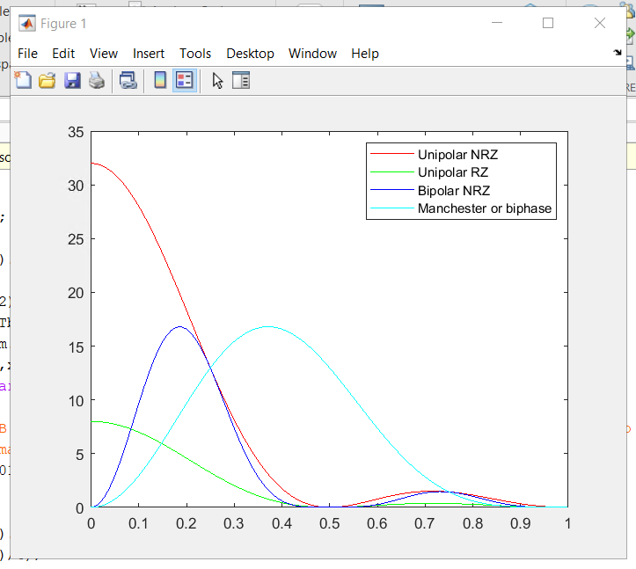
Line Codes
QUESTION:
Compare the NBR-Polar and the Manchester-Polar codes in the diagram. Which one requires more bandwidth?
ANSWER:
The Manchester-Polar (Light Blue) requires more bandwidth.
Screenshot of the power spectral densities of four-line codes: NRZ-Polar, NRZ-Unipolar, NRZ-Bipolar, and Manchester-Polar

Slide 14
Cables and Structured Cabling
In this module, I will examine the prevailing network cabling installation standards employed in structured cabling systems for multimedia communications. The research will primarily reference the ANSI/TIA-568 and ISO/IEC 11801 structured cabling standards, serving as foundational resources for online investigations.

Slide 15
Questions
1. Why must the twisting in the individual wires be maintained in a UTP cable?
Answer:
The twisting in Unsheilded Twisted Pair (UTP) cables serves several important purposes such as Cross-talk reduction, noise immunity, consistent impedance, and signal integrity.
2. How many inches should UTP cable be separated from 110 volts electrical cable?
Answer:
The recommended separation distance between UTP cables and 110 volts electrical cables can vary depending on the specific standards and regulations applicable in different regions and environments. However, a commonly recommended guideline is to maintain a minimum separation distance of at least 12 inches (30 centimeters) between UTP cables and electrical cables carrying 110 volts.
3. Horizontal cabling connects what areas to each other?
Answer:
Horizontal cabling plays a critical role in providing connectivity between the network infrastructure in telecommunications rooms or enclosures and the network devices used by end-users, enabling data, voice, and other communication services to be delivered reliably and efficiently throughout the building or campus.

Slide 16
Questions Continued
4. What is a plenum rated cable?
Answer:
A plenum-rated cable is a type of cable that is specifically designed and approved for use in plenum spaces within buildings. Plenum spaces are the areas used for air circulation in heating, ventilation, and air conditioning (HVAC) systems, typically found above suspended ceilings or below raised floors.
5. What is a riser tube used for?
Answer:
A riser tube, often referred to as a riser conduit or riser cable, is used in building and construction to vertically run cables or pipes between floors or levels of a structure. The primary purpose of a riser tube is to provide a protected pathway for cables, wires, or pipes to be routed from one floor to another, allowing for organized and secure installation of communication, electrical, plumbing, or HVAC systems throughout the building.
6. Is the grounding of equipment mostly a safety or a performance concern?
Answer:
The grounding of equipment is a critical aspect of both safety and performance in electrical and electronic systems. Proper grounding helps to protect personnel and equipment from electrical hazards, ensure compliance with safety standards and regulations, maintain signal quality and reliability, and optimize the overall performance and functionality of electrical and electronic systems in various applications and environments.

Slide 17
Antenna Gain and Free Space Path Loss
In this module, I will investigate the attributes of antenna gain and free space path loss. The assigned tasks involve analyzing the interplay between signal frequency, antenna size, and antenna gain, as well as examining the relationship between signal frequency, distance, and free space path loss.

Slide 18
Antenna Gain
1. What is the maximum theoretical antenna gain of a common dish antenna at the 2.4 GHz band?
Answer: 22.379
2. What is the maximum theoretical antenna gain of a common dish antenna at the 5 GHz band?
Answer: 29.079
3. Given the same sized reflector, which signals, high-frequency, or low-frequency, can be more efficiently focused by a common dish antenna (i.e., result in a higher antenna gain)?
Answer: High-Frequency
4. What is the maximum theoretical antenna gain of the dish antenna used in the VLA radio telescopes in New Mexico at the 5 GHz band?
Answer: 63.059
5. Given the same signal frequency, which dish antennas, large-sized or small-sized, are more efficient at focusing the signal (i.e., result in a higher antenna gain)?
Answer: Large-Sized

Slide 19
Free Space Path Loss
What is the free space path loss in dB at the 2.4 GHz band?
Answer: -80.4
2. What is the free space path loss in dB at the 5 GHz band?
Answer: -87.2
3. How does the free space path loss at a higher frequency (e.g., the 5 GHz band) compare with that at a lower frequency (e.g., the 2.4 GHz band)?
Answer: It loses strength faster
4. What is the free space path loss in dB over 20 meters at the 2.4 GHz band?
Answer: -66.421
5. What is the free space path loss in dB over 40 meters at the 2.4 GHz band?
Answer: -72.441

Slide 20

Free Space Path Loss Continued
6. What is the free space path loss in dB over 80 meters at the 2.4 GHz band?
Answer: -78.462
7. When the distance doubles, how does free space path loss in dB change approximately
Answer: Down 6 dB everytime the distance is doubled
8. Use a scientific calculator to calculate Delta $L_{fS}$ for D1 = 20 meters and D2 = 40 meters.
Delta $L_{fS }$= ______-6.02_____
9. Is your calculation approximately the same as the result from Part 1 Step 2?
Answer: Yes

Slide 21
Bit Error Rate of Fading Channels
In this module, I will compare the bit error rate (BER) performance across three noise-limited and fading communications channels. The tasks include exploring and analyzing the BER performance of wireline and optical channels utilizing FSK, PSK, and DPSK modulation techniques, as well as examining the BER performance of wireless channels employing PSK modulation.

Slide 22
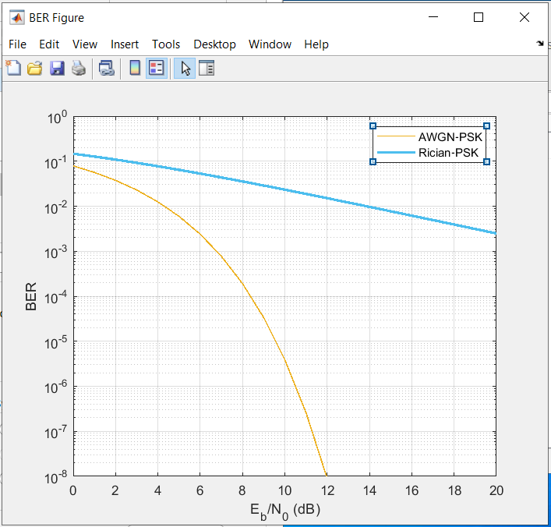
AWGN Channel and Rician Channel
Screenshot of the bit rate error performance of both AWGN and Rician fading Channels.

Slide 23
AWGN Channel and Rician Channel
QUESTION:
Compare and contrast the BER performance of PSK over a noise limited (AWGN) transmission channel to the performance of PSK over a Rician channel at 5- and 10-dB Signal to Noise Ratio (E_{b}/N₀), respectively.
Is there a significant difference in BER performance of PSK between the AWGN channel and Rician channel?
ANSWER:
There is a significant difference between AWGN and Rician at 5-dB as they are close but are way off between each other at 10-dB. The AWGN goes to zero in the graph and Rician stays high but does lower some.

Slide 24
Career Skills Obtained
This project has provided me with a comprehensive exploration of key concepts and technologies central to modern telecommunications and networking. Through hands-on projects, I have gained valuable technical skills in analyzing complex systems, researching industry standards, and evaluating communication channels' performance. Additionally, the projects have fostered critical thinking, data analysis, and technical writing abilities, essential for problem-solving in real-world scenarios.

Slide 25
Conclusion
By completing this project, I have not only enhanced my technical proficiency but also developed important soft skills such as communication, time management, and teamwork. Overall, this project series equipped me with a diverse skill set that is highly relevant and valuable across various career paths in the rapidly evolving fields of telecommunications, networking, and multimedia communications.

Slide 26
References
What is an Unshielded Twisted Pair (UTP)? - Definition from WhatIs.com. (n.d.). SearchNetworking. https://www.techtarget.com/searchnetworking/definition/Unshielded-Twisted-Pair
‌ archonone. (2021, June 7). How Far Apart Should I Separate Networking Cables from Power Outlets? ArchonOne. https://www.archonone.com/how-far-apart-should-i-separate-networking-cables-from-power-outlets/
Communications, B. W. (n.d.). Horizontal and Backbone Cabling Explained. Www.bwcfla.com. https://www.bwcfla.com/blog/horizontal-and-backbone-cabling-explained#:~:text=Horizontal%20cabling%20extends%20from%20a
‌What Is Plenum and How Do Plenum-Rated Cables Work? | C2G. (n.d.). Www.cablestogo.com. Retrieved March 25, 2024, from https://www.cablestogo.com/learning/library/connected-classroom/what-is-plenum#:~:text=Plenum%20rated%20cable%20has%20a
StackPath. (n.d.). Www.cablinginstall.com. https://www.cablinginstall.com/design-install/cabling-installation/article/16468266/intrabuilding-riser-cable-a-look-at-the-basics
‌admin. (2023, May 25). The Importance of Equipment Grounding. Copper Mountain Technologies. https://coppermountaintech.com/the-importance-of-equipment-grounding/#:~:text=Proper%20equipment%20grounding%20is%20important

