Slide 1
Home Security System
Amber Palmer
May 2022
CEIS101

Slide 2
Introduction
I am currently a student in Information Technology and completed the Home Security System as a first-time project. This project is a smart home automation and security system. I started by designing the prototype in Tinkercad. Then using the hardware from my IoT Tech Core Kit, and programming through Arduino IDE I was able to add a door sensor to check whether the door is open or closed, a distance sensor to monitor for intruders, automated lights that turn on when it’s dark, water level sensor for flooding and temperature and humidity sensor to monitor the weather. This is how it all came together.

Slide 3
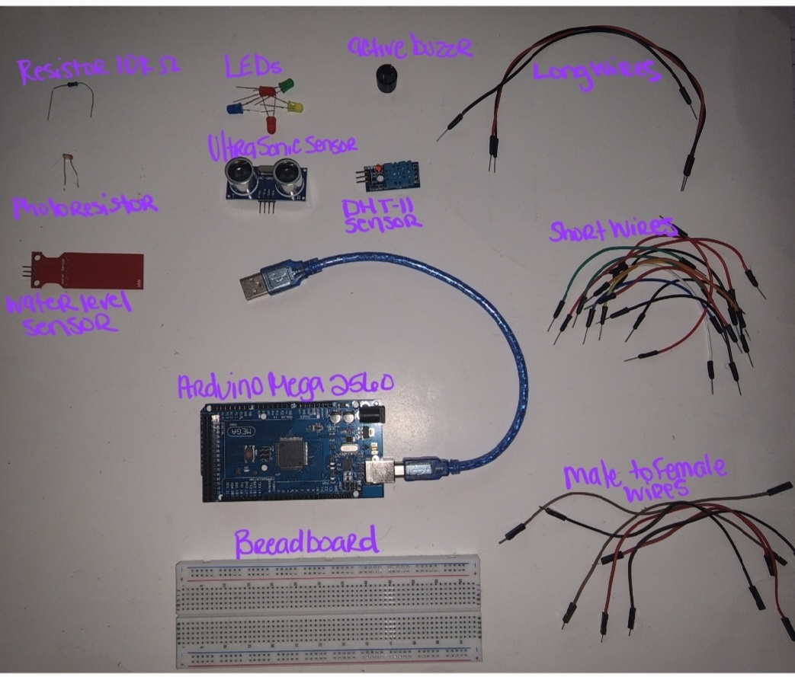
Project Materials

Slide 4
My Challenges
Tinkercad was confusing at first. I am still practicing projects so that I can really get the coding portion of the project down. I also crossed a few of my wires with the LEDs, and the light sensor stayed on because I did not realize I need to adjust the sensitivity . I went back and read through the guide again along with watching the project portion of the weekly class and was able to quickly resolve my mistake. I like the fact that these projects allow me to make mistakes, that’s what I really learn from. The challenge of figuring it out.

Slide 5
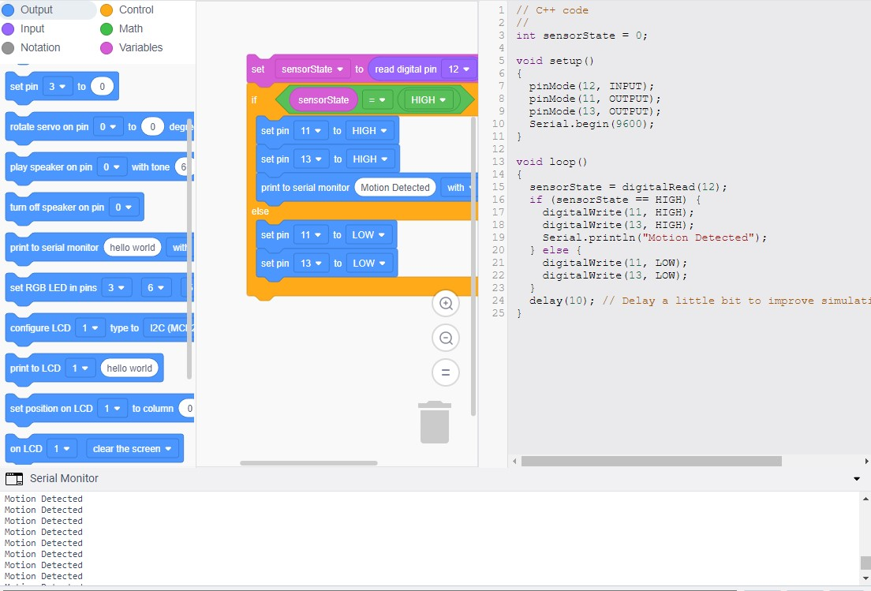
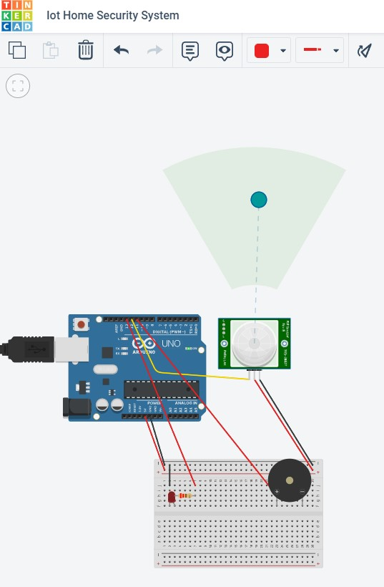
Tinkercad

Slide 6
Career Building Skills
I have better knowledge of building the block code in Tinkercad, knowing what components are needed in order to complete the circuit simulation, applying that knowledge in placing the physical components in the Breadboard, and adjusting the provided code to match requirements. One other valuable thing I learned throughout this project is troubleshooting from the simplest possible issue to the hardest and not to ever assume.

Slide 7
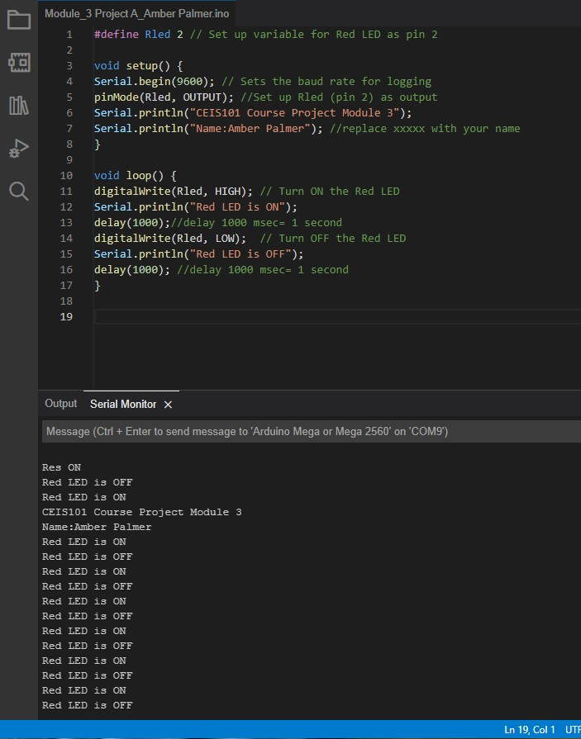
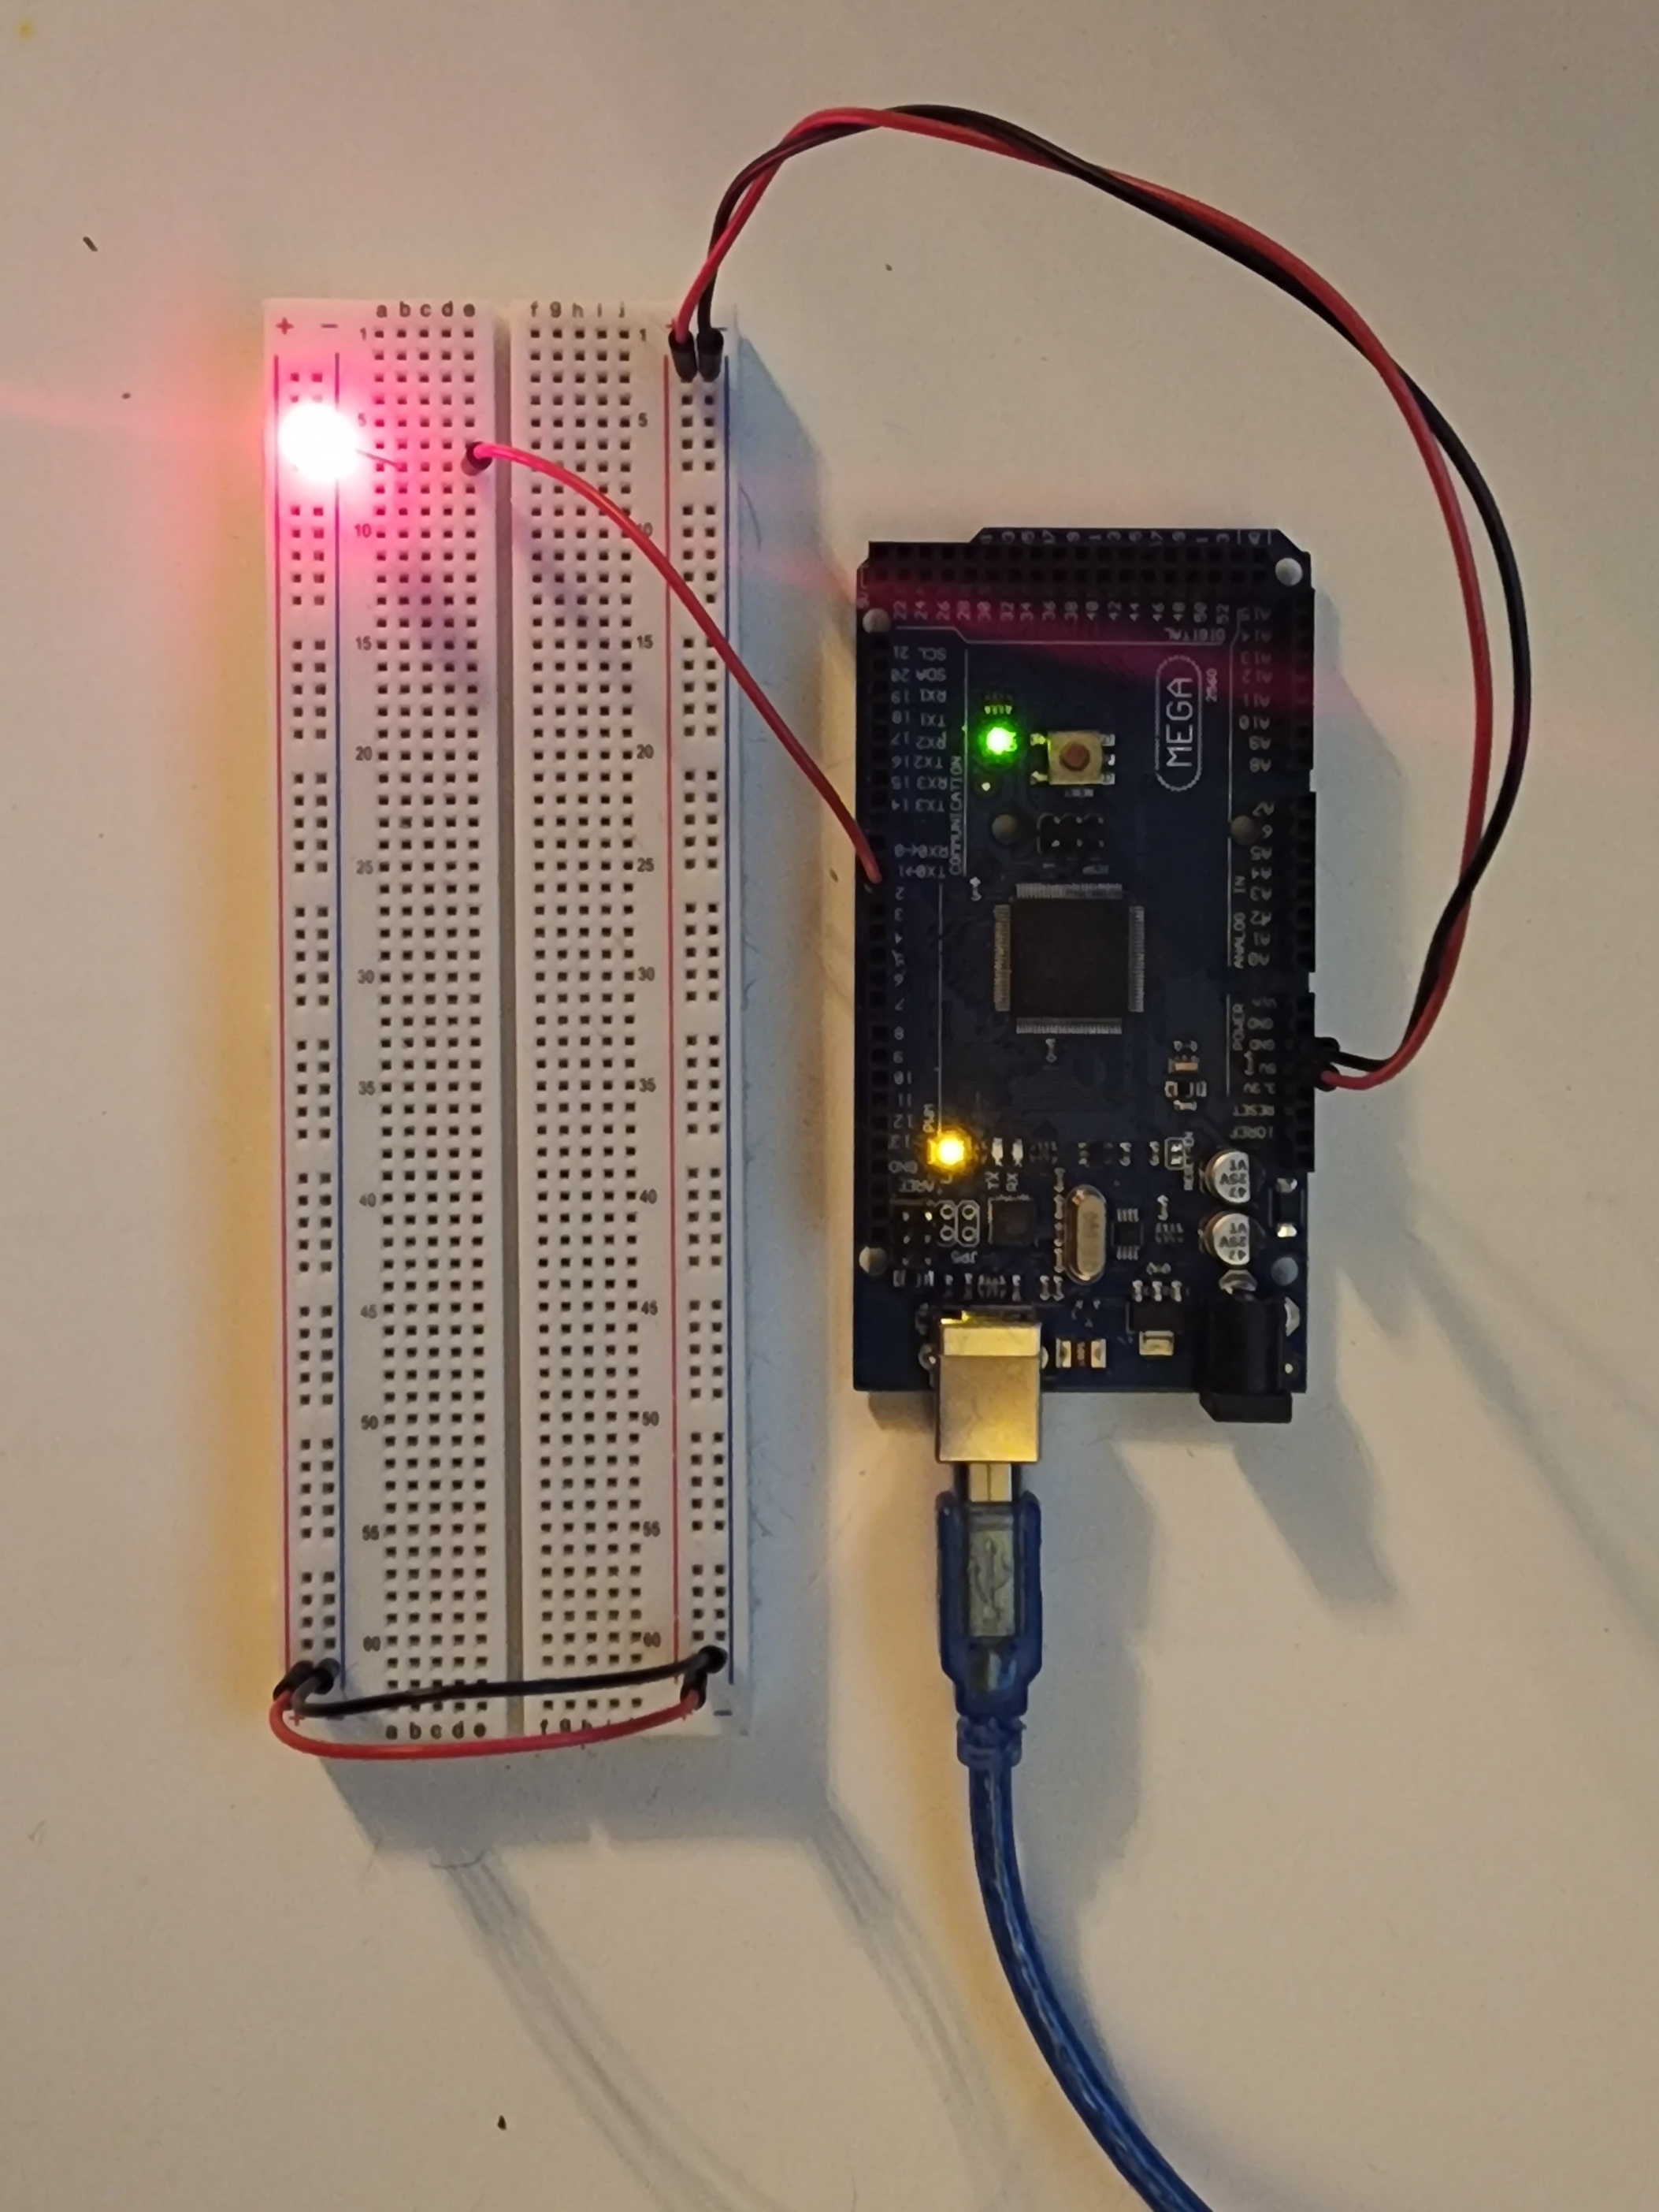
Single LED

Slide 8
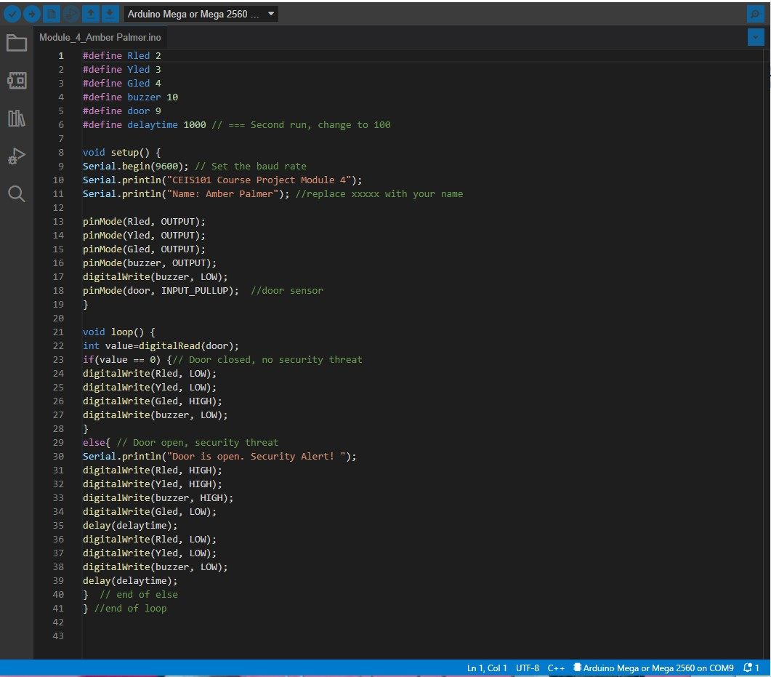
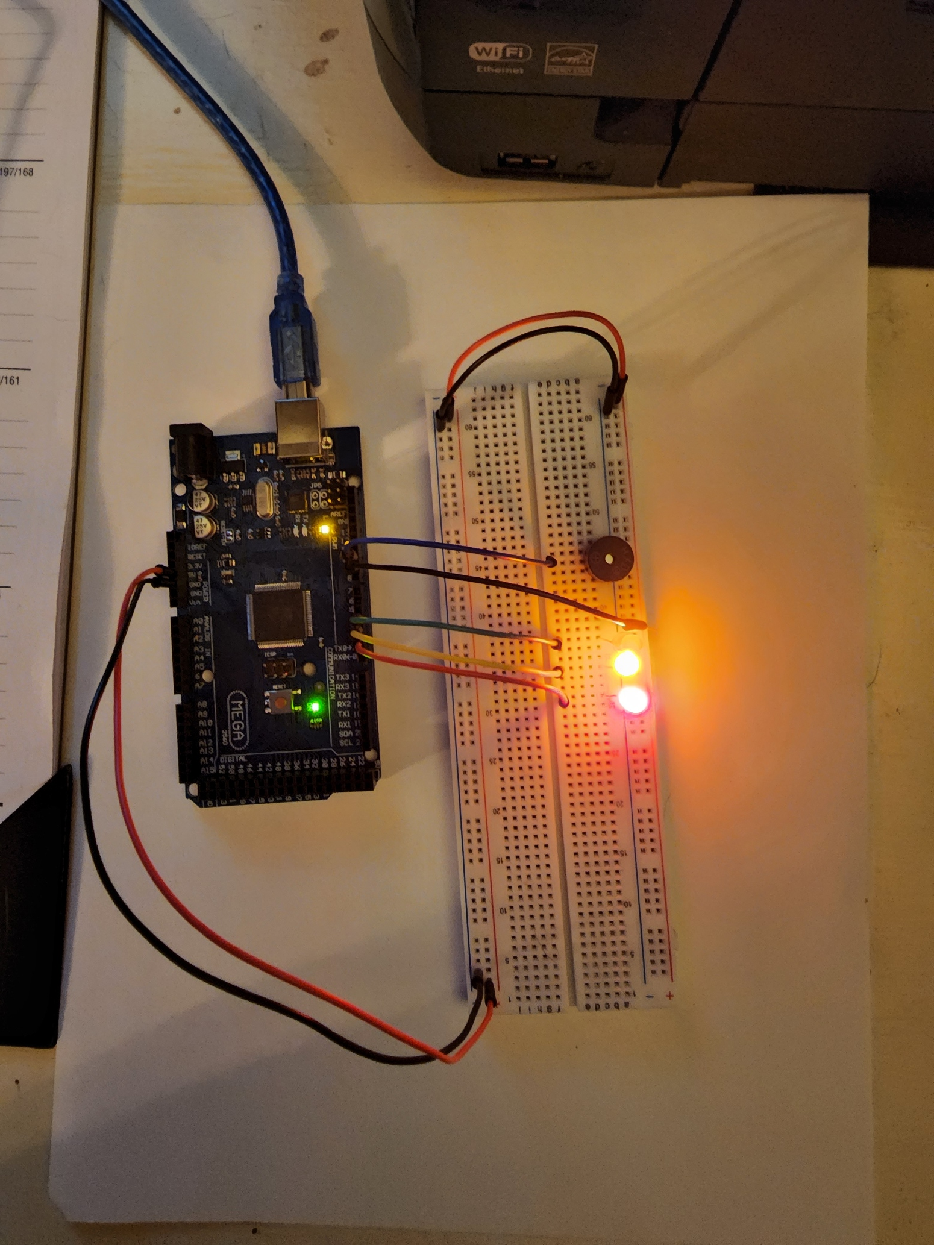
Door Sensor

Slide 9
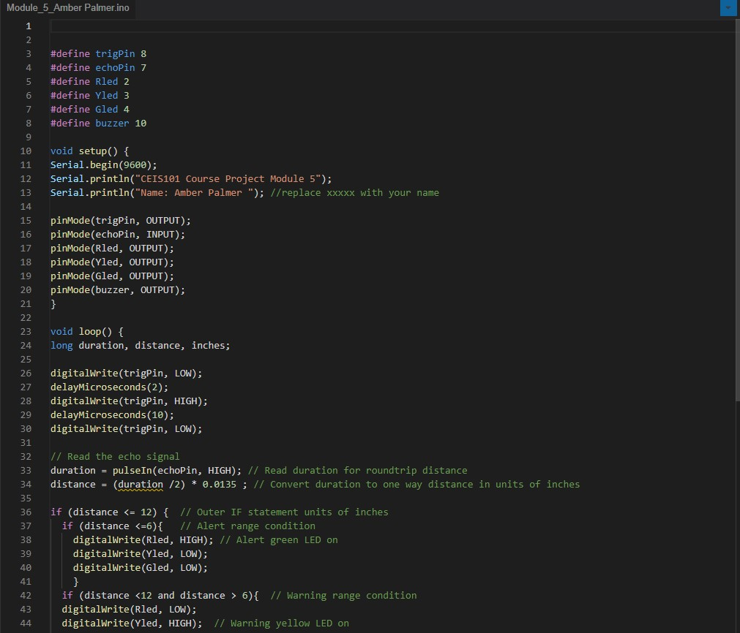
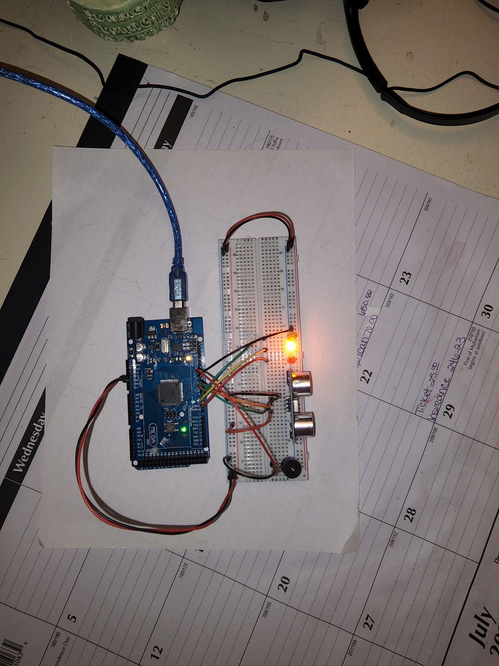
Distance Sensor

Slide 10
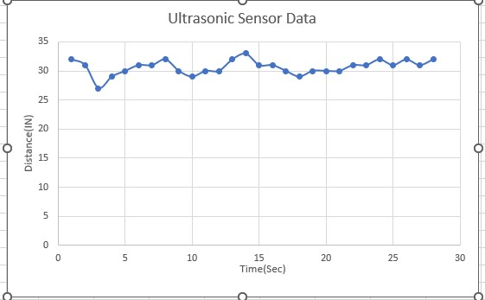
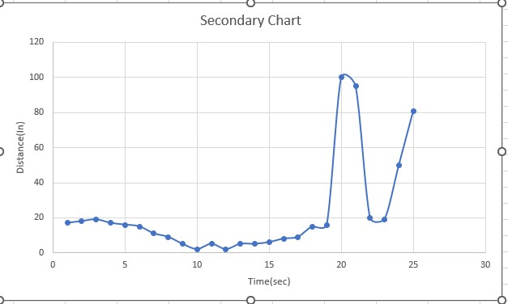
Distance Sensor Serial Plotter

Slide 11
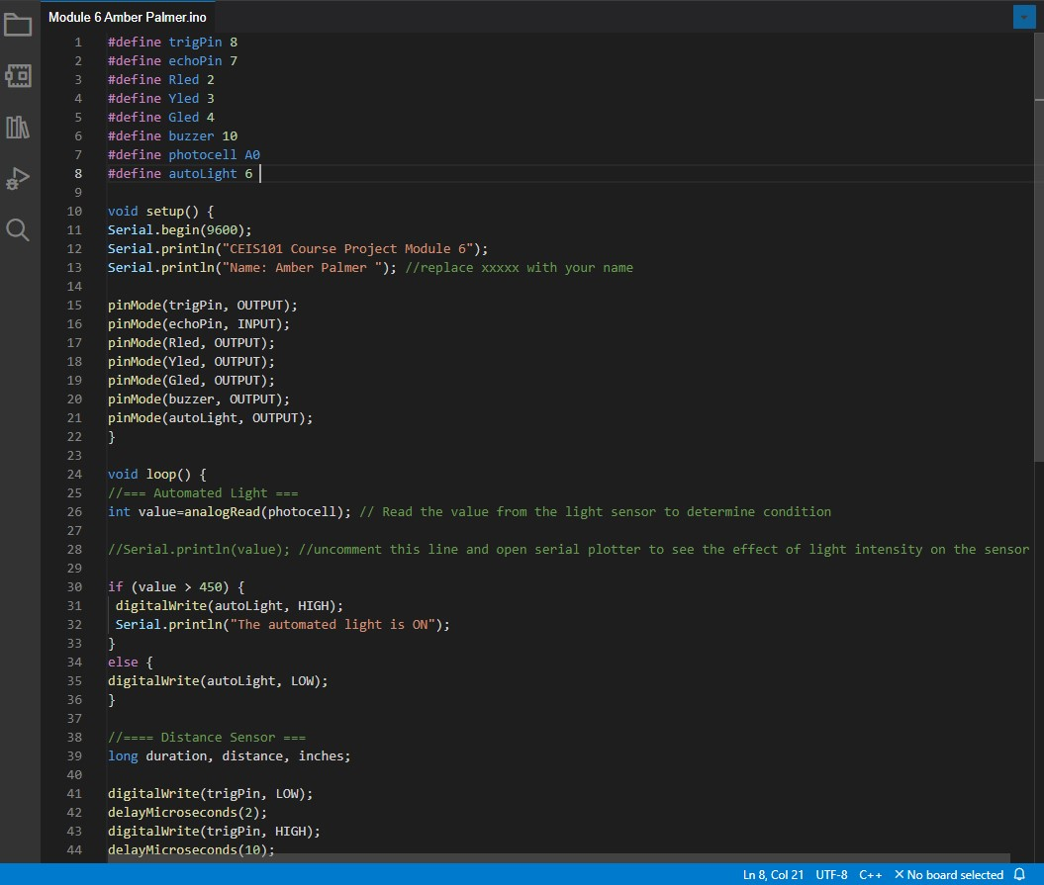
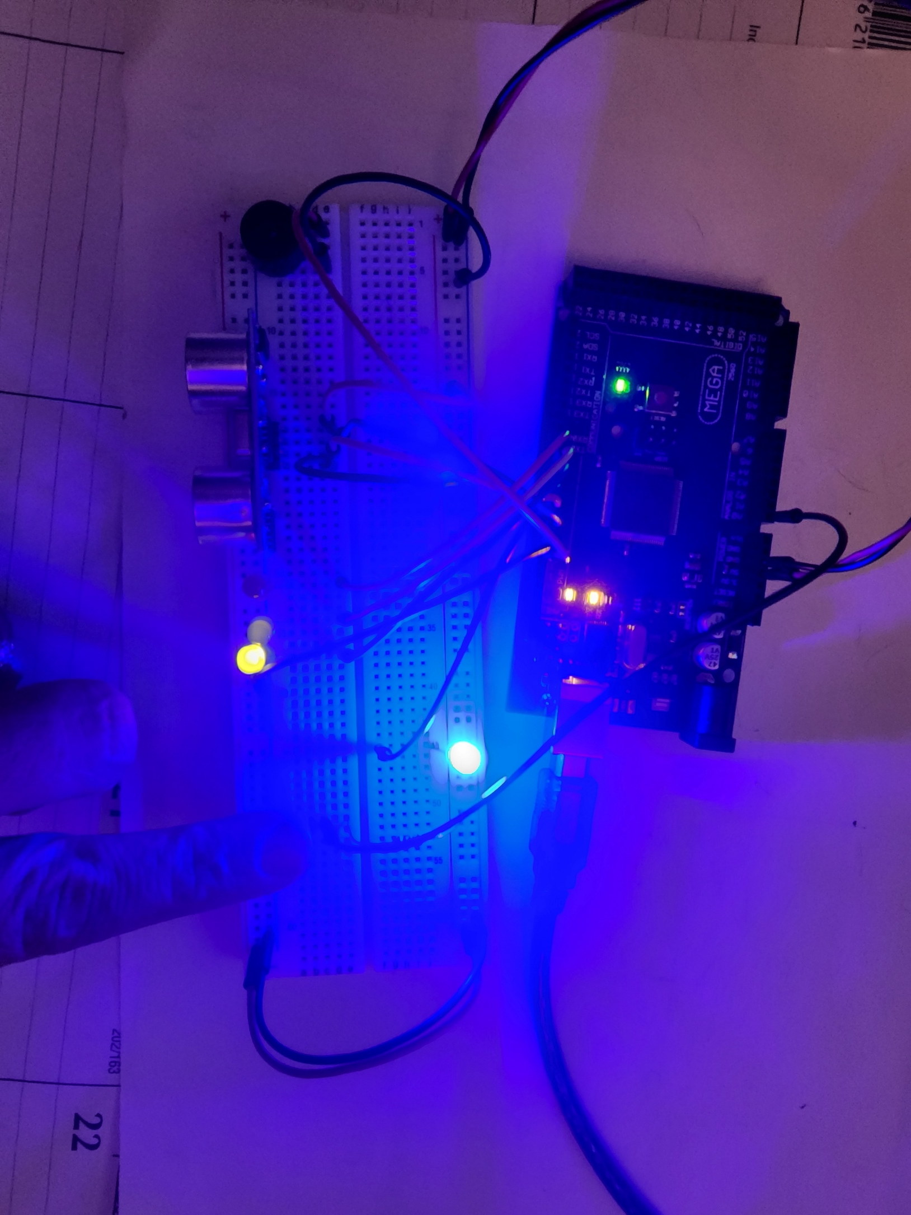
Automated Light

Slide 12
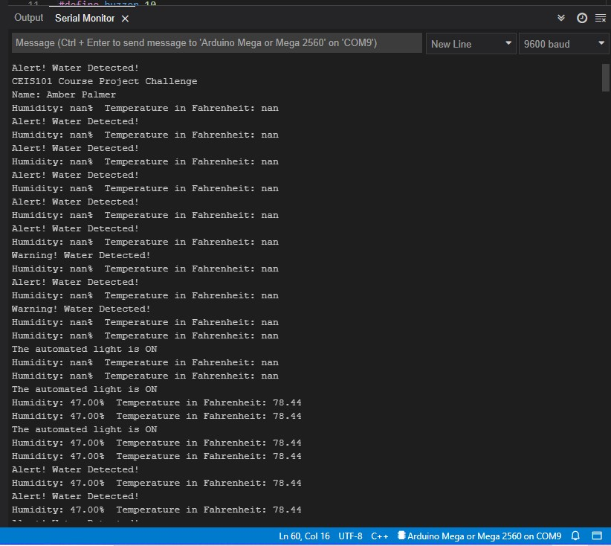
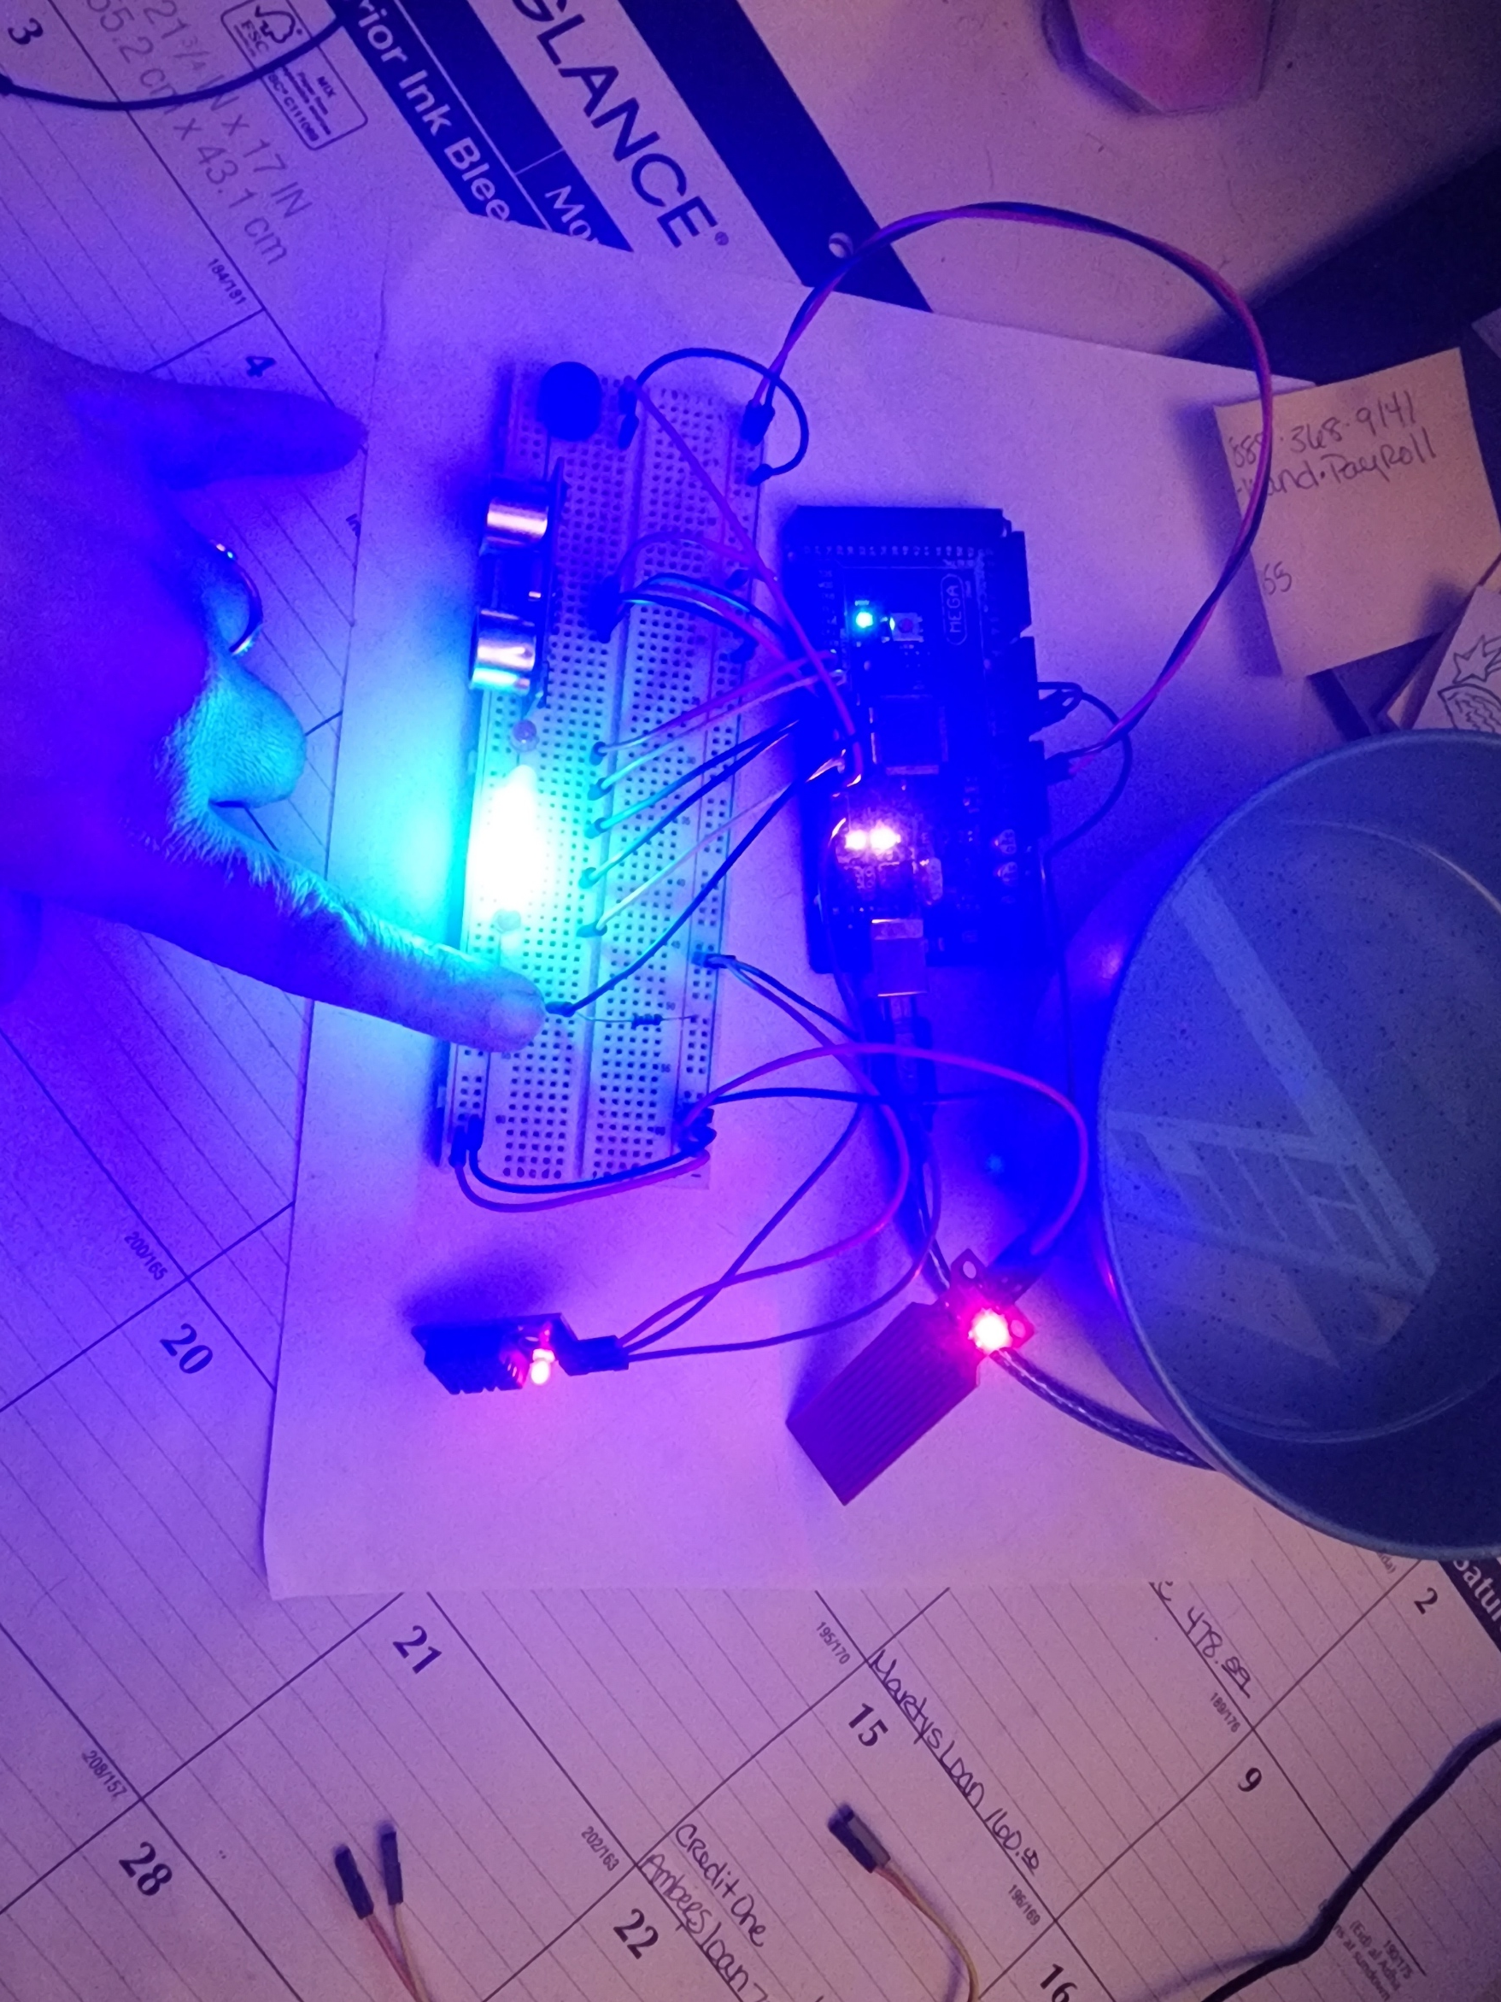
Challenge adding DHT-11 and water sensor video

Slide 13
Conclusion
I hoped you enjoyed my project preview as much as I enjoyed revisting all the different parts of the project. I remember when I successfully connected the single LED light and it started shinning how excited I was to continue these courses building up to the final project. And now I am here and was able to complete all the different task. My lights shine and my sensors are outputting data. I could not be more excited to select my next project to add to my portfolio. Thank you for taking the time to experience my journey with me.

