Slide 1
PHYS204
Final Project
Amber Wilkins

Slide 2
Contents
Inventory Parts and Software
Precision of the Ultrasonic Sensor
Gravitational Acceleration of a Free-Falling Object
Conservation of Energy of a Free-Falling Object
Relationship between Linear and Rotational Motion
Observing the Hall Effect

Slide 3
INTRODUCTION
Physics is a branch is science that explains the universe using fundamental laws and mathematics. Practicing physics helps teach physical principles behind the workings of the universe and helps train you in the solution of complex logical problems. This course project utilizes various sensors to obtain data that is processed by various scientific methods.

Slide 4
Introduction and Software
This is an introduction to the parts and software that were needed to conduct the experiments that will investigate the various fundamental laws of physics we covered in this course. The detailed material list is a vital component of any lab report and facilitates the replication of experiments. The following slides will give a summery description of the equipment used to gather the data to be analyzed.

Slide 5
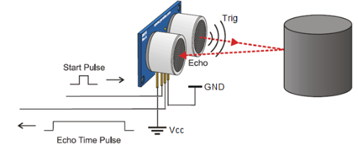
Ultrasonic Sensor HC-SR04
Describe the working principles of ultrasonic sensors in detail.
The sensor is an electronic device with two transducers that are used to detect an object within its range which is 3cm to 3m. When activated, one transducer sends a burst of ultrasounds by converting electric pulses into sound waves. The other transducer listens for the echo of the ultrasounds to bounce off an obstacle and come back. The sensor measures the round-trip time between the outburst of ultrasound and the reception of the echo. With known round trip and speed of sound times, the device can measure the distance that the sound traveled. The sensor that we will be using has four pins, the Vcc pin that operates the voltage, GND is the ground pin, Trig pin that is used to trigger the outgoing burst, and the echo pin that is used to detect the returning echo from the nearby obstacle.

Slide 6
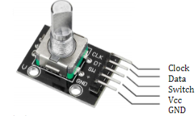
Rotary Encoder KY-040
Describe the working principles of rotary encoders in detail.
  The rotary encoder is an electro-mechanical device that generates an electrical signal according to rotational movement. The one that we are using is the incremental rotary encoder with five pins that generates a series of square wave pulses. The encoder has a disk with evenly spaced contact zones that are connected to the common pin SW (switch) and two other separate contact pins CLK (clock) and DT (data). As the disk rotates, pins CLK and DT will make on and off contact the common SW pin and two square wave output signals will be generated accordingly. The +pin is the operating voltage pin and the GND pin is the ground pin. If the encoder rotates clockwise, the CLK square wave will lead and if the encoder rotates counter-clockwise then DT square wave will lead.

Slide 7
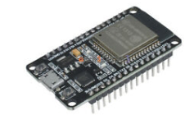
Hall Effect Sensor ESP32
Describe the working principles of the Hall Effect Sensor in detail.
  Under the metal lid of the ESP32, there is a hall effect sensor. This sensor can detect variations in the magnetic field within its surroundings. The greater the magnetic field, the greater the sensor’s output voltage. The measurements from the sensor can increase or become negative depending on the magnet pole facing the sensor.

Slide 8
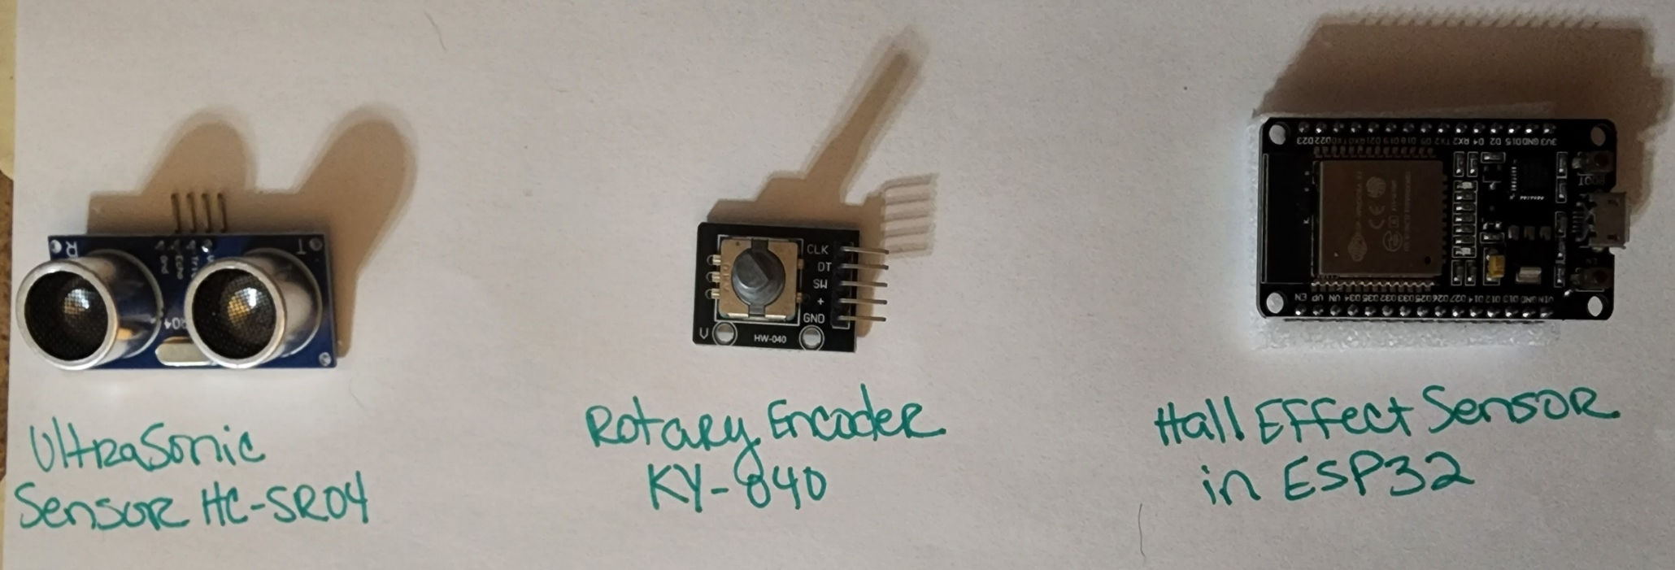
Photos of my Equipment

Slide 9

Screenshots
What tool will you used to take screenshots? How does it work?
  The snipping tool is installed on my Windows 11 PC and pinned to the lower bar on my screen. The print button on my keyboard is also another option that can be used to open the snipping tool.
  Ctrl+C and Ctrl+P are the two shortcut keys that I will use to copy and paste the screenshots that are taken although the snipping tool automatically copies the screenshot when it is snipped.
  The snipping tool gives full control of what you would like to screenshot on the screen. So either I can snip the whole page, the entire screen, or a portion of the screen depending on what is being requested.

Slide 10


Required Software

Slide 11
Precision of the Ultrasonic Senor
The following representations show how we apply what we have learned about number and units to determine the precision of the ultrasonic sensor. Assessing the accuracy of a sensor is important in experiments, as sensors tend to experience drift over time, leading to inaccurate readings influenced by factors like temperature, humidity, and component fatigue.

Slide 12
Data Collection
Trial | Ruler Distance (cm) | Total Roundtrip Distance (m) | Time from Serial Monitor (microseconds) | Roundtrip time (s) | Velocity = distance/time (m/s)
1 | 8 | 0.16 | 492 | 4.92 e-4 | 325.20
2 | 10 | 0.2 | 586 | 5.89e-4 | 339.56
3 | 15 | 0.3 | 925 | 9.25e-4 | 324.32
4 | 20 | 0.4 | 1187 | .0012 | 333.33
5 | 30 | 0.6 | 1724 | .0017 | 352.94

Slide 13



Data Analysis
Average velocity from table
Percent difference where $v_{sound}=343 m/s$
$$v_{avg}= \frac{v_{1}+v_{2}+v_{3}+v_{4}+v_{5}}{5}$$
Answer:
335.07
m/s
$$Percent difference = \frac{\left|335−343\right|}{343}×100$$
Answer:
2
m/s

Slide 14
Lessons Learned
Briefly describe and explain the results.
  The distance/time result is based on the distance the object was placed from the sensor and the amount of time the signal took to travel from the sensor to the object and back. The further the object from the sensor the longer the time to return is.
What is the dependence of temperature, humidity, and atmospheric pressure on the speed of sound? How does it affect the results?
  Atmospheric pressure has a negligible effect on the speed of sound because both the density and the bulk modulus of the air change with pressure, leaving the speed of sound mostly unaffected. The sound depends more on temperature and composition. Temperature causes an increase in the speed of sound with rising temperatures of 0.3 m/s per Fahrenheit. Higher humidity levels lead to a moderate increase in the speed of sound due to lower air density.

Slide 15
Gravitational Acceleration of a Free-Falling Object
The following slides apply what we have learned about motion as a change of position to find the gravitational acceleration of a free-falling object using the ultrasonic sensor. The reported in this section of the project will also be used in the next portion of the project as well.

Slide 16
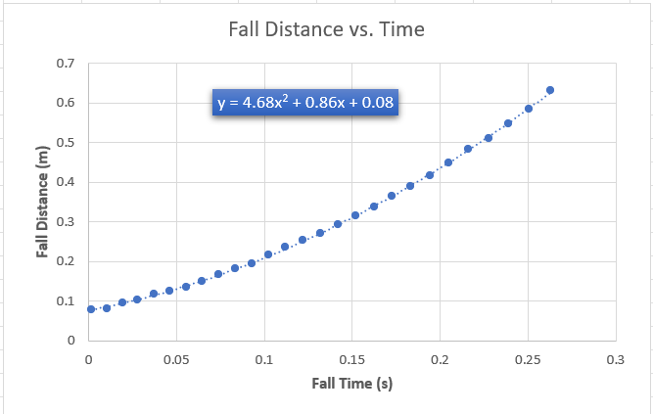
Excel Table and Graph
PHYS204 Module 3 Project
Name: PHYS204 Team
Speed of sound: 343.00 m/s
Initial distance to ground: 69.29 cm
TIME[s] | Distance[cm] | Ready! 321 GO!
0.0014 | 7.94
0.0103 | 8.2
0.0192 | 9.57
0.0281 | 10.29
0.0372 | 11.78
0.0463 | 12.5
0.0554 | 13.67
0.0646 | 14.97
0.074 | 16.89
0.0834 | 18.38
0.0929 | 19.59
0.1025 | 21.75
0.1122 | 23.62
0.122 | 25.42
0.132 | 27.15
0.142 | 29.29
0.1522 | 31.49
0.1625 | 33.94
0.1729 | 36.46
0.1835 | 39.1
0.1943 | 41.79
0.2052 | 44.85
0.2163 | 48.4
0.2276 | 51.21
0.2391 | 54.93
0.2508 | 58.6
0.2628 | 63.28

Slide 17
Data Collection
Trial | x² coefficient value from curve fitting | Acceleration (m/s²) = 2* (x² coefficient)
1 | 4.68 | 2*4.68=9.36m/s^2
2 | 5.02 | 10.04m/s^2
3 | 4.66 | 9.32m/s^2
4 | 4.62 | 9.24m/s^2
5 | 4.73 | 9.46m/s^2

Slide 18



Data Analysis
Average acceleration from table
Answer: 9.48 m/s^2
Percent difference with $g=9.8 m/s^{2}$
Answer: 3.27 %
$$a_{avg}= \frac{a_{1}+a_{2}+a_{3}+a_{4}+a_{5}}{5}$$
$$Percent difference =\frac{\left|a_{avg}−g\right|}{g}×100$$

Slide 19
Lessons Learned
Briefly describe and explain the results.
  The difference in the results changed with the height that the object was being dropped from and the weight of the object.
How much variation is there from trial to trial? What does this indicate about the uncertainty of the result?
  Depending on the air resistance from the height that the object was dropped effects the result in time that it takes for the object to fall. This indicates that there will be small changes in the results for the final results from time and distance.

Slide 20
Conservation of Energy of a Free-Falling Object
An analysis of motion helps introduce the real nature of physics, to understand the nature and behavior of the physical world. We will now use what we have learned about motion to demonstrate the transformation of energy. By keeping track of energy as it is transformed from one kind to another, we can learn a great deal about the universe.

Slide 21
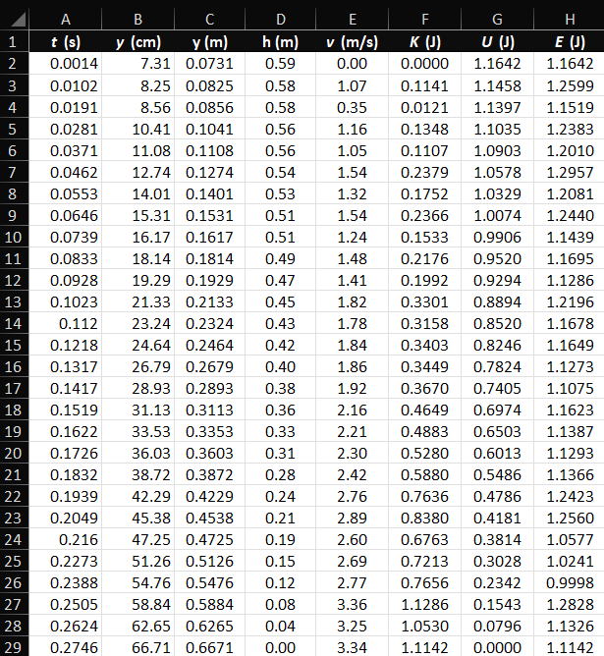
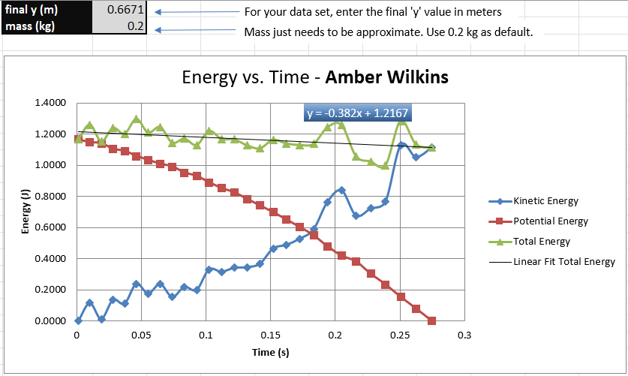
Excel Table and Graph

Slide 22




Data Analysis
Theoretical value of final velocity
Final velocity from experimental data (or largest velocity)
Percent difference
Answer: 17.0 %
$h=y_{final}−y_{initial}=$ 0.6004 m
$v_{f}=\sqrt{2gh}=$ 3.43 m/s
$v_{experimental}$ =
2.85 m/s
$$Percent difference =\frac{\left|v_{f}−v_{experimental}\right|}{v_{f}}×100$$

Slide 23
Lessons Learned
Discuss the key characteristics of the plot. Consider the points when potential energy U is maximum, U is minimum, kinetic energy K is maximum, K is minimum and when U and K are the same value. What is the significance of these points?
  When they are the same value the line starts to curve downward which represents the loss of energy as the project goes on. Potential energy U minimum and Kinetic energy K minimum represents where the object changes direction which would be falling. Potential energy U maximum and kinetic energy K maximum represents the maximum speed of the object. When U and K are the same this represents the balance in energy between kinetics and potential energy.

Slide 24
Lessons Learned
What is the trend of the best fit line for the total energy E in your data? If the data is accurate, the total mechanical energy should decrease slightly. Why is that?
  The best fit line is the horizontal line that shows total energy does not change over time. The line decreases due energy loss at each point of the experiment due to air resistance, frictional force, and/or sensor and measurement inaccuracies.

Slide 25
Relationship between Linear and Rotational Motion
Now it is time to move on to more complex motions and systems. In the part of the project, we apply what we have learned about circular motion to convert radial displacement to linear displacement using the rotary encoder.

Slide 26
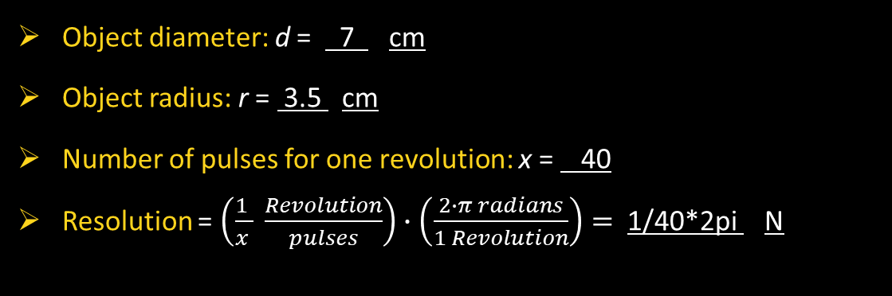
Data Collection
Object diameter: d = 7 cm
Object radius: r = 3.5 cm
Number of pulses for one revolution: x = 40
Resolution = $\left(\frac{1 }{x } \frac{Revolution}{pulses}\right)∙\left(\frac{2∙π radians}{1 Revolution}\right)=$ 1/40*2pi N

Slide 27
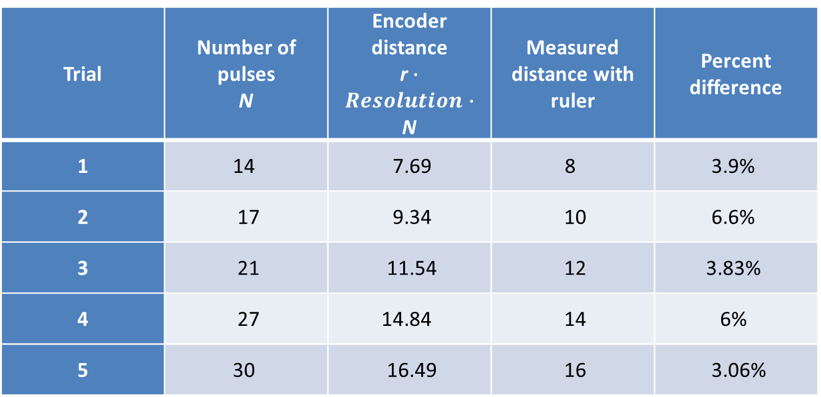
Data Analysis
Trial | Number of pulses N | Encoder distance r$∙Resolution∙$ N | Measured distance with ruler | Percent difference
1 | 14 | 7.69 | 8 | 3.9%
2 | 17 | 9.34 | 10 | 6.6%
3 | 21 | 11.54 | 12 | 3.83%
4 | 27 | 14.84 | 14 | 6%
5 | 30 | 16.49 | 16 | 3.06%

Slide 28
Lessons Learned
Briefly describe and explain the results.
  The measurements could be off when taking the measurements causing variations in the results.
What are some applications of this measuring technique? Could this measuring system be used to measure surfaces that are not flat?
  Laser displacement sensors can be used to measure the distance between the sensor and the flat surface, providing information about the surface profile and deviations from flatness. By scanning across the surface, these sensors can create a 2D profile or map of the surface flatness.

Slide 29
Observing the Hall
We are constantly surrounded by waves in our everyday lives such as sound waves to our ears so we can hear, light waves made of photons that move through matter so we can see, and invisible wave such as infrared, ultraviolet, cosmic rays, radio and TV transmissions. Not only are we surrounded by wave but also magnetic and electrical fields. Finally, we will investigate the hall effect to measure the proportional voltage under the effect of a magnetic field.

Slide 30
Excel Graph

Slide 31
Lessons Learned
Briefly describe and explain the results.
  Depending on the negative or positive side of the magnet would depend if the results were positive or negative. The numbers moved from 0 to reflect which side of the magnet was moved closer to the sensor.
Describe how the Hall sensor works. What are some applications for the Hall effect sensor?
  The Hall effect occurs when a magnetic field perpendicular to an electric current in a conductor or semiconductor produces a voltage (the Hall voltage) perpendicular to both the current and the magnetic field.
  Automotive Industry: Throttle Position, Speed, and Position Sensors
  Electronics: Proximity and Magnetic Sensors
  Medical: Magnetic Resonance Imaging (MRI) and Infusion Pumps
  Security: Intrusion Alarms

Slide 32
Project Challenges
Throughout this project, I encountered numerous challenges. One of the main difficulties was tackling the mathematical questions, particularly knowing which formulas to use for the equations and ensuring the correct units were applied, as some data was listed in m/s while others were in percentages. However, by delving deeper into the coursework and study materials, I was able to overcome all these obstacles.

Slide 33
Career Skills
Some career skills developed from completing this course project would be:
Technical Proficiency from gaining familiarity with different types of sensors and their applications.
Analytical Skills from learning to analyze data and interpret results based on the principles of physics.
Problem-Solving by identifying potential errors in data collection and analysis.
Critical Thinking by evaluating how the environmental factors impact sensor performance.

Slide 34
Conclusion
Physics is a branch of science that explains the universe using fundamental laws and mathematics. Since IoT technology is part of our daily lives and physics describes the governing laws of the universe, various technologies can be utilized to demonstrate the governing laws of physics. The goal for this project was to gain a better understanding of the governing laws of physics and to gain insight into ourselves by studying the firmament as a whole.

