Slide 1

CEIS110 FINAL PROJECT
AMBER PALMER

Slide 2
INTRODUCTION
Data is growing at an exponential rate and is being generated from numerous sources. All this data needs to be stored, managed, analyzed, and secured.
In this project I will demonstrate data analysis of weather data downloaded from a cloud data source, store it in a database, then extract and process it.
The language used is Python which imports the SQL Library within the Spyder program that shows the manipulation of the weather data in the form of graphs and tables that can help assist in making predictions.

Slide 3
SOFTWARE INVENTORY
The first step of this project is going to start with developing a system using software such as Anaconda(Spyder) that runs the Python programming language to download weather data from a cloud source by importing SQLlite, store it in a database within Python and then extract the desired subsets for cleansing and processing.

Slide 4
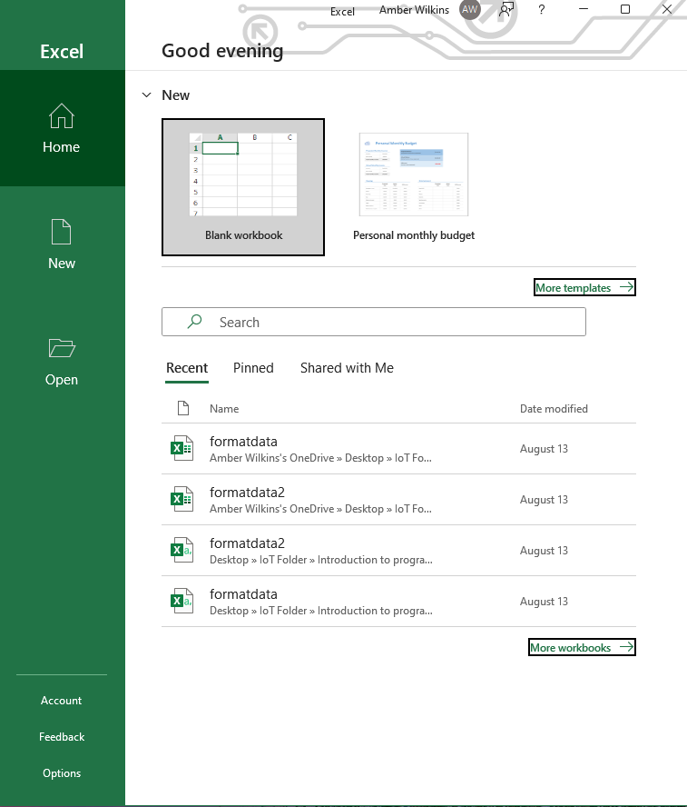
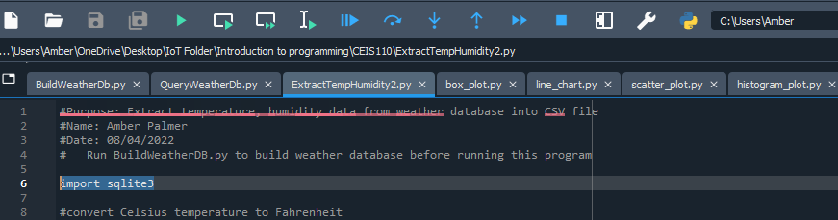
SOFTWARE

Slide 5
PLANNING AND DESIGN
After the software was downloaded, a plan was created for the temperature data project.
The plan that was created is then represented in a flowchart.
The flowchart represents the steps to be taken in order from top to bottom following the directions of the arrows.
The planning and design steps are crucial to the execution of the program.

Slide 6
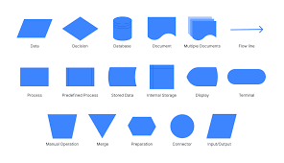
WHAT ARE FLOWCHARTS?
Flow charts are used to graphically explain a system. Ovals, squares, diamonds, etc. are connected through arrows and represent the data flow to the current problem including inputs, outputs, and storage points.
Flowcharts are used to represent programs, algorithms, or any ordered process. A flow chart should be created before starting a process to determine the logic flow before the project is executed.
Flowcharts and data flow diagrams are used to graphically describe a solution to the current problem.
The image to the right a list of some of the flowchart shapes.

Slide 7
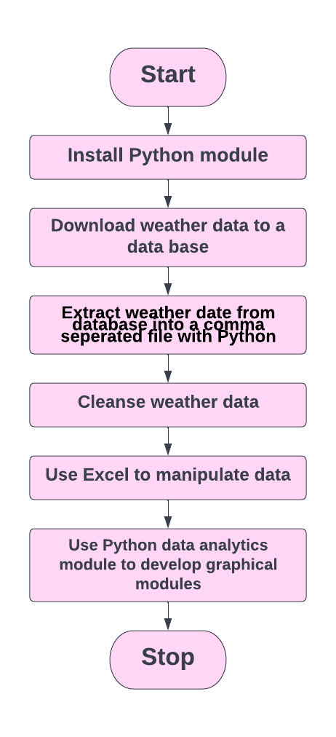
FLOWCHART USED FOR THIS PROJECT
Install Python
Download weather data to data base
Extract weather data from data base into a comma separated file in Python
Cleanse weather data
Use Excel to manipulate data
Use Python data analytics module to develop graphical modules

Slide 8
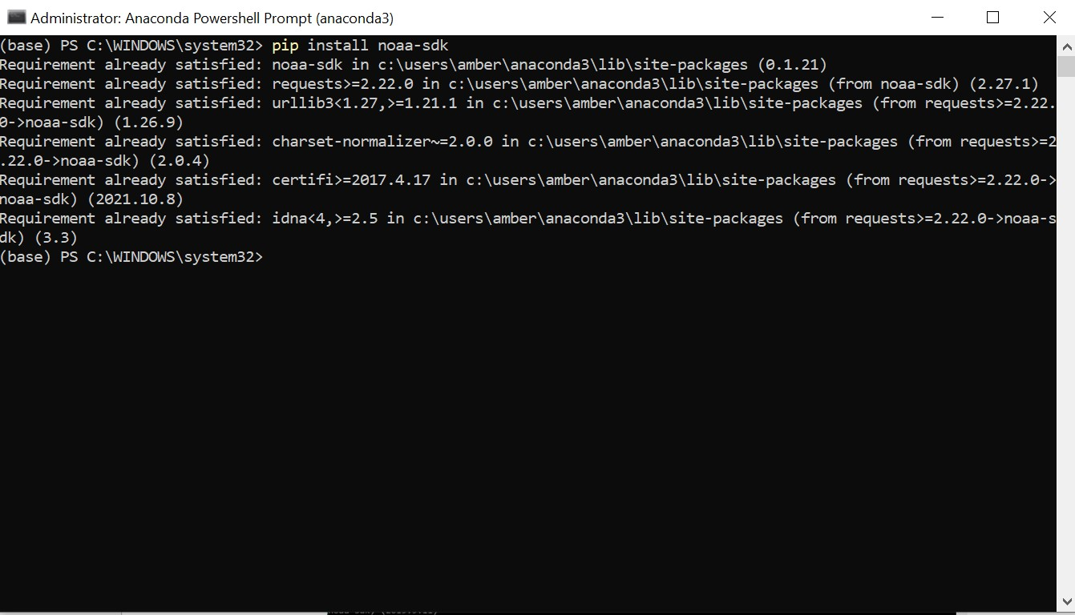
ADDING THE LIBRARY
I started with installing the library module required to download weather observations from the US government National Oceanic and Atmospheric Administration (NOAA) weather data service using a cloud-based Application Programming Interface (API).
The screenshot presented to the right shows this library has been satisfied. This library is installed from the Spyder command line as an administrator.

Slide 9
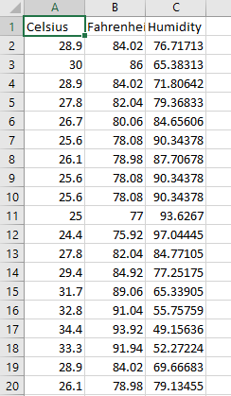
GATHERING TEMPATURE AND HUMIDITY DATA
After planning and design the code was developed to download a set of weather observations based on the specified zip code.
This data was stored in a comma-separated table in the local database.
The image to the right represents the comma separated database stored in a table.

Slide 10
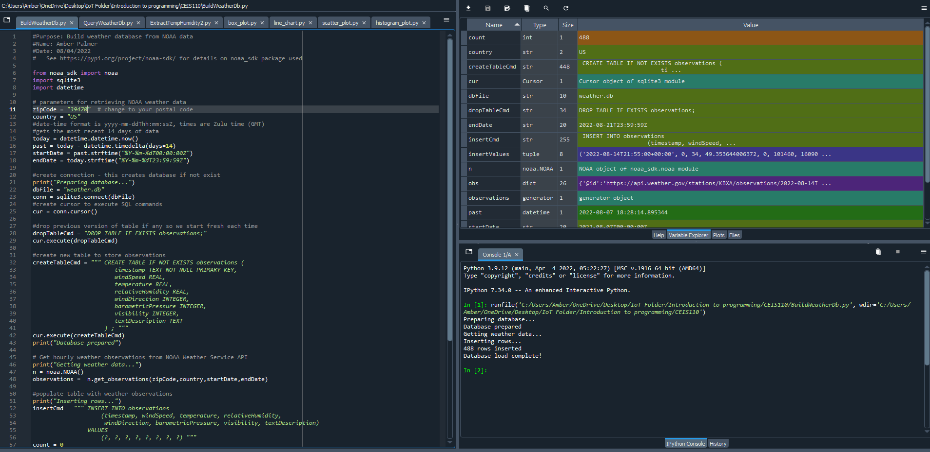
BUILD WeatherDb.py code
(SCREENSHOT)
Screenshot of the code in Spyder.
The database is named weather.db and will be stored in the same directory or folder as the Python code is stored.
The code used here will create a table named Observations with fields, timestamp, windspeed, temperature, relativeHumidity, windDirecrtion, biometricPressure, visibility, and textDescription.

Slide 11
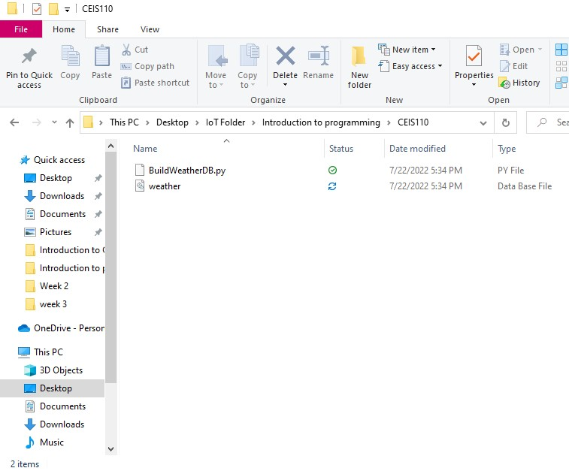
Weather.db FILE
(SCREENSHOT)
This screenshot is of the Windows File Explorer showing the weather.db was created and stored in the same folder as the Python code.

Slide 12
QUERYING THE DATABASE
SQL stands for Structured Query Language and is a specialized programming language for working with relational databases. Database systems have client tools to allow me to issue SQL commands to the database and then view the output of the issued command.
The Python language running inside the Spyder software was used to issue SQL query commands to my database to store the data in a table in the Excel software.
Python issues the SQL commands to the database, in the background, then receives and displays the results.

Slide 13
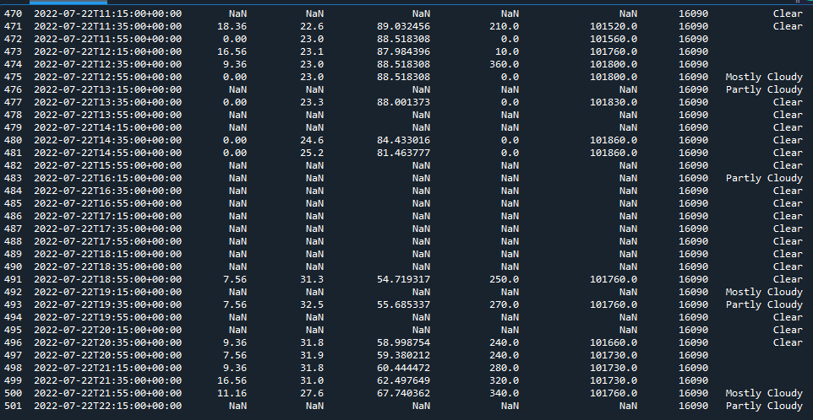
QUERY TO RETRIEVE ALL COLUMNS AND ALL ROWS (SCREENSHOT)
The command selectCmd=“SELECT * FROM observations ORDER BY timestamp;” will retrieve all columns and rows of the observation table.
Another way of querying the database would be to change the same command to find the temperature and windspeed of the entries with a textDescription of clear, selectCmd=“SELECT temperature, windspeed, textDescription From observations where textDescription=‘Clear’;”
The screenshot on the right represents all columns and rows the requested database.

Slide 14
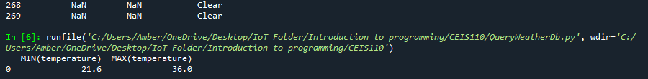
QUERY TO RETRIEVE THE LOWEST AND HIGHEST TEMPATURES (SCREENSHOT)
You can also run an alternative command to see the lowest and highest temperatures observed in this data set, selectCmd=“SELECT MIN(temperature), MAX(temperature) FROM observation;”
The screenshot on the right represents the highest and lowest temperature in Celsius.

Slide 15
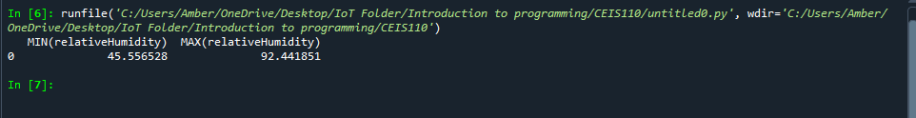
QUERY TO RETRIEVE THE LOWEST AND HIGHEST HUMIDITY (SCREENSHOT)
Changing the sections of code to represent the desired the column is as easy as changing the temperature command to relativeHumidity.
selectCmd=“SELECT MIN(relativeHumidity), MAX(relativeHumidity) FROM observation;”
The below screenshot is the results from changing the one line above.

Slide 16
DATA CLEANSING
Data Cleansing is the removal of spurious or missing data, and is performed to ensure the data is complete, valid, and standardized.
The database may contain some missing or invalid data that is represented by the word NULL in the query results. Python can remove these missing or NULL values so Excel will be able to work with the file.
The Python program is saving the output into a csv file so that it can be read by Excel.

Slide 17
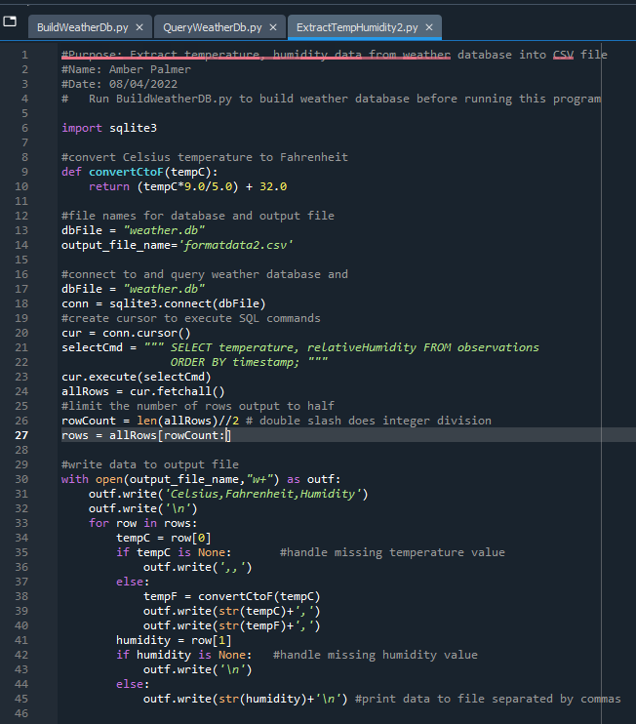
EXTRACTING THE TEMPERATURE AND HUMIDITY USING PYTHON CODE
Because there may be null or missing values, the code used retrieves only the temperature and humidity values and writes them to a comma separated values file.
Two files are created, formatdata.csv and formatdata2.csv, and the data is split in half between the two files.

Slide 18
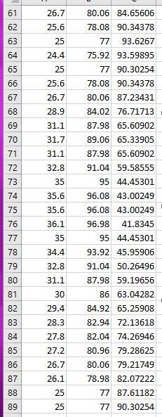
DATA FORMATED IN A EXCEL SPREADSHEET
The formatdats.csv file was created by the Python program and saved within the same folder as the Python code itself.
This code only contains three columns; Celsius, Fahrenheit, and Humidity.
Statistics can be performed on this data and represented in a graph or plot graph.
The screenshot on the right represent the 3 columns of data mentioned above.

Slide 19
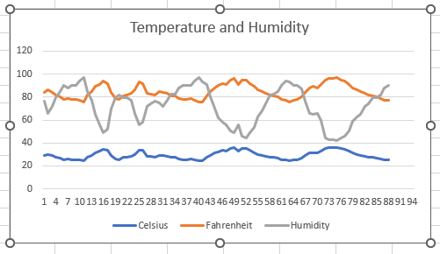
DATA VISUALIZATION
This screenshot is a line chart that was developed in excel showing the temperature and humidity of the period one saved in the formatdata.csv file.
The line chart represents Celsius with the blue line, Fahrenheit with the orange line, and Humidity with the grey line.

Slide 20
DATA ANALYTICS
Python Data Analytics allows for individuals to develop charts and graphs representing the data.
Pythons data analytic module uses Pandas and matplotlib.pyplot and is available with Anaconda.
There are several plots that can be generated using this data such as a boxplot, line graph, histogram and etc..
Using the line graph chart, a prediction was able to be made about the temperature and humidity relationship.

Slide 21
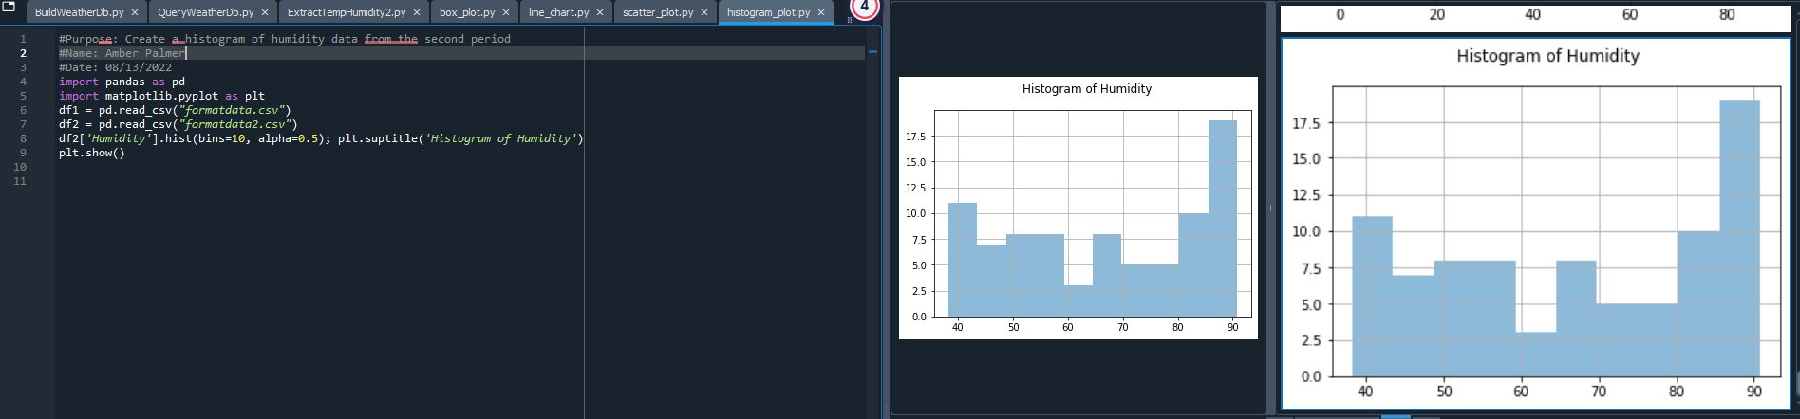
HISTOGRAM OF HUMIDITY
Below is the screenshot of the histogram chart representing humidity for the first set of data.
#Purpose: Create a histogram of humidity data from the second period
#Name: Your name
#Date: Your date
import pandas as pd
import matplotlib.pyplot as plt
df1 = pd.read_csv("formatdata.csv")
df2 = pd.read_csv("formatdata2.csv")
df2['Humidity'].hist(bins=10, alpha=0.5); plt.suptitle('Histogram of Humidity’)
plt.show()

Slide 22
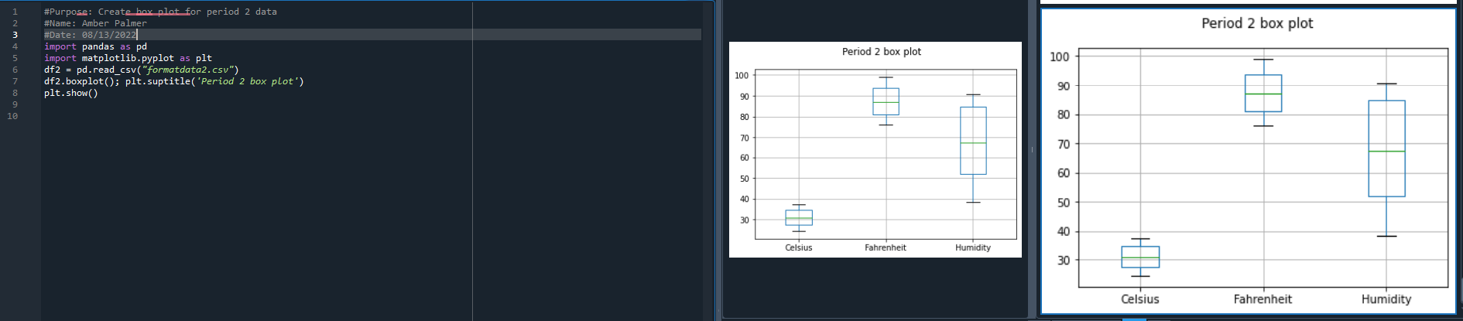
PERIOD TWO BOX PLOT
#Purpose: Create box plot for period 2 data
#Name: Your name
#Date: Your date
import pandas as pd
import matplotlib.pyplot as plt
df2 = pd.read_csv("formatdata2.csv")
df2.boxplot(); plt.suptitle('Period 2 box plot')
plt.show()

Slide 23
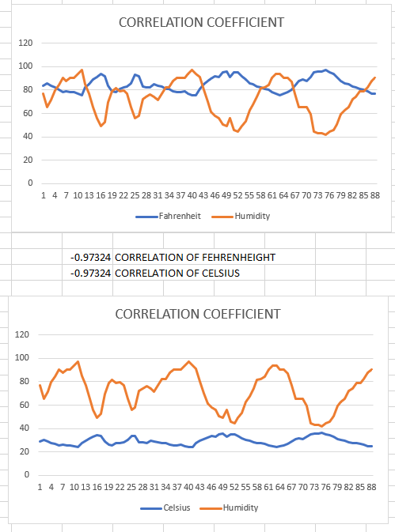
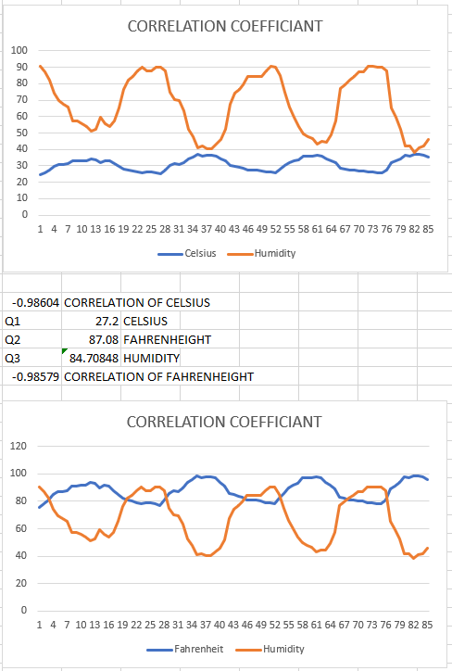
ANALYSIS
The next step in the analysis is to develop a question and then review the data listed in the different graphs to answer the question.
The question I asked was, “Is there a relationship between temperature and humidity? Can you prove your theory?
Using the correlation command in Excel I was able to create a line graph to represent the relationship between the humidity and temperature.
The screenshots show the temperature and humidity for both sets of data one and two. The formatdata1 file is shown on the left and the formatdata2 file is shown on the right.
The data shows that when the temperature is high, the humidity is lower, and when the temperature is low, the humidity is higher. The correlation coefficient for data set 1 is -0.97 and the correlation coefficient for data set 2 is -.098, which is a pretty close relationship as 0 represents no relationship at all.

Slide 24
CODE
#Purpose: Create Fahrenheit plot
#Name: Amber Palmer
#Date: 08/21/2022
import pandas as pd
import matplotlib.pyplot as plt
df1 = pd.read_csv("formatdata.csv") #baseline data is period 1 (older)
df2 = pd.read_csv("formatdata2.csv") #data for period 2 (more recent)
plt.figure(); df2.Fahrenheit.plot(label = 'Fahrenheit'); df2.Humidity.plot(label = 'Humidity'); plt.legend(loc='best'); plt.suptitle('Temperature vs Humidity')
plt.show()

Slide 25
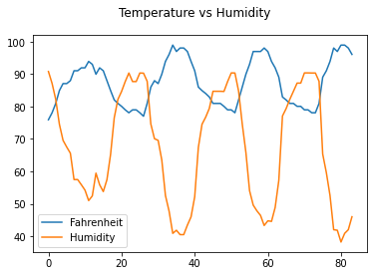
PREDICTION
The previous code compares Humidity to temperature in Fahrenheit. The blue line represents the temperature and the orange line represents the humidity. There are greater variations in humidity than there are in temperature.
After reviewing the results I predict that it is not the temperature that causes the change in Humidity rather than the time of the day, rain, and other factors such as geographical location.
I predict all these other factors will always cause the Humidity to varyfrom day to day.
Additional research can be performed to support this theory.

Slide 26
CHALLENGES
Some of the challenges I faced, and there were numerous, was finding a zip code in my area that would provide enough data to represent in Excel to create the charts with.
The process of learning Spyder and how the functions work.
Applying the commands in Excel such as =CORREL in the actual spreadsheet. I think it took me a short minute and a Google search to figure out how that worked. I never even knew that the Excel spreadsheet could be given input in the command form.

Slide 27
CAREER SKILLS GAINED
Several career skills were obtained throughout this project.
Communication and organization with creating Flowcharts to represent the plan and direction of the chart.
Programming using Python, and being able to import library packages.
Database development.
Data Cleansing.
Analytics of different charts to help make an educated prediction.

Slide 28
Conclusion
Building this project helped give me hands-on experience with all the topics taught throughout the course.
This project covered the Fundamental topics of programming with data by using the data collected from the cloud service to perform data analytic operations.

