Slide 1
Fundamentals of Infrastructure Security
Final Project
Amber Palmer
SEC290
Prof L.Burnette

Slide 2
CONTENTS
Threat Intelligence and Reconnaissance
Vulnerability Management Program and Vulnerability Scans
Cloud Security, Infrastructure Security, and IAM Security
Software Development Security, Security Monitoring, and Incident Response Program
Indicators of Compromise and Forensic Analysis
Risk Management, Policy, and Compliance

Slide 3
Introduction
In this final project, I am pulling together all previously created projects to demonstrate the skills I have learned throughout the course. Through the Fundamentals of Infrastructure Security course, I have developed the foundation of understanding which better prepares me for a career in Cybersecurity. New technologies and applications are being developed on a regular basis, creating an abundance of new job opportunities. This understanding is demonstrated through different labs represented in weekly projects.

Slide 4
Threat Intelligence and Reconnaissance
In this module, I will demonstrate the manual process of discovering vulnerabilities using nbtscan to enumerate a machine. When trying to discover vulnerabilities you should use several different techniques. Next, I will use the Nmap scripting engine tool to locate the MS08-067 vulnerability in the Windows 7 machine. Finally, I will use the exploit command in Metasploit to gather details about the target host.

Slide 5
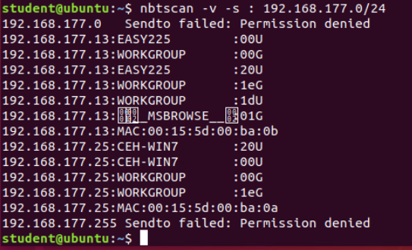
Manual Vulnerability Discovery using nbtscan to enumerate the machines. The two machines that I will target are the Easy running Windows Server 2003 and the CEH running Windows 7.

Slide 6
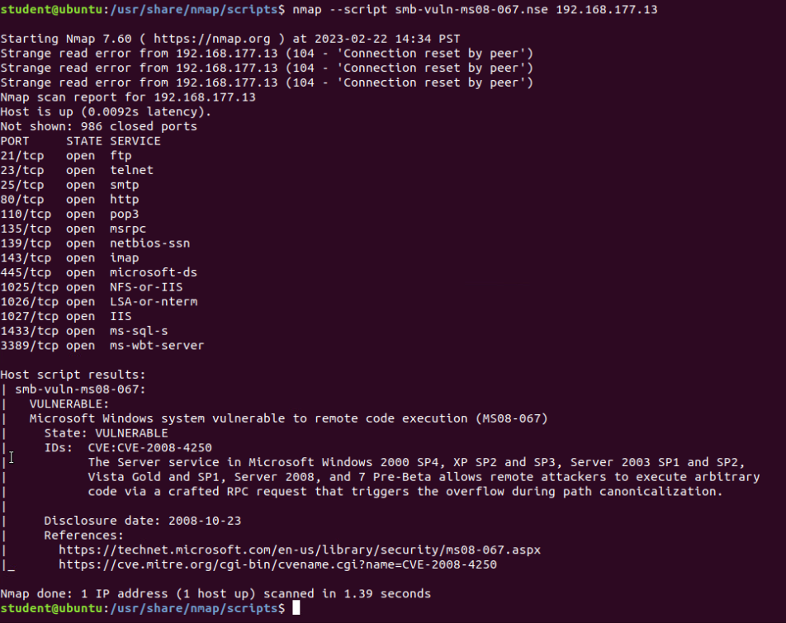
Using the Nmap –script command, I have shown that the Microsoft machine is vulnerable to the MS08-067 vulnerability.

Slide 7
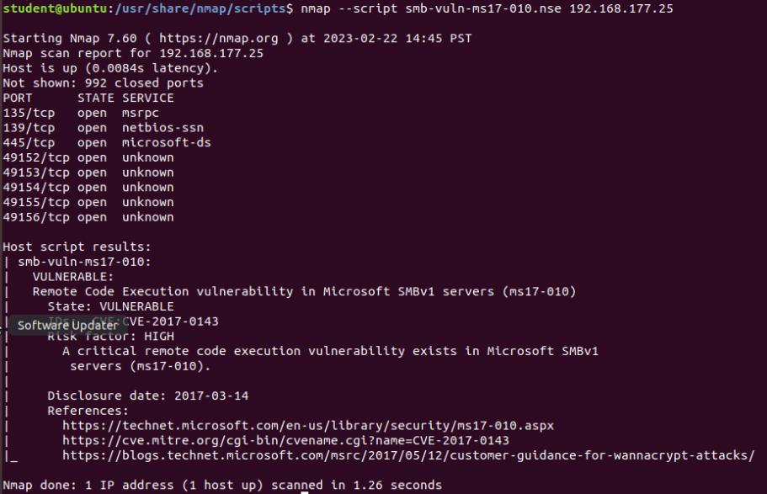
Using the same Nmap command to show the second target is also vulnerable to the MS17-010 vulnerability.

Slide 8
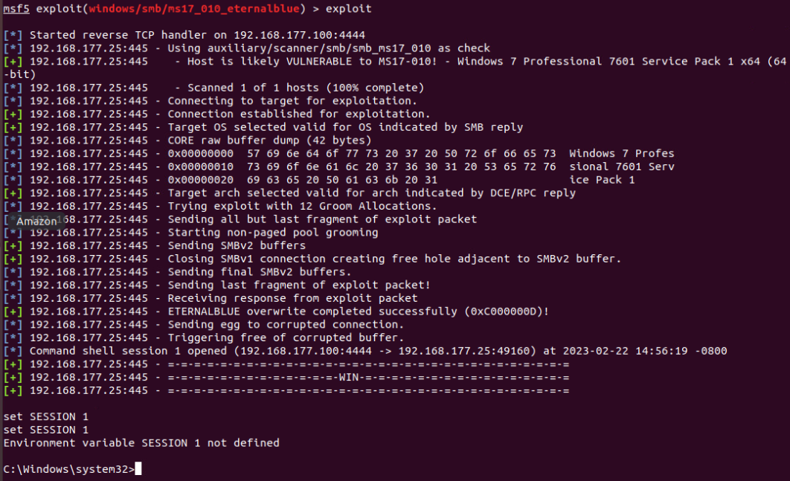
Using the exploit command in the msfconsole I was able to gain access to the Windows Machine. Notice the Windows command prompt at the bottom.

Slide 9
Intrusion Analysis using Wireshark
In this module, I will conduct fundamental protocol analysis activities including basic protocol analysis, using display filters to extract data, common attacks, and basic attack analysis. The following slide will answer questions pertaining to the lab on Basic Attack Analysis to demonstrate my understanding of the task that was completed.

Slide 10
1. Look at capture no. 20 and 22. (You can use the “Go” link at the top of the Wireshark screen to quickly go to a specific capture) Both packets are ICMP traffic but there are subtle differences between them. Compare the time-to-live and data field sizes in the two packets. What differences do you see?
The packet number 20 TTL is 64 and the data field size is 56 bytes.
The packet number 22 TTL is 128 and the data field size is 32 bytes.
2. Do a little Internet research to discover which operating systems use the specific values in their ping commands. What operating system generated the echo request in capture 20?
Linux, macOS, and a few other OS use the TTL value of 64 for ICMP protocols. I am going with Linux, packet 22 is windows
3. Review packet no. 37 and beyond, what do you think is taking place here?
A DDoS attack is flooding the target.
4. Look at capture 22846. What is suspicious about the flag settings in this packet?
The FIN flag is being sent in response to the RST, ACK flag
5. What is the IP address of the host being targeted?
192.168.25.1

Slide 11
Cloud Security, Infrastructure Security, and IAM Security
In this module, I explored manual Open SSL analysis by creating and testing an SSL/TLS file. I start by creating the public and private keys that will be used for the encryption of all secure traffic using different openssl commands. After the certificate and key are created, I will access the web page from the terminal while monitoring traffic with Wireshark. It is important when issuing commands to use the correct version so the authentication is the same or an error will occur. The next two slides show the GET request and the decrypted version of the SSL stream.

Slide 12
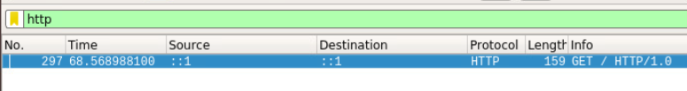
The HTTP filter in Wireshark narrows the results to help see the GET command.

Slide 13
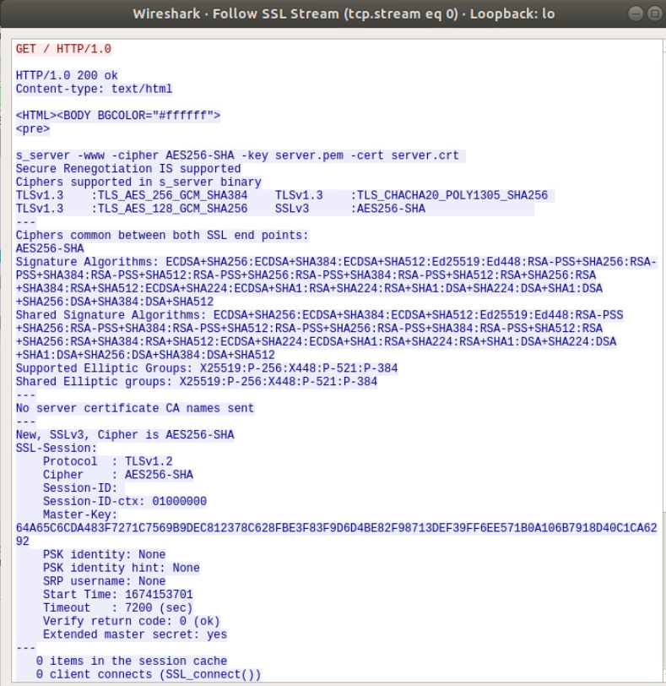
The decrypted SSL stream from Wireshark

Slide 14
Software Development Security, Security Monitoring, and Incident Response Program
This module explores Snort, which is an open-source intrusion prevention system (IPS). The Snort IPS uses a series of rules to help define malicious network activity and then uses those rules to identify packets that match them and generate alerts for administrators. Snort has three primary uses such as a packet sniffer, a packet logger, and it can be used as a full-blown network intrusion prevention system. In the next couple of slides, I will demonstrate testing and creating Snort Rules.

Slide 15
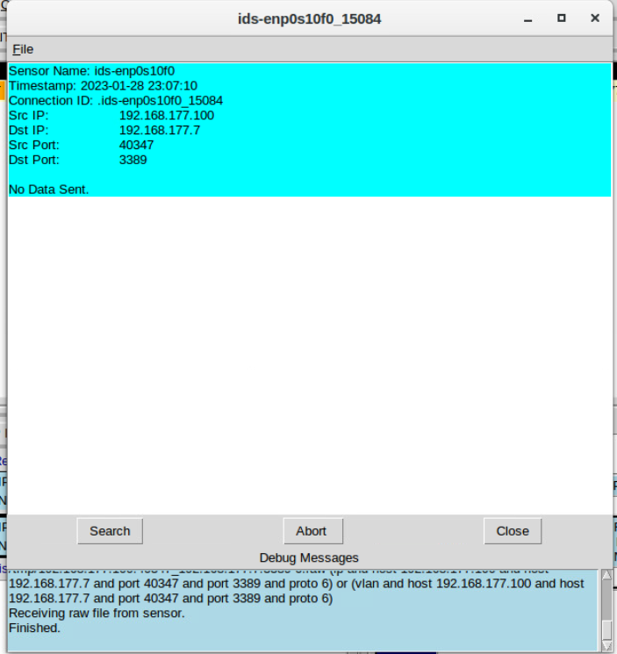
This is the transcript of the XMAS scan alert

Slide 16
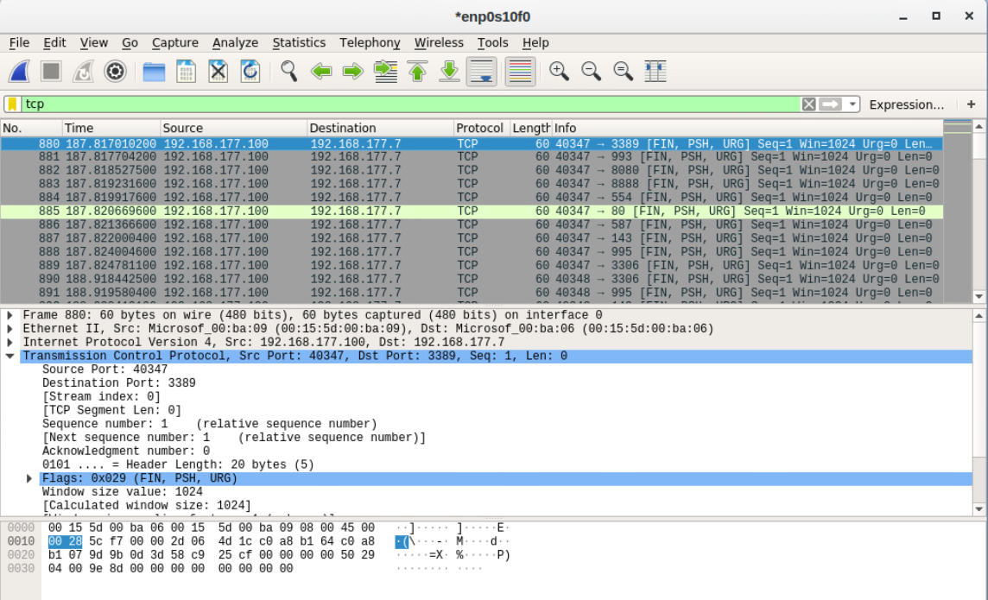
TCP packets generated by the XMAS scan.

Slide 17
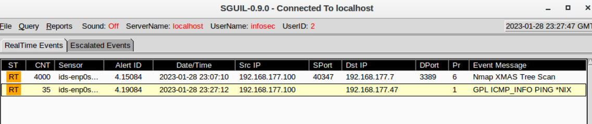
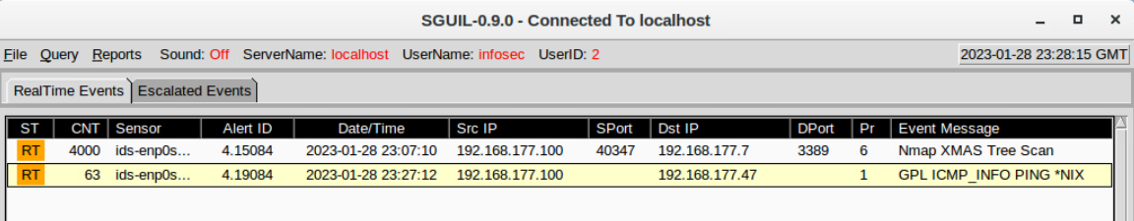
Ping activity alert

Slide 18
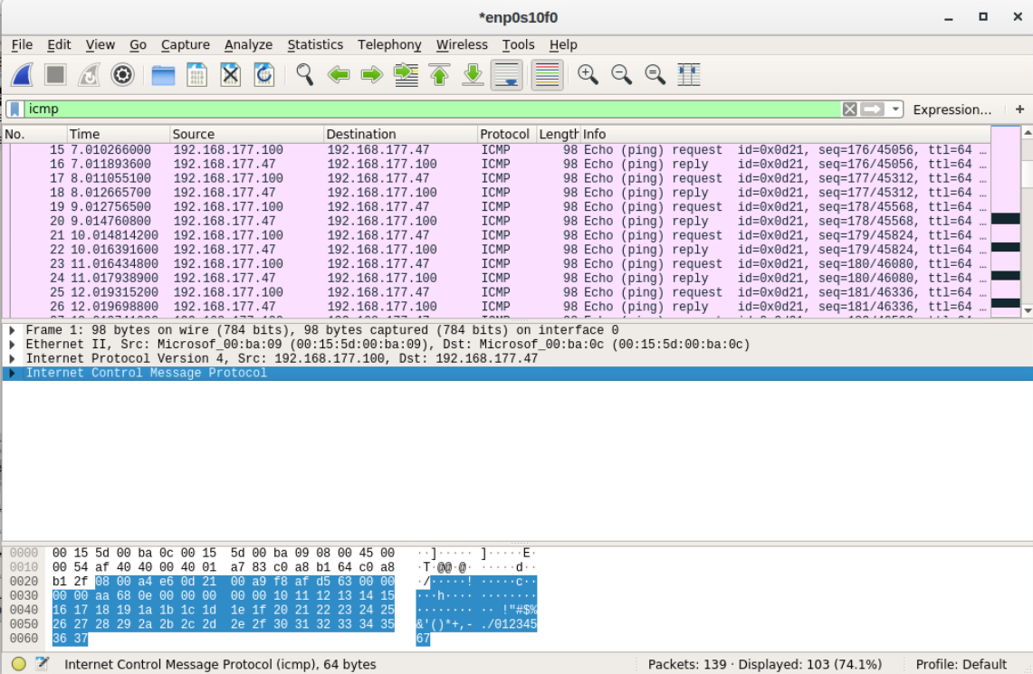
ICMP packets generated by the ping activity

Slide 19
Indicators of Compromise and Forensic Analysis
This module reviews the process of memory analysis which is a vital form of cyber investigation that allows an investigator to identify unauthorized and anomalous activity on a target computer or server. This is usually achieved by running special software that captures the current state of the system’s memory as a snapshot file, also known as a memory dump. The basic built-in tool for this task is ps (Process Status) which is a command line utility that is used to display or view information related to the processes running in a Linux System.

Slide 20
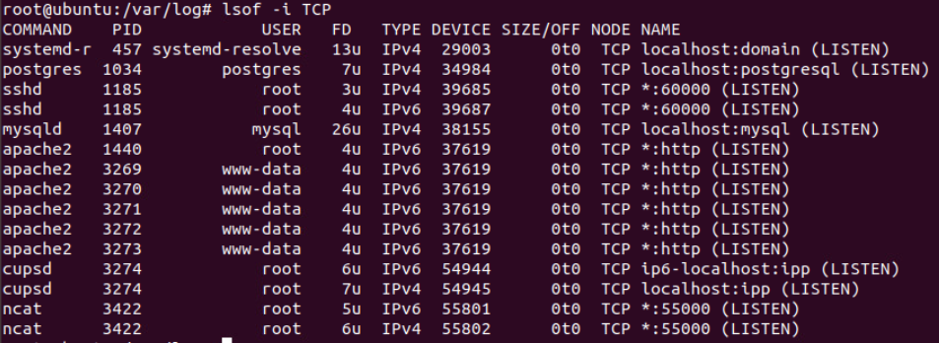
This image shows port 55000 open for both IPv4 and IPv6.
Linux Processes were described in the intro.

Slide 21
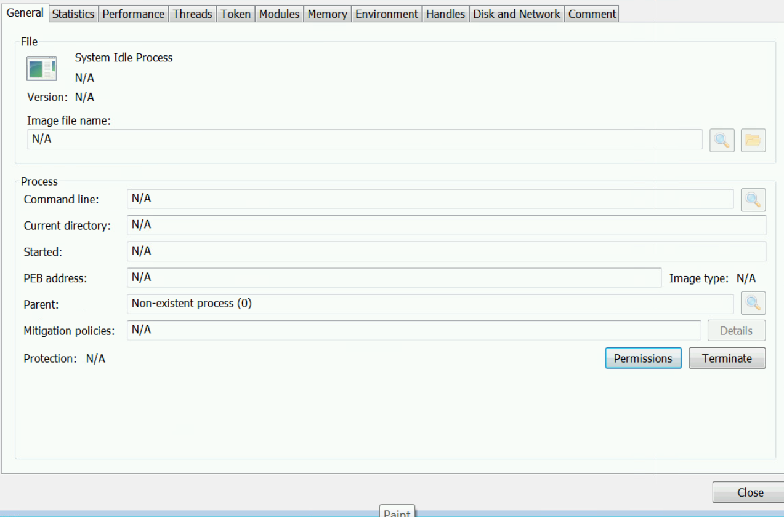
Process Hacker is a powerful tool that provides info about different processes. Here is
properties of a chosen process.

Slide 22
Process Monitor is a troubleshooting and data collection tool used by many systems administrators as well as Microsoft’s support organization. This image shows ifFaceName in the Path column and Data: Roman in the detail column.

Slide 23
Risk Management, Policy, and Compliance
In this module, I configure the iptables for the network utilizing different methods such as configuring the rules for accessing the virtual machine that is in the Demilitarized Zone (DMZ). A black hole route is a network route that goes nowhere to force an attacker down a specific path. A bogon is a packet that contains an IP address that isn’t in the range allowed for public internet use and there is no reason such a packet should appear from an internet host and if it does it is likely forged. A stateful firewall is a firewall that checks the states of incoming packets and decides to allow them through the firewall based on their state. NAT is a firewall feature that changes the IP address of incoming or outgoing packets so that multiple internal systems can be mapped to the same public IP address.

Slide 24
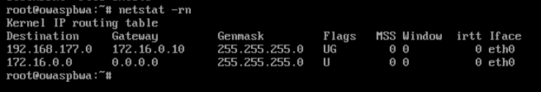
The Output of the DMZ Route Table output

Slide 25
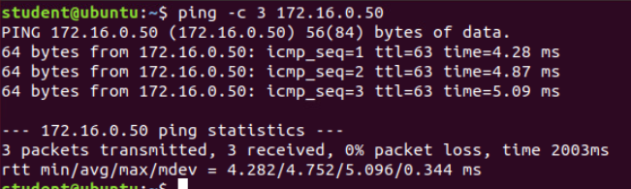
Here is a successful ping from the Ubuntu Web VM and the DMZ VM.

Slide 26
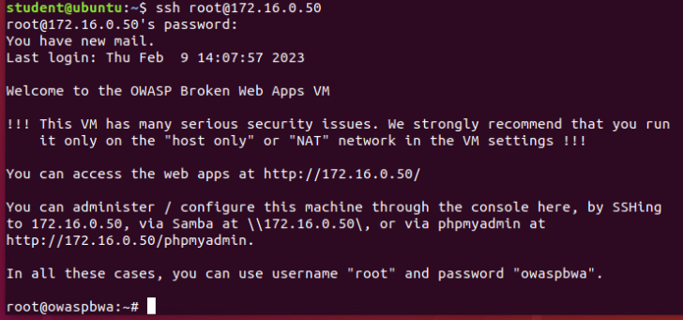
Here are two time-based access rules in the FORWARD chain.

Slide 27
Challenges
I experienced numerous challenges throughout this project such as missing certain single-letter commands in the string of commands. Some of them sure can get long. Another issue I had was not giving the commands enough time before executing the ping commands. Regardless of the challenges I may have faced, I always managed to go back and read the instructions with a little care or Googled something I wasn’t sure I really understood to see if I could find an explanation in different wording. Cybersecurity is not just about what you know but about finding the answers to the things you don’t.

Slide 28
Career Skills
This course has taught me many different skills such as vulnerability scanning, data analysis, Wireshark scanning, how to set iptables, and so much more. This course has taught me many different security tools and concepts I will need to be successful in Cybersecurity. I also have a better understanding of how to think like a hacker and what to look for when being attacked inside an organization.

Slide 29
Conclusion
This project covers the Fundamentals of Infrastructure Security. It includes activities such as configuring firewall rules, deploying Snort sensors for network intrusion detection, exploring SSL encryption, analyzing traffic to detect attacks, exploiting Microsoft vulnerabilities, and conducting live memory analysis. It lays the foundation for my understanding of cybersecurity and prepared me for a career in the cybersecurity field.

