Slide 1
Final Project
SEC285
Amber Palmer​

Slide 2
AGENDA
Preparation
Asymmetric Key Encryption
Stateful Firewall
Bring Your Own Device(BYOD) Security Policy
Multi-Factor Authentication (MFA) Submission
Vulnerability Assessment Submission

Slide 3
INTRO-DUCTION
Throughout this course project, I will demonstrate some of the fundamentals of Information Security. Using the Microsoft Hyper-V environment with Kali Linux VM, Ubuntu VM, and Metasploit Linux Server VM, I will execute encryption and decryption of Asymmetric Keys, harden a Linux server by setting up a stateful firewall, establish multifactor authentication (MFA), and perform a vulnerability assessment utilizing multiple tools such as NMAP, Netcat, and Wireshark. Outside of demonstrating Information Security inside the Hyper-V, I will also demonstrate security by developing a BYOD Security Policy to represent an organization’s expectations regarding the proper usage of their computing resources.

Slide 4
Preparation
In this section of the project, I will execute the proper start-up and shutdown process of the Microsoft Hyper-V environment that will be providing access to the Kali Linux VM, Ubuntu VM, and the Linux Server VM. Inside these Virtual Machines is where I will execute and test a range of Security Fundamentals.

Slide 5
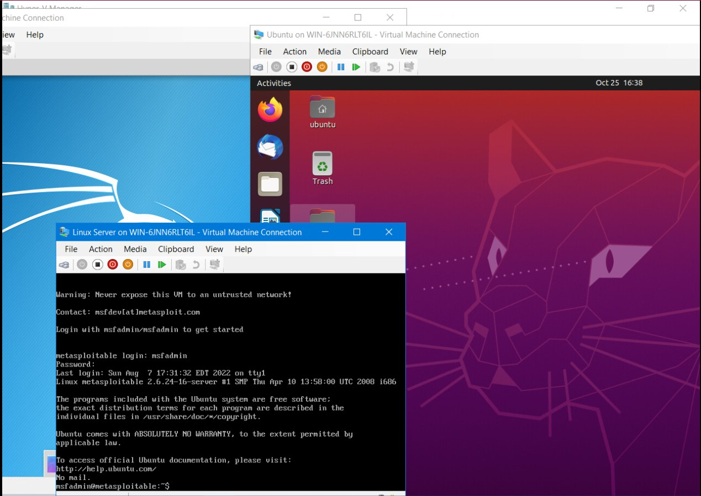
Start up of Machines

Slide 6
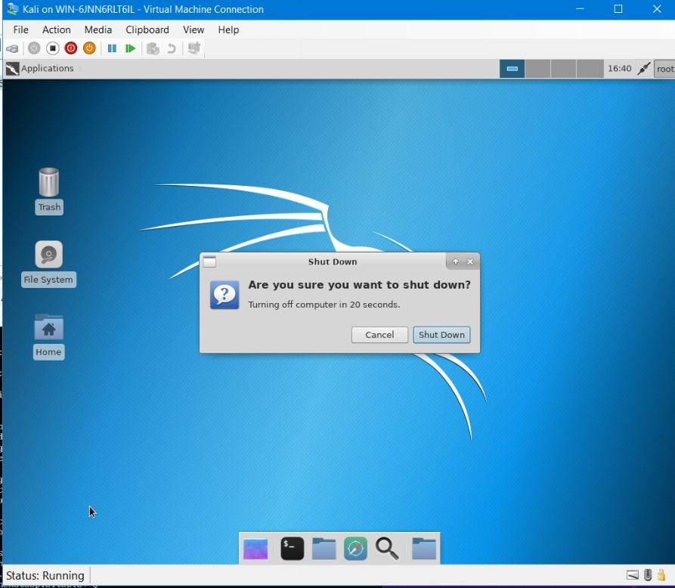
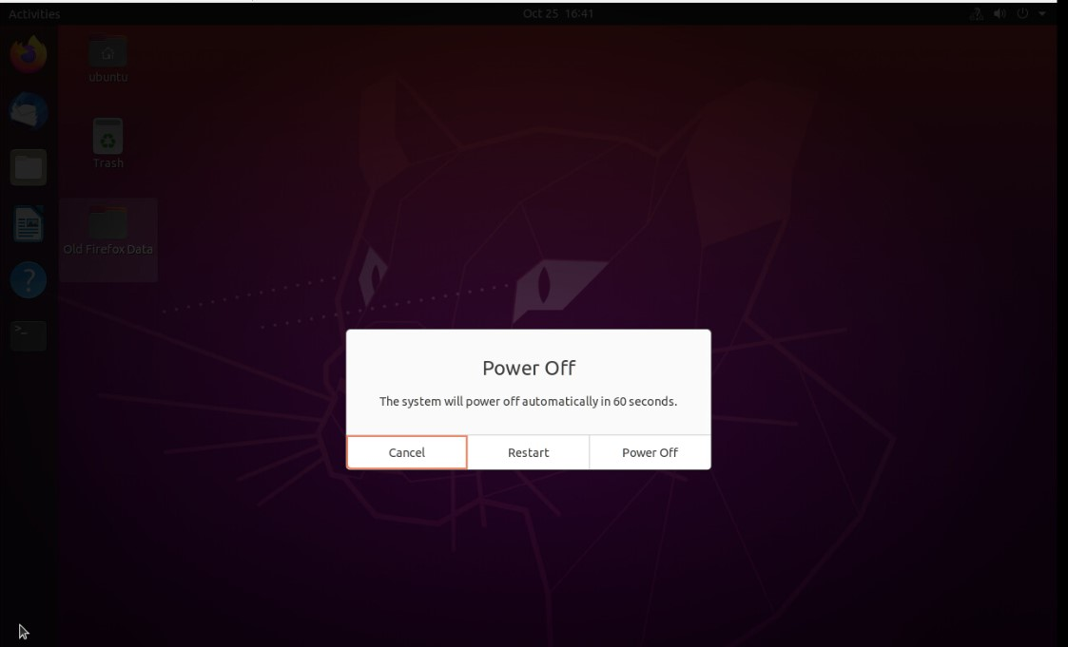
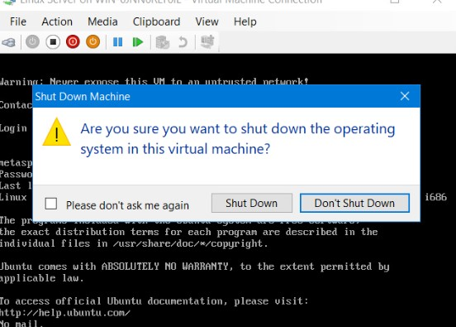
Shutting down machines

Slide 7
Asymmetric key encryption
Secure file management is implemented to mitigate risk to enterprise data assets. In order to encrypt data at rest and enforce forensic deletion of files I will implement asymmetric key encryption using GPG and then permanently delete files using the shred command. GPG is an open-source implementation of the pretty good privacy (PGP) asymmetric encryption protocol that uses a pair of public and private keys to encrypt and decrypt your files.

Slide 8
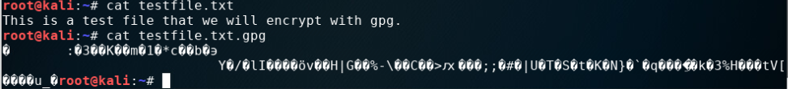
File encryption
The first executed command shows the plaintext form of the file, and the second executed command shows the encrypted form of the file using GPG.

Slide 9
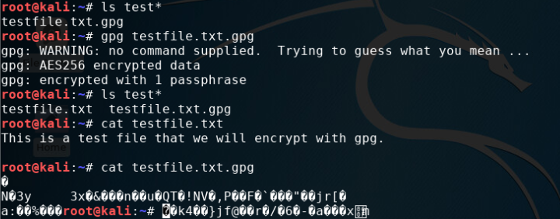
File decryption
The ls test* command shows the encrypted file by itself, followed by the decrypting process, and ends with the testfile.txt showing decrypted and testfile.txt.gpg showing the encrypted state.

Slide 10
Stateful firewall submission
Firewalls are used to protect enterprise computing resources from attacks by allowing access from approved hosts only. In this section, I will demonstrate how to harden a Linux server by deploying a stateful firewall with iptables. Most enterprises use applications that fall into two categories, Transmission Control Protocols (TCP) and User Datagram Protocol (UDP) with UDP being a connectionless protocol and TCP being connection-oriented. A three-way handshake is required between two endpoints in order for the session to be established. Default settings of these connections leave ports open that can be attacked by cybercriminals, leaving corporations vulnerable. Implementing the IP table rules only allows web (http/https), email (SMTP), name resolution (DNS), and SSH services to be open.

Slide 11
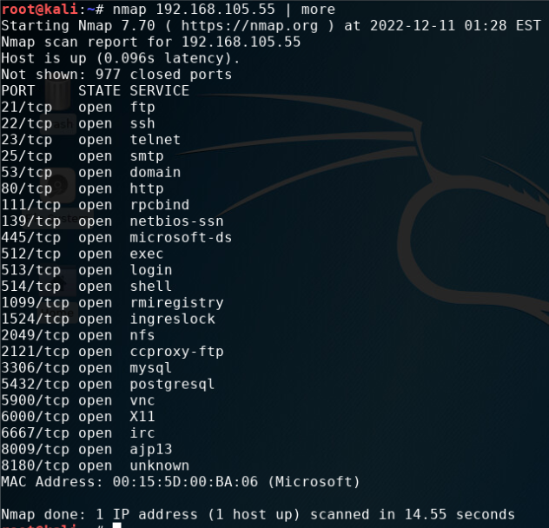
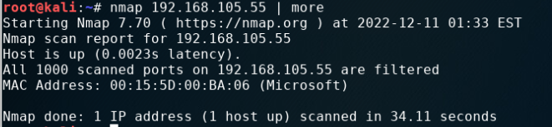
What effect does the sudo iptables --policy INPUT DROP command have on the access to computing resources?
The first scan showed many ports that were open. After running the above command no ports reflected opened because the above firewall rule dropped all incoming connections to the Linux Server.
(Before)
(After)

Slide 12
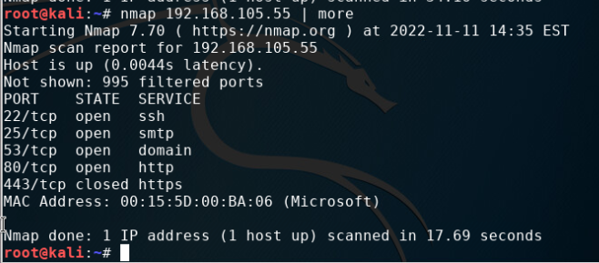
Nmap scan
This screenshot shows the Nmap scan after all iptable rules were implemented

Slide 13
BYOD security policy
A security policy is a high-level set of documents that establishes standards of an organization’s expectations regarding the proper usage of their computing resources by specifying what behaviors are acceptable and which behaviors are not acceptable while utilizing organizational computing resources. It is important for security practitioners to be familiar with designing effective security policies to protect the organization’s resources, networks, and devices.

Slide 14
BYOD Security Policy
ABC Corporation
Overview
BYOD is a current industry trend that allows employees the ability to use their own laptops, tablets, and smartphones to connect to the internal network of ABC corporation. Starting in 2010 Android started picking up and the release of the first iPad helped pave the way for corporations to implement BYODs but without much support. In 2011, BYOD programs and official support were implemented in the workplace and at a much faster pace. Due to the COVID pandemic, 85% of organizations implemented BYOD policies. Companies that are implementing BYOD make an annual savings of $350 per year, per employee. Before COVID, Intel reported in 2014 that 70% of their 80,000 employees were using their own devices for company work. This new revolution does not come without risks, such as a lack of antivirus or firewall software, stolen or lost devices, and employees leaving the company with company data on their personal devices. The MDM tool utilized is Miradore.
Purpose
Threats are often beyond our control, but vulnerabilities can be managed to help reduce risk. Inventory of all devices connected to ABC corporation will help in conducting vulnerability assessments and removing any unknown devices identified on the network. Working with software developers and hardware manufacturers will help the company in being vigilant in identifying and patching software and hardware vulnerabilities. Employees must be trained in identifying what hyperlinks and phishing emails might lead to malware being introduced to the network. BYOD must be enrolled in the Mobile Device Management platform to allow the company to track and have a level of management over the connected devices. Malware protection establishes and maintains malware defenses to detect and respond to known attack codes.

Slide 15
Scope
All individuals within the ABC corporation must comply with all BYOD policies and be approved by the security team prior to use or connection to the network. iOS devices, Android devices, and Windows devices are allowed once they are verified by the security team. Once the investigation on said devices has been completed, a formal letter of approval will be given and a BYOD Security Policy must be signed for each device joining the network that will be used to access the company’s data. The Mobile Application Management tool will deploy in-house developed software, third-party software applications, and volume-licensed applications from Apple’s App Store and Google Play. A Mobile Identity (MI) tool is used to ensure that only trusted devices and users have access to the network infrastructure. The EMM suite also provides access controls for company files, data loss protection, file sharing rules, cut/paste restrictions, digital rights management, and containment. All devices must be presented to IT for proper job provisioning and configuration of standard apps, such as browsers, office productivity software, and security tools before they can access the network.
Policy
ALL BYOD DEVICES ARE SUBJECT TO SECURITY ASSESSMENTS PRIOR TO ACCEPTANCE TO ABCs CORPORATION’S NETWORK. No iOS or Android device may be jailbroken or rooted. Any BYOD device such as mobile devices, laptops, and tablets must be updated to the newest version and any patches available installed, screen locks must be applied, network configurations must ask to join a network and not be set to automatically connect to available networks, employees and leadership may only download pre-approved apps from the devices app store, encryption of the device must be utilized, use of up-to-date antivirus software were applicable, and may not have passwords remembered by any web pages or apps installed on the device. Additionally, Android devices must have KNOX implemented on the devices along with a hybrid model of Mobile Device Management (MDM). IT staff will use the MDM tool to enforce and confirm compliance with the acceptable use policy (AUP). Passwords must be 20 characters long and include one number, one upper-case letter, and one symbol.

Slide 16
Policy Compliance
Any employees and leadership found to have violated this policy may be subject to disciplinary actions up to and including termination of employment. The company reserves the right to disconnect devices or disable services without notification
Related Standards, Policies, and Processes
Health Insurance Portability and Accountability Act (HIPAA) is a federal privacy rule that establishes national standards to protect an individual’s medical records and other individually identifiable health information.
Payment Card Industry Data Security Standard (PCI-DSS) applies to all entities that store, process, and/or transmit cardholder data. It covers technical and operational system components included in or connected to cardholder data.
California Consumer Privacy Act (CCPA) imposes substantial duties on entities or persons that collect personal information about or from a California resident.
Virginia’s Consumer Data Protection Act (CDPA) requires companies covered by the law to comply with rules on the data they collect, how it’s treated and protected, and with whom it’s shared.

Slide 17
Definitions and Terms
Enterprise Mobility Management (EMM) – a suite of tools that includes MAM tool that deploys verified apps and software along with Mobile Content Management tool to provide controls to company files, dtata loss protection, file sharing rules, cut/paste restrictions, and digital rights management.
Containment- is used to encapsulate personal data from business data.
Miradore- is a free online solution for MDM management that supports Android, iOS, Windows Phone, Windows desktops and laptops with an unlimited number of device registrations.
Acceptable Use Policy (AUP) – informs users how they are expected to use their devices and software regarding company work.
Revision History
Date of Change | Responsible | Summary of Change
August 2019 | Sans Policy Team | Updated and converted to new format
November 2022 | Amber Palmer | Updated and Defines Policies and Restrictions

Slide 18
Multi-factor Authentication (Mfa)
Multifactor Authentication uses a combination of a one-time password (OTP) and a regular password to mitigate the security risk of using a single sign-on (SSO) password within organizations. Using an SSO password simplifies the authentication process of an end-user but does not provide any security measures. The Google Authenticator app is available on Android and iPhone and can be found in the device’s app store. Once the authenticator app is configured, on my device and within Ubuntu, I will be prompted to provide the one-time password before logging in with my personal password.

Slide 19
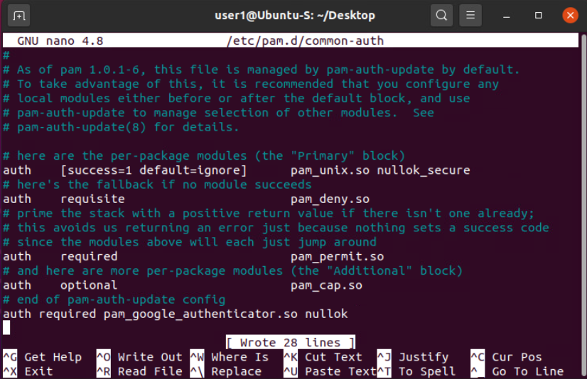
Common-auth configuration file
This image shows the file that was assessed to configure the Google Authentication app by entering the command listed at the bottom of the file. To complete the setup of the app issue the command, google-authenticator, and complete the next steps.

Slide 20
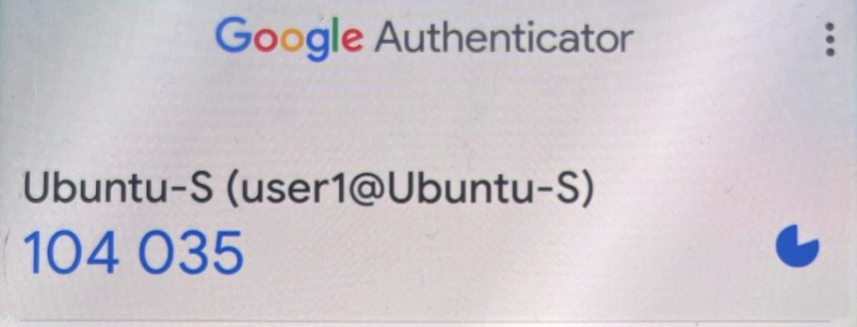
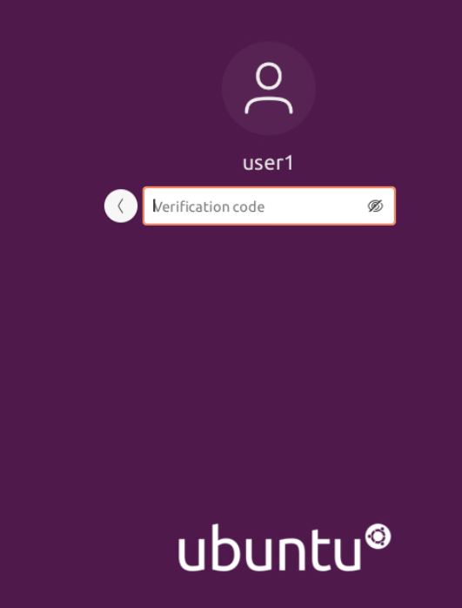
Mfa log-on screen
(Google Auth App)
(MFA Login using Google Authenticator)
Once the configuration process is complete and the QR code is scanned through the application set-up process the authenticator app and Ubuntu login page will sync. If the code changes on the app before hitting enter on the Login page, the code will have to be updated to the newly generated code. This code changes every 30 seconds. As shown in this image, your personal password needs to be submitted first, and then the OTP request will be required next.

Slide 21
Vulnerability assessment
Tools such as NMAP, Netcat, and Wireshark are used inside Kali Linux by security practitioners to conduct vulnerability assessments. NMAP is a tool that can be used to identify IP addresses that are being used on a network segment for devices that are currently running. The Netcat tool can be used to get more information, such as the version, of FTP, SSH, and SMTP applications that were discovered using NMAP. Wireshark is a packet sniffing tool that can be used to analyze network traffic in order to gain insight into client and server applications. Nessus Essentials is a free vulnerability scanner that provides a GUI interface and an entry point for a vulnerability assessment.

Slide 22
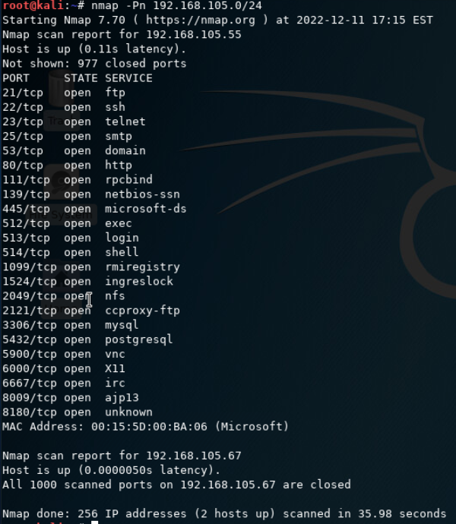
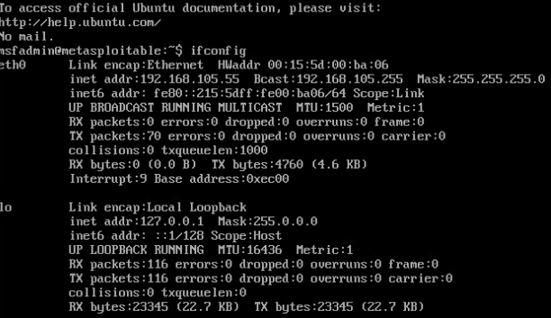
nmap
Shows the IP address of the Server and the open ports.
The IP address of the Linux Server VM is listed below.

Slide 23
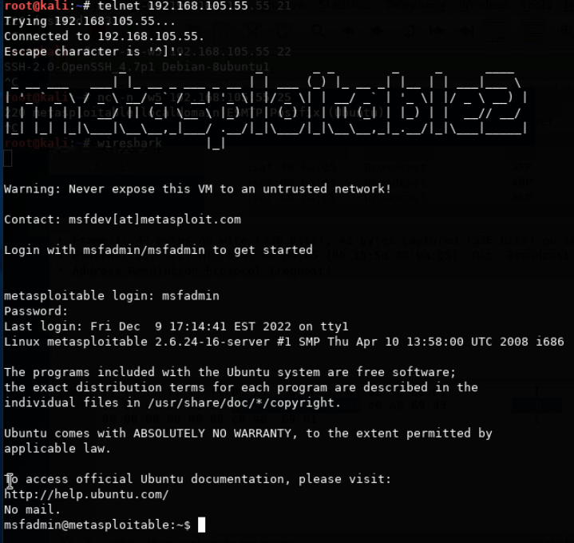
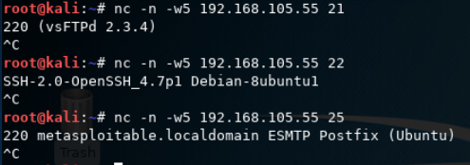
Netcat
Utilizing telnet to access the Linux Server VM to generate login data for Wireshark to capture.
The below screenshot reflects the command telling Netcat to ignore name resolution, waiting no more than 5 seconds, on IP address 192.168.105.55 21 for the port number, and so on. Port 21 is FTP, 22 is SSH, 25 is SMTP. The version of each application is listed below the command.

Slide 24
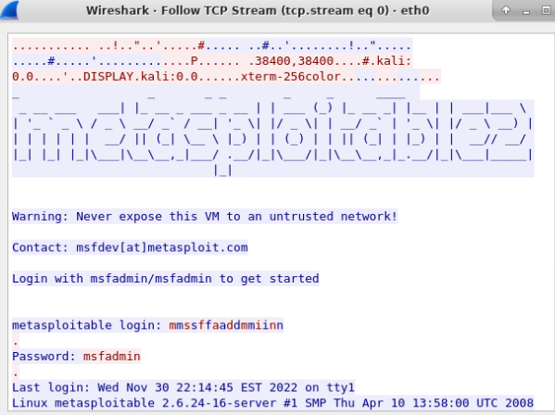
wireshark
Wireshark is a packet-sniffing tool that was used to capture the Server Login credentials. Once the packets were captured, I filtered the results by typing telnet in the filter bar and viewed the TCP stream revealing the Linux Server VM’s login credentials.

Slide 25
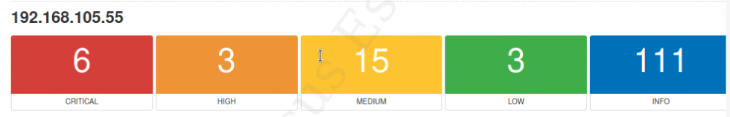
nessus
Nessus Essentials is a vulnerability scanner that provides an entry point for vulnerability assessment by performing a basic network scan by specifying an IP address, hostname, or subnet. For this scan I used the Linux Server VM’s IP address of 192.168.105.55. Viewing the report by the HTML option will reflect the results listed bellow.

Slide 26
challenges
I worked through many challenges throughout this project such as remembering which applications run on their specific ports. Processing commands through the tools utilized through vulnerability assessments. Wireshark also has a lot of moving parts and running the correct applications while viewing the specific packets to view login information for a server on the network. I have gained so much knowledge and appreciation during this project simply from overcoming the challenges I experienced.

Slide 27
Career skills
Through this project, I was able to gain hands-on experience in numerous subjects such as encrypting data at rest by implementing asymmetric key encryption using GPG, hardening a Linux Server by implementing IP table rules that only allow HTTP/HTTPS, SMTP, DNS, and SSH protocols. Developing a security policy will help educate employees on the proper use of enterprise computing resources, networks, and devices. MFA also gives an extra layer of protection, being able to implement MFA security at a Linux level is a must in this era. The skills I enjoyed the most are the tools used to get current versions of the servers (Netcat), verify open port numbers and applications (NMAP), analyze network traffic to capture the server login information (Wireshark), and the vulnerability scanner used through a graphical interface in order to gain entry point for a vulnerability assessment.

Slide 28
conclusion
Fundamentals of Security is the most important step in protecting and understanding the challenges we face in the Cyber World today. Networks, devices, and corporations must have a multitude of security measures in place to protect all factors that will eventually arise. Having a firm understanding and ability to carry out vulnerability assessments by gathering information from tools utilized in Kali Linux or by Nessus. This project is a firm demonstration of my ability to execute the required skills to gain information from unsecured networks.

Slide 29
references
All of the information used in my Project came from the Project Guides.
Security Policy https://nationalcybersecuritysociety.org › 2019/05

Slide 30
THANK YOU
Amber Palmer
LINKEDIN: linkedin.com/in/amber-wilkins-998519220/
WIX: awilkins8385.wixsite.com/my-site

