Slide 1
CEIS114 Final Project
Smart Traffic Light Controller
October 2022
Amber Palmer

Slide 2
Introduction
This course project covers the fundamental concept of the IoT by integrating hardware, software, and networks into a whole system. In this project, we will focus on the development of an IoT device to simulate a multiple-traffic controller system utilizing ESP32 Microcontroller, Motion Sensor, and a push button to signal walking or emergency personnel. The design and development process of the device includes planning, hardware setup, programming, and networking. The following slides will represent every step of the way. The next few slides represent the supplies needed to complete the project and building it one step at a time.

Slide 3
Next, I will represent the equipment needed to complete the project, connecting the ESP32 to 2 of the breadboards, and scanning for WIFI networks using the wifi scan option in Arduino.

Slide 4
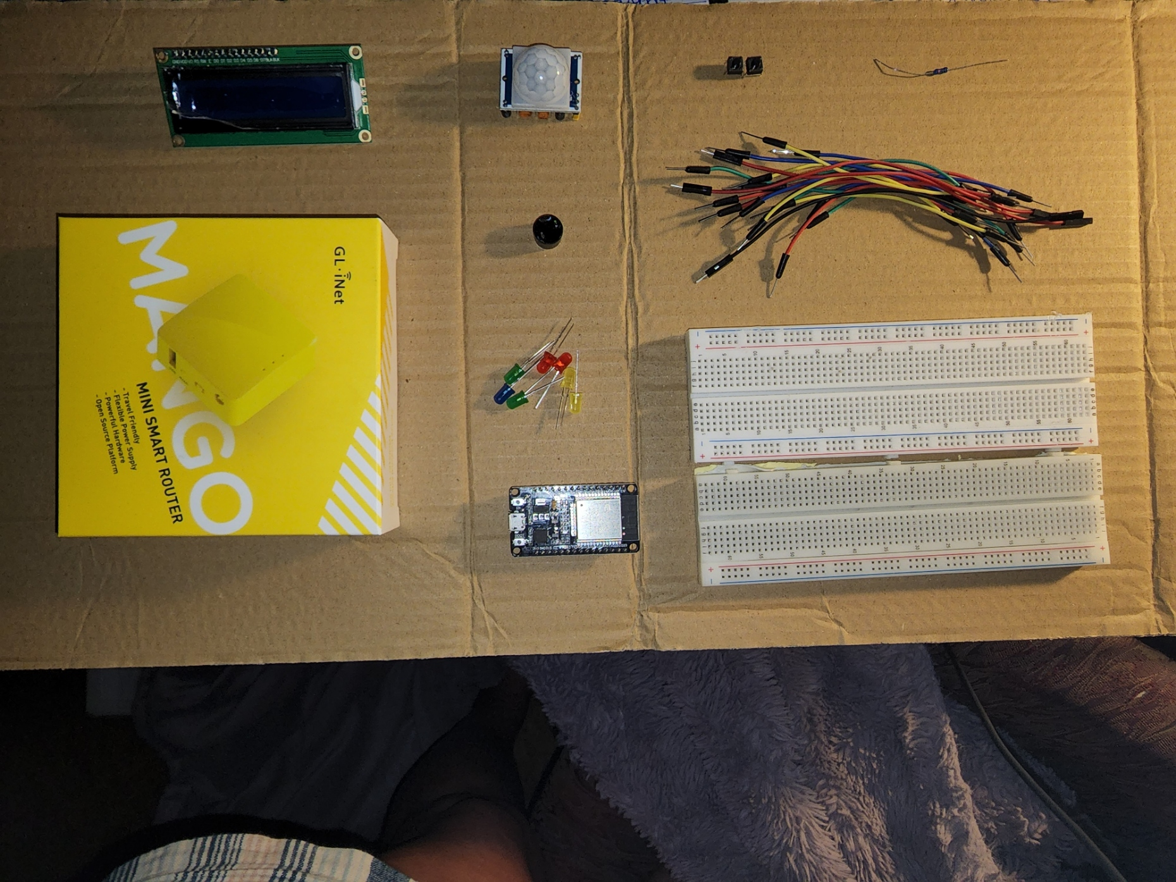
Inventory
ESP32 Board
Red, Yellow, Green, and Blue LED lights
220 Ohm resistor (optional)
Wires
Breadboards (2)
LCD unit with 12c Adapter
Active buzzer
Mini Router (if you do not already have one)
Push buttons (2)
PIR Motion sensor

Slide 5
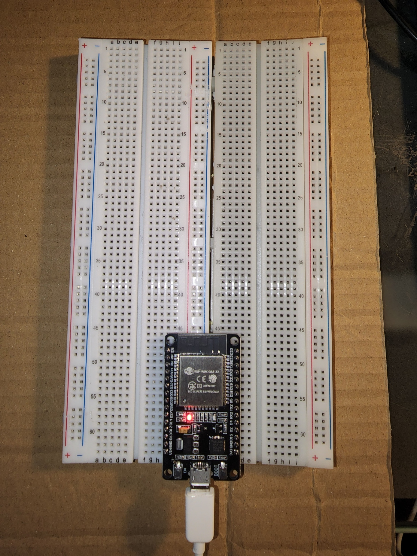
ESP32 Powered On

Slide 6
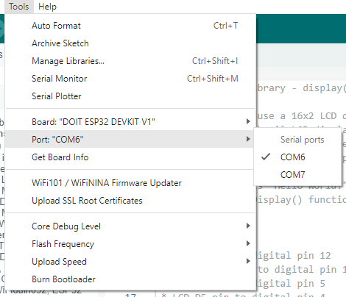
Installation of Arduino IDE with port selected from the tools menu

Slide 7
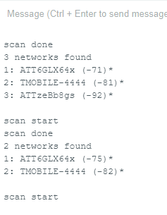
ESP32 WiFi scan displayed in the serial monitor

Slide 8
Creating the traffic controller
In this phase of the project, I will start to build the traffic controller. I use the ESP32 microcontroller and the two breadboards it is still connected to, and add some wires to connect the Red, Yellow, and Green LED lights. I could have also added 220 Ohm resistors, but I chose not to simply because there are so many other parts we are adding to the breadboards and I felt like it was becoming a little crowded.

Slide 9
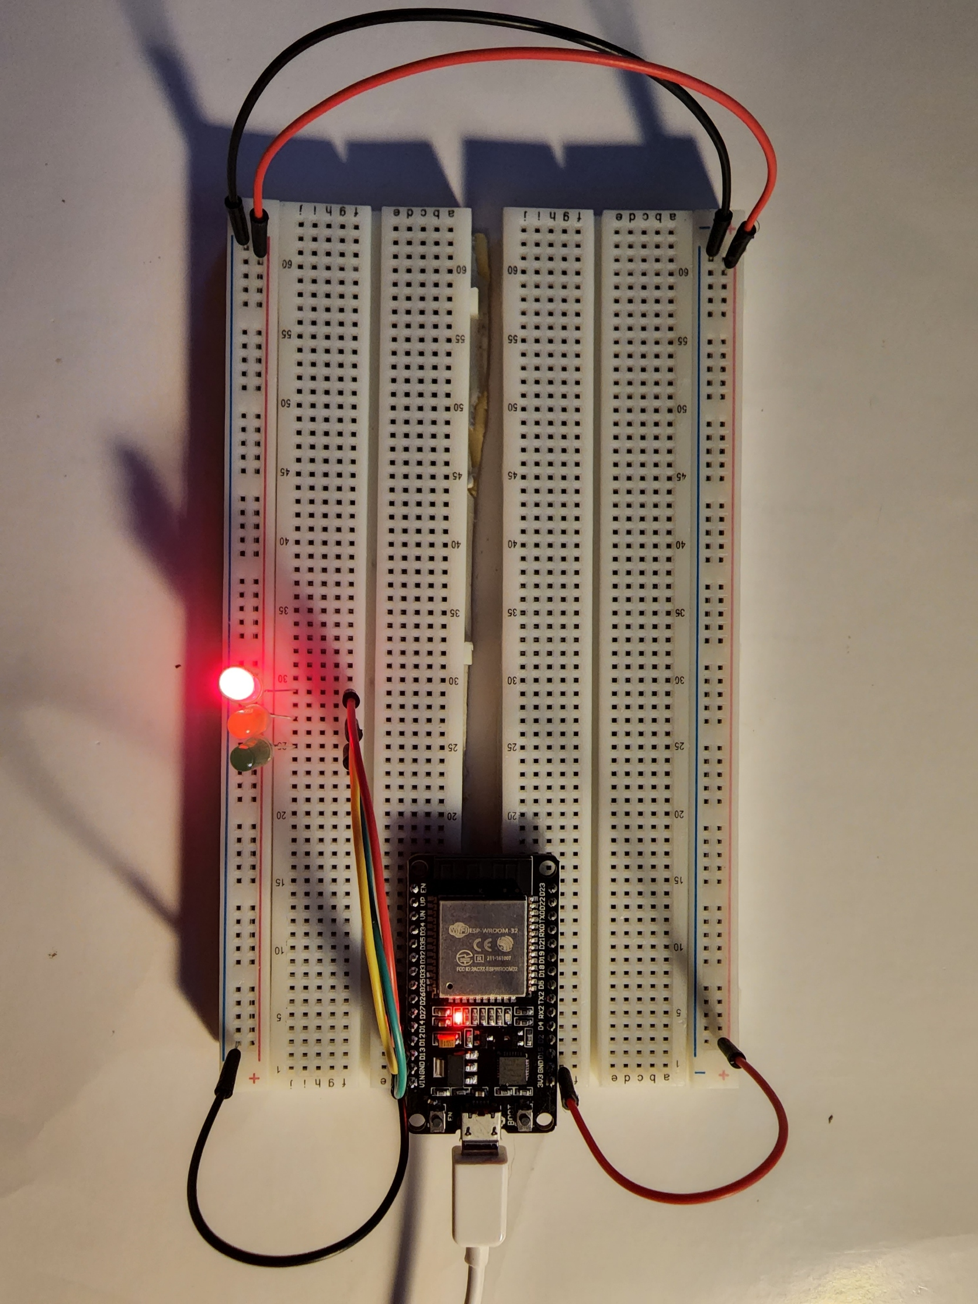
Picture of circuit with working leds

Slide 10
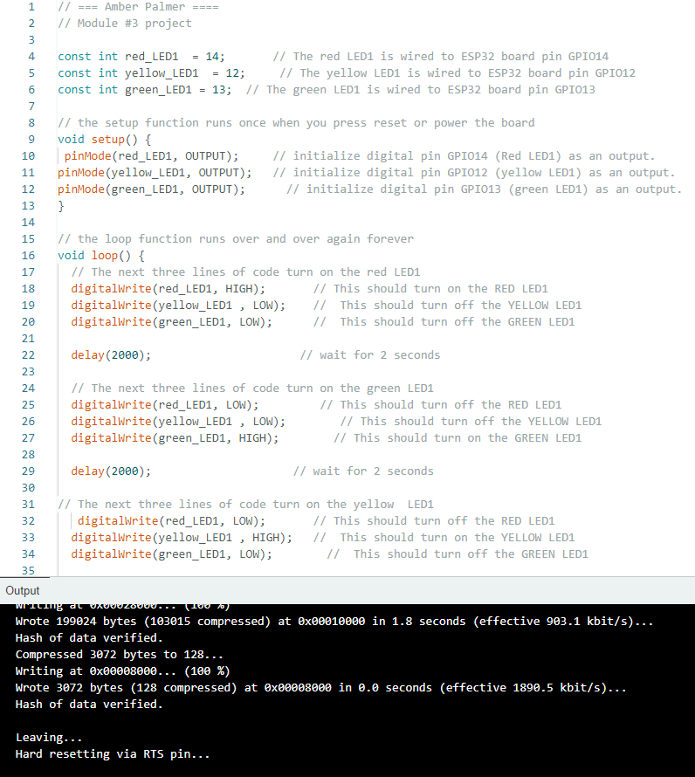
Screenshot of the code used in Arduino to run the led lights

Slide 11
The next two slides represent creating a multiple traffic light controller by adding another set of LEDs such as the red, green, and yellow lights. I will also be adding a few more wires and plugging them into there respective locations. The lights light up after plugging the code into Arduino.

Slide 12
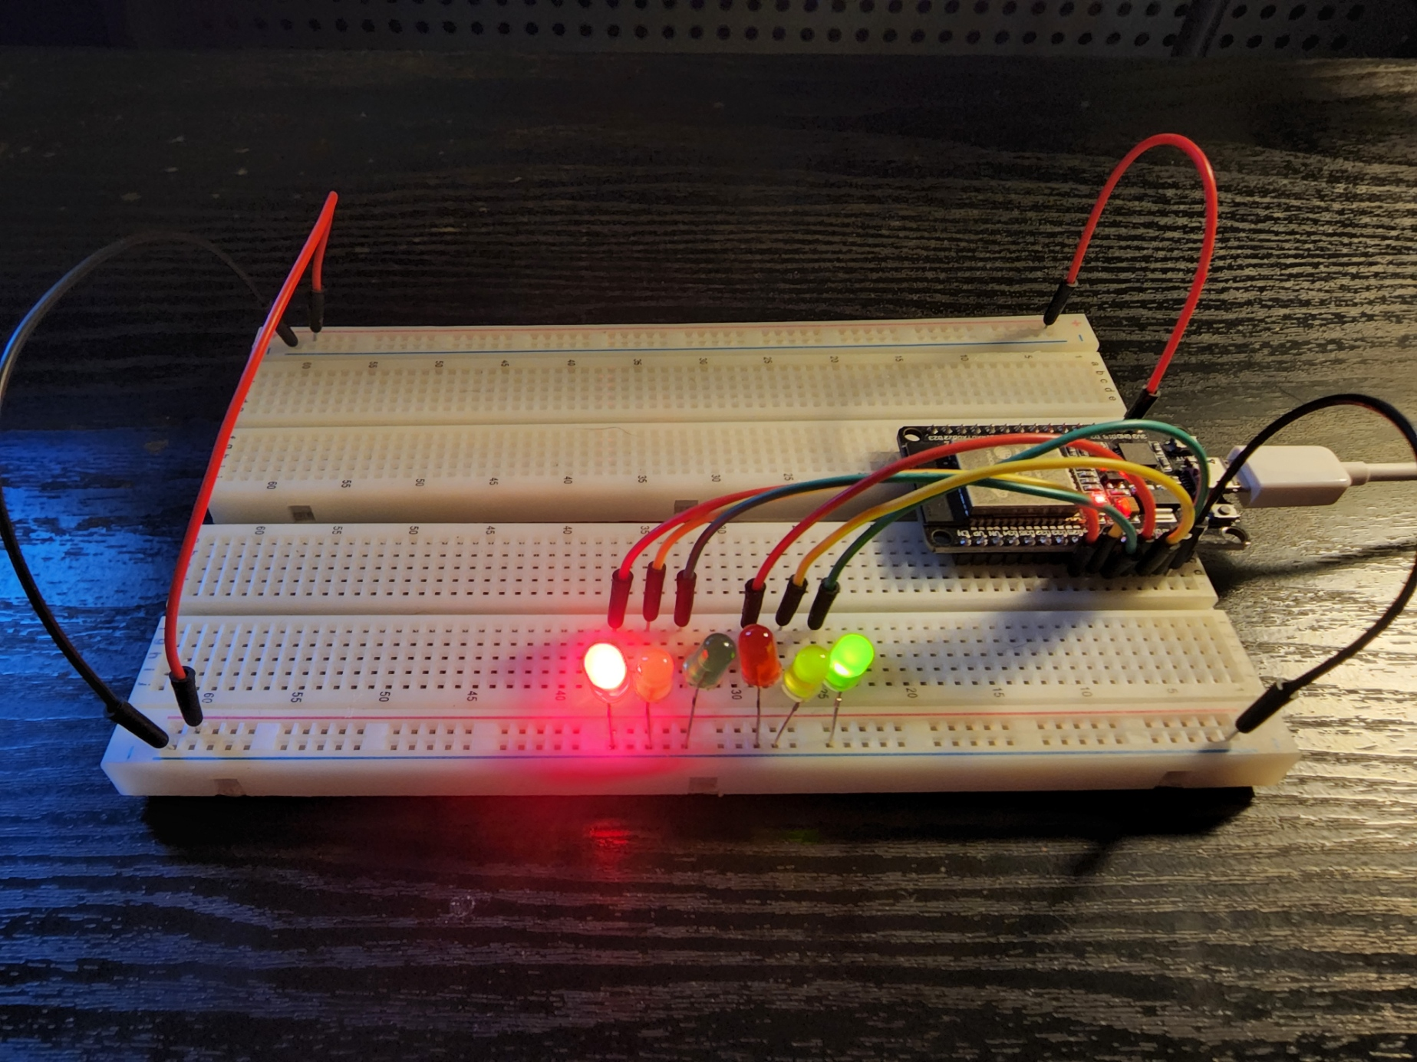
Working led lights. One side of the 4 way is red and the other side is green.

Slide 13
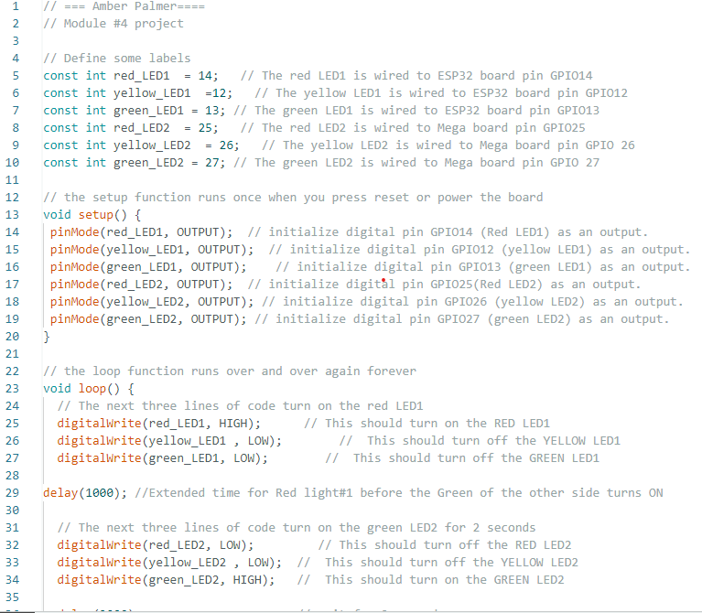
The code used to program the lights. This code tells the lights when to change and how often.

Slide 14
Next you will see the demonstration of creating a multiple traffic light controller with a cross walk. The lights will change to match the crosswalk. The serial monitor shows when you should walk and how long you have before the light changes again.

Slide 15
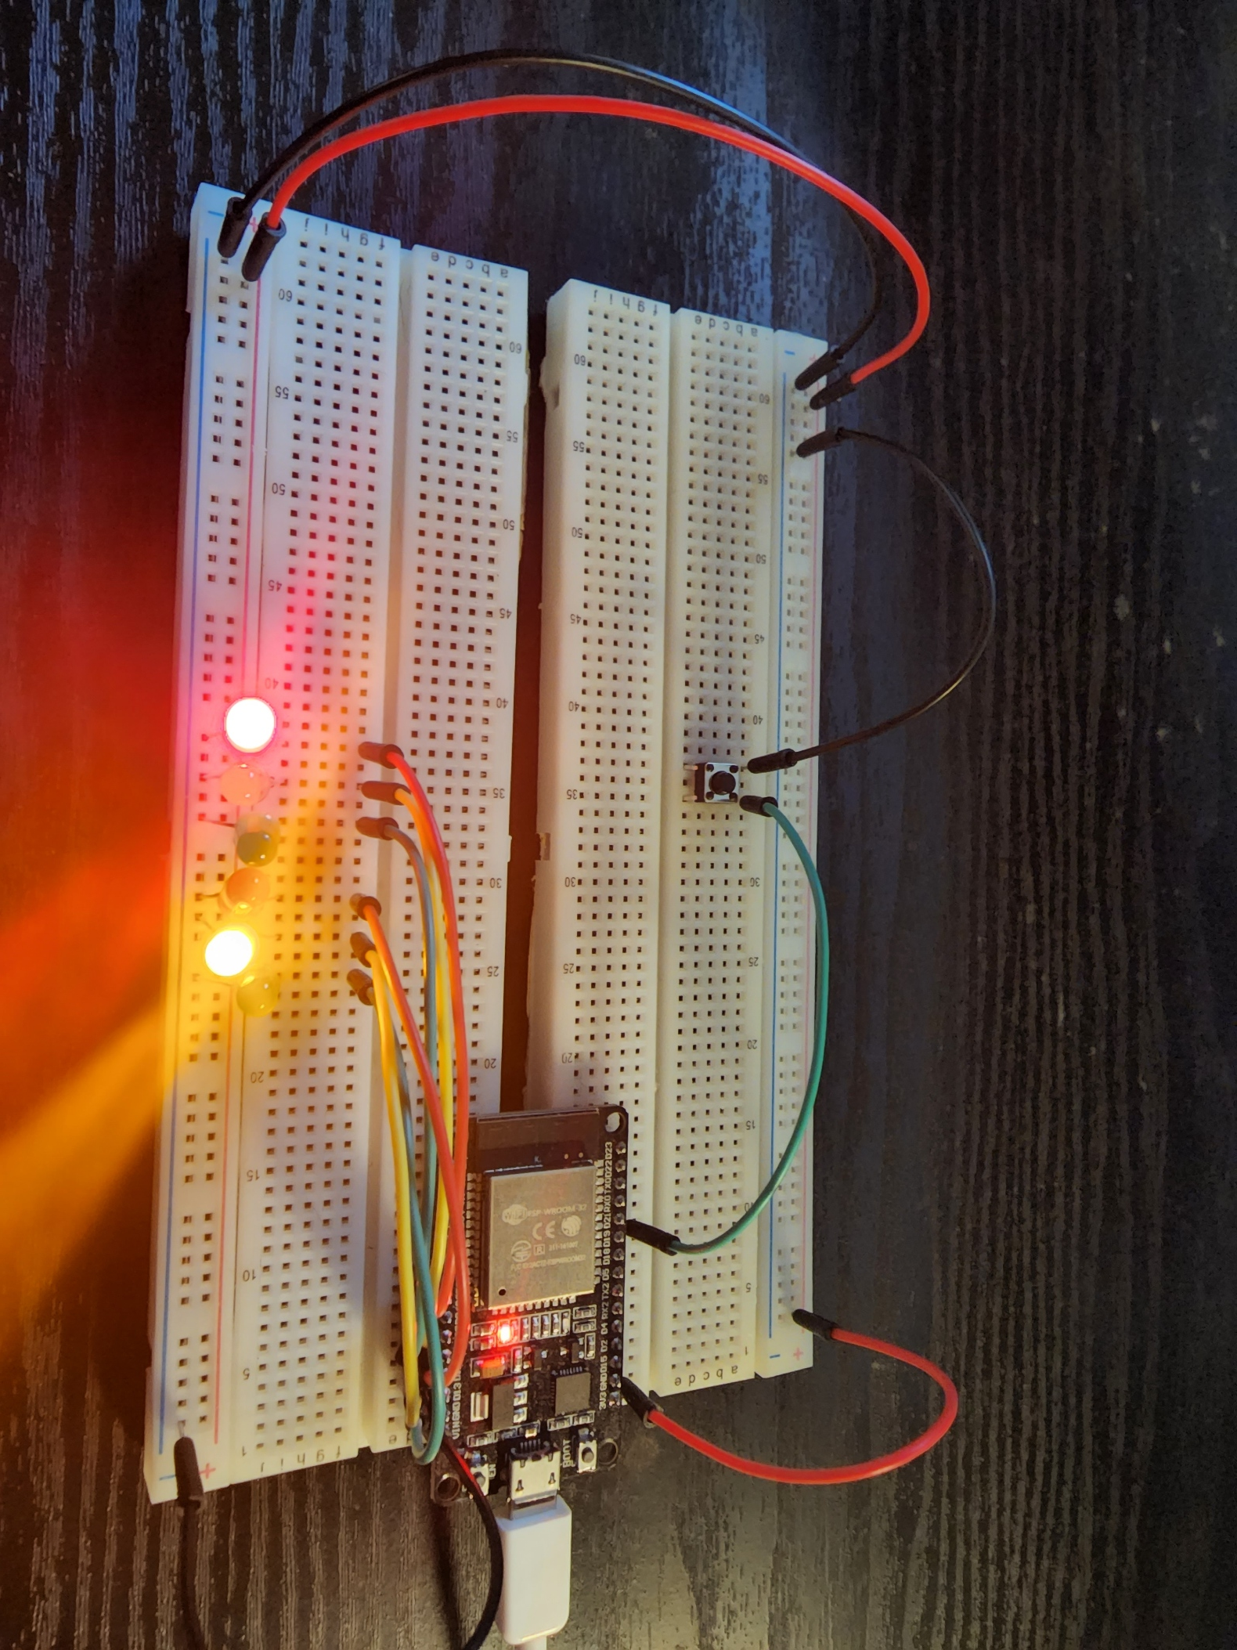
In this project I used the following parts:
ESP32 Board
Red, Yellow, and Green LEDs (2 sets)
Push Button
Wires
2 Breadboards

Slide 16
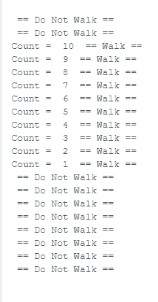
Serial monitor showing when to walk and when to not walk

Slide 17
In the next project I will be adding the crosswalk option using a button and a buzzer to signal the crosswalk. I also installed the LCD to add the timer of how much time there is before the light changes and the message states do not walk.
The Parts used for this project are:
ESP32 Board
Two sets of Red, Yellow, and Green LEDs
Button
LCD Unit
Buzzer
Wires
2 Breadboards

Slide 18
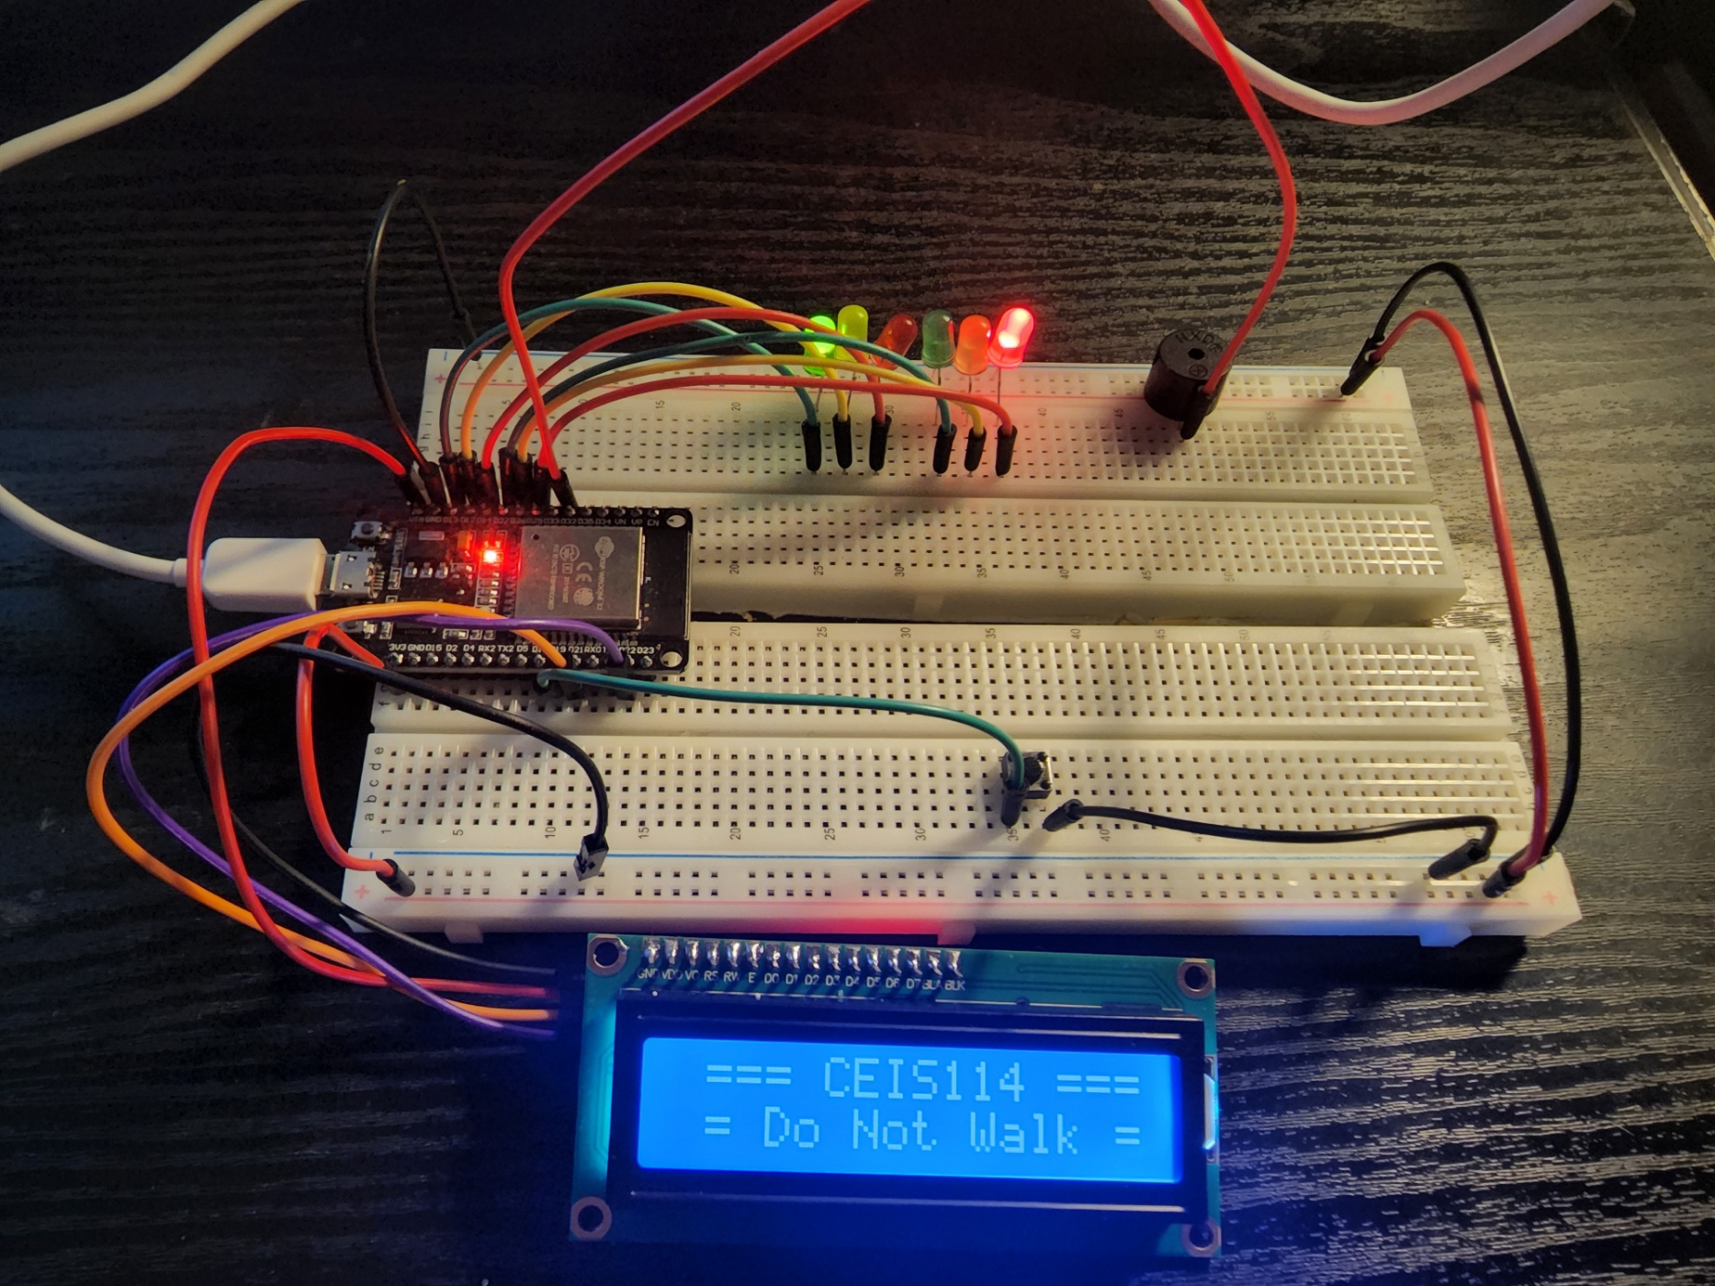
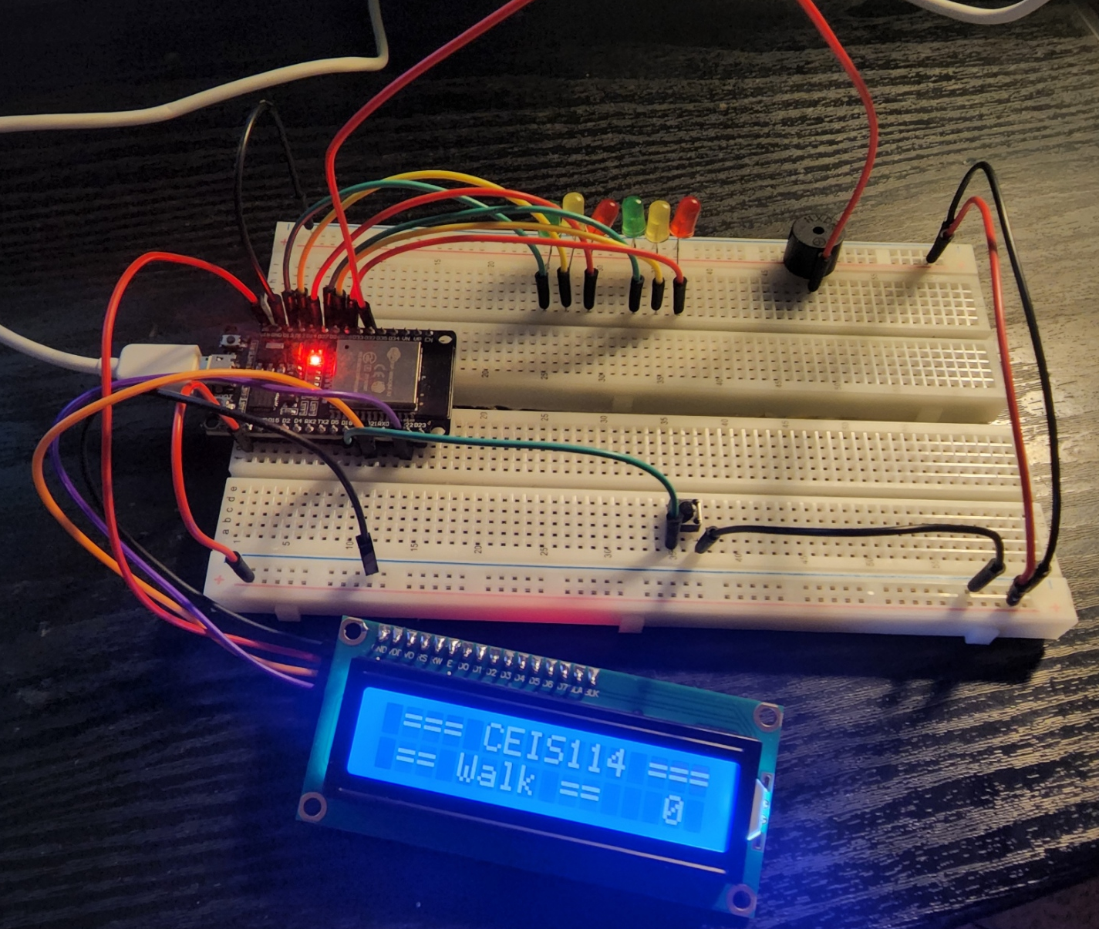

Slide 19
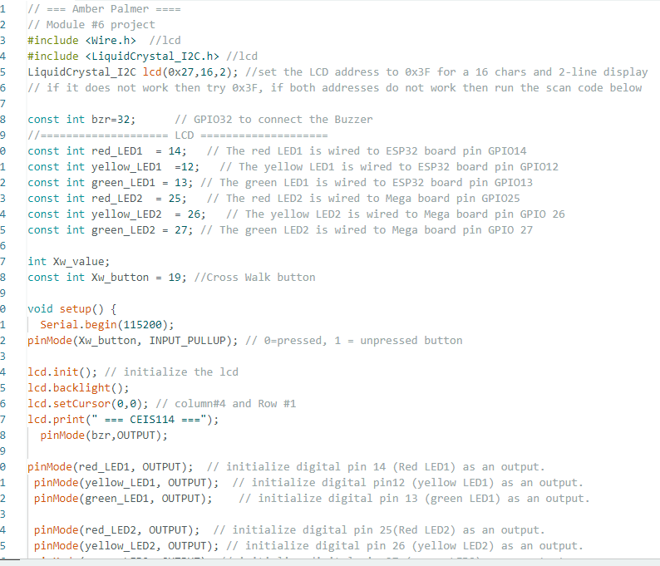
Here is the code used to program the Arduino IDE. For the LED to work I also downloaded the zip file LiquidCrystal_12C-master Library

Slide 20
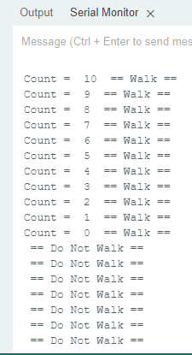
This screenshot reflects what the LED shows on the screen of the LED as it counts down.

Slide 21
Multiple Traffic Light Controller with Cross Walk and an Emergency Buzzer with a SMART Sensor.
The final part of this project is to design a traffic light that is continuously active in one direction of the major street and the minor side of the street is always red. The motion sensor added will activate the minor street traffic light when there is motion (cars) detected. There are two buttons added to this project, one is to signal the crosswalk and the other is to signal an emergency signal.
Parts Used:
ESP32 Board
2 sets of Red, Yellow, and Green LEDs
1 Blue LED
LCD Unit
Buzzer
2 Push Buttons
Motion Detector
Wires
2 Breadboards

Slide 22
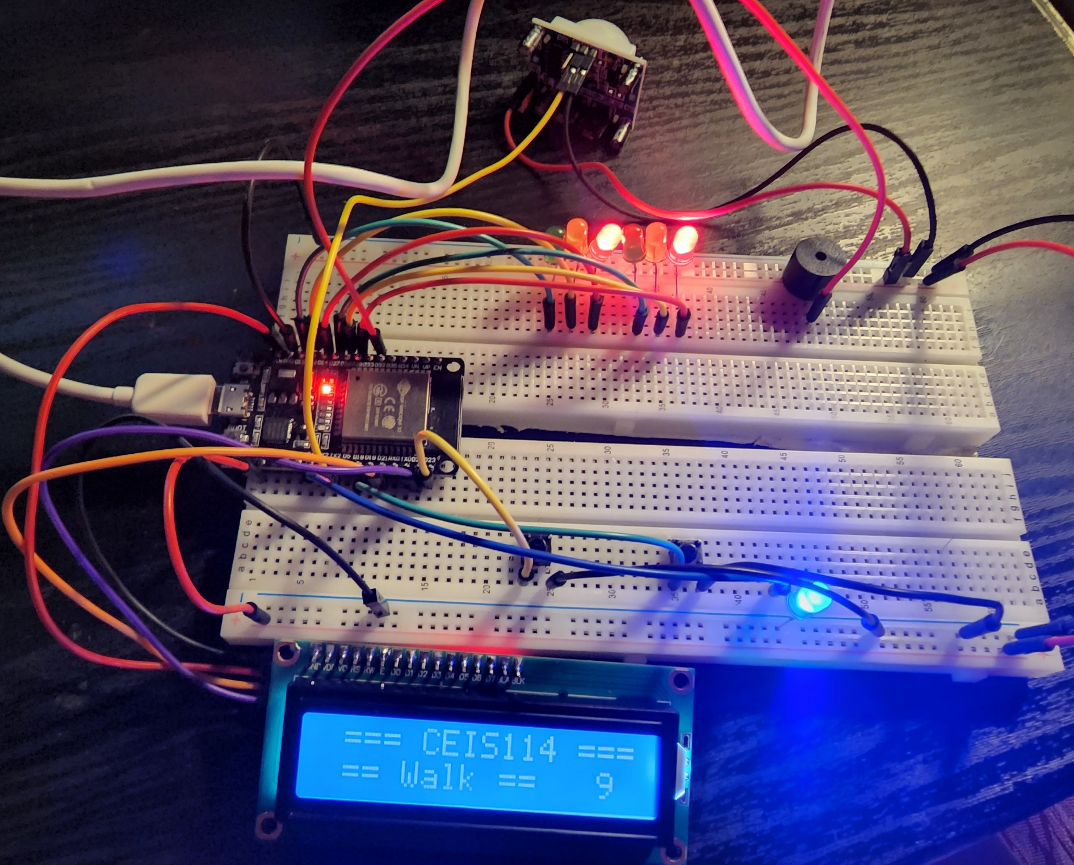
Here you can see that the emergency button was triggered indicated by the blue LED and both red LEDs are signaling both the major street and minor street to stop. The counter on the LED screen has also paused.

Slide 23
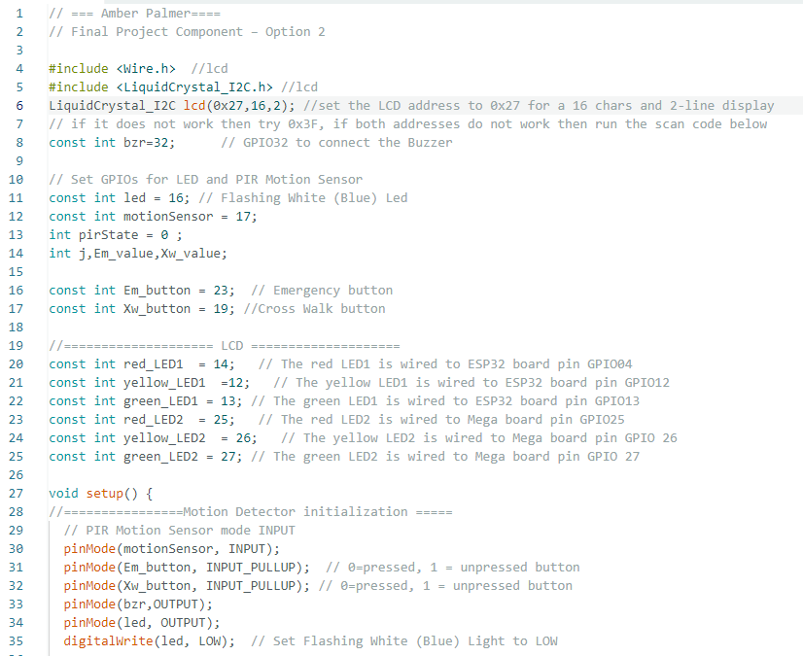
The Arduino code used to tell the components what to do and how to react after the emergency button is used and the crosswalk button is used.

Slide 24
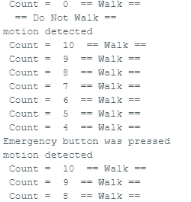
Screenshot of the serial monitor confirming the motion sensor is detecting movement, the emergency button was pressed, and the crosswalk button was utilized. Pressing the emergency button stops all other actions.

Slide 25

Feed Back to my peers and the post I made

Slide 26
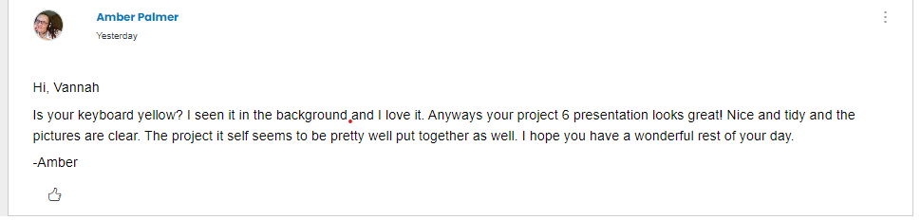
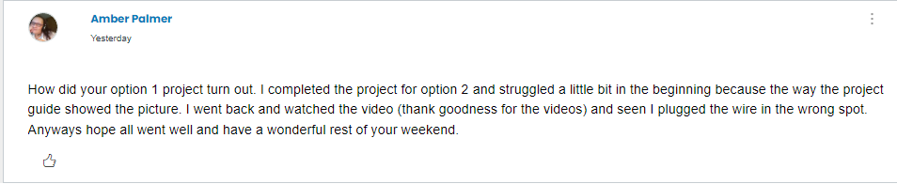

Slide 27
Challenges in the project
I faced many challenges in this slide. The first challenge I had was downloading and installing the driver needed to communicate with the ESP32 Microcontroller. I downloaded it, but did not install it correctly so I received errors instead of being able to search for the WiFi in my area. In Module 2 I kept installing the LED lights backwards and tried to disconnect the two end pieces from a board they would not come off of. After changing my board to another one that came in the kit I was easily able to disconnect the two ends. The next issues I ran into was with the LED reflecting the walk and do not walk banner. I had to adjust the contrast on the board and change the LCD address from 0x27 to 0xx3F because the LCD was showing boxes across the screen instead of the words.

Slide 28
Career skills slide
Skills I have gained throughout this project is the process it requires to build a smart traffic light controller using the principles of technology. The ability to identify resources needed to build a smart traffic controller and how to operate the smart traffic light controller and how to test the controller that I built. Troubleshooting is one of the biggest skills I learned due to the many issues I experienced while putting the project together.

Slide 29
conclusion
Smart Traffic Light systems are super beneficial in high traffic areas. The automatic detection of traffic helps keep down on traffic build-up. The detection for emergency vehicles will stop traffic on both sides for the emergency personnel to navigate through red lights with both sides stopped. The crosswalk button helps people get across the road with out vehicles zooming through and tells the pedestrian when it’s not safe to walk. Smart traffic controllers help cut down on accidents for drivers, emergency vehicles, and pedestrians. I think all high traffic areas should be equipped with these controllers as it is a benefit for everyone. Plus it helps with the build-up of traffic waiting for the light to change such as is common with traditional light systems.

