Slide 1
CEIS106 Final Project
Amber Palmer

Slide 2
Introduction
In this presentation I will be illustrating different administrative tasks utilizing the Ubuntu Linux Distro hosted through the Hyper-V virtual machine listed on Azure. This environment was preset for students already, but this project can also be implemented by these simple steps, download the Linux Distro of your choice along with a virtual machine to run the Linux OS alongside your current operating system. Next, you will need to choose your language, disk partition or logical volume manager, and file system. Once the GUI starts, right-click on the desktop and select the open terminal option. The following slides demonstrate my ability to execute the administrative task using the CLI.

Slide 3
Linux File System
Starting this module I will demonstrate my understanding of navigating the Linux file system tree by answering a few questions of relevance.
Then I will visually demonstrate how to create directories and files.
I will also visually demonstrate coping and removing files and directories.
Finally, I will show the command used to locate these files and directories.

Slide 4
Navigate the Linux filesystem tree
1. What is the pwd command an acronym for? What about the cd command?
Answer here:
pwd – print working directory
cd – change directory
2. Explain the differences between a relative path and an absolute/full path in Linux.
Answer here:
An absolute path is the full path to a directory. All absolute path names begin with /.
A Relative path is the path related to the present working directory or pwd command.
References:
1. https://www.geeksforgeeks.org/
2. http://www.differencebetween.net/

Slide 5
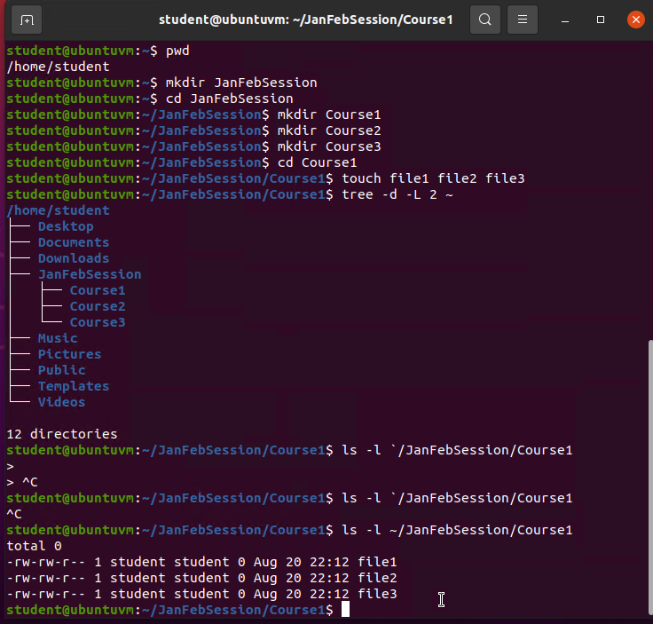
Create directories and files

Slide 6
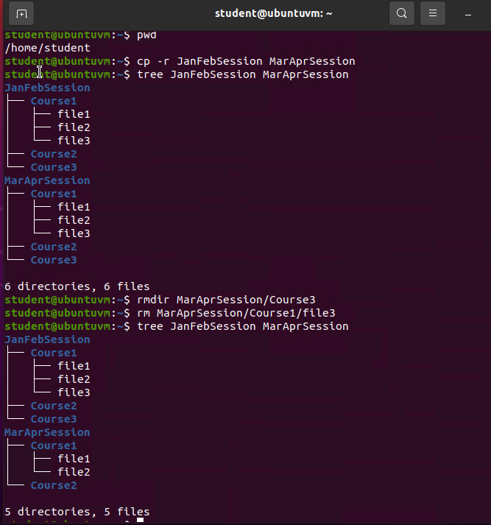
Copy and remove directories and files

Slide 7
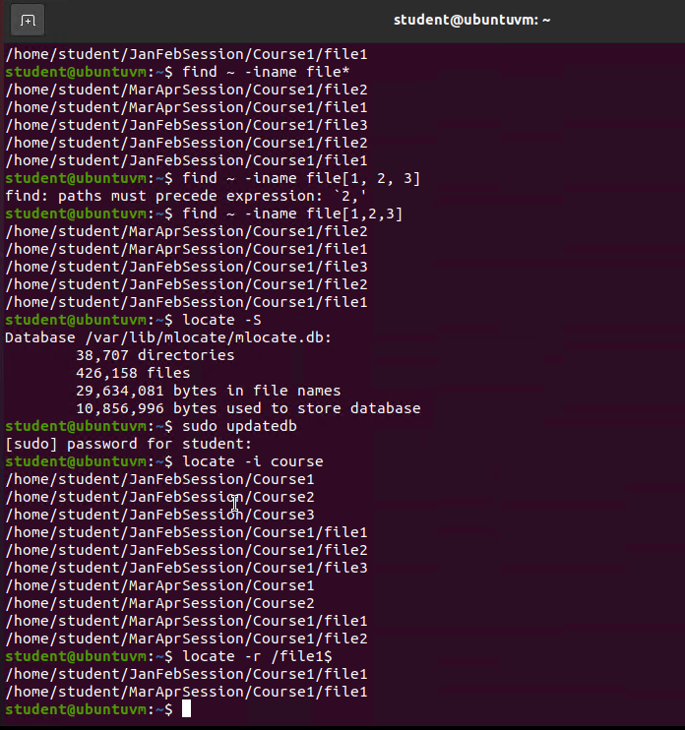
Locate directories and files

Slide 8
Linux Shell Script
For this module I will start with creating a shell script.
Then I changed the script’s file permissions.
Next I demonstrate setting the PATH variable.
Finally, I make the PATH variable permanent.

Slide 9
Create a shell script
1. What are the file permissions of the script?
Answer here: rw- (read/write) representing the owner permissions
rw- (read/write) representing the group permissions
r-- (read) representing all others
2. What’s the name of the user-defined variable in the script?
Answer here:
$text
3. Which redirection meta-character is used in the script? What does it do?
Answer here:
>> appends additional information to the file content rather than the shell overwriting the contents previously saved to the file.
References:
1. Module 3: Lesson 3: Redirection
2. Module 3: Lesson 1: User-defined variables

Slide 10
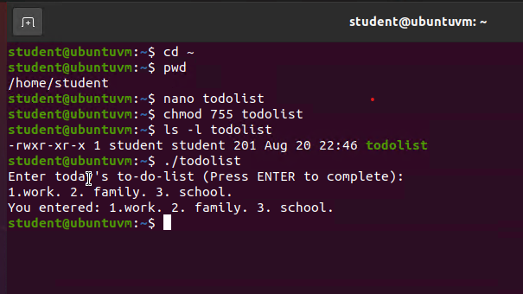
Change script file permissions
Take a screenshot of the output in Step 5.

Slide 11
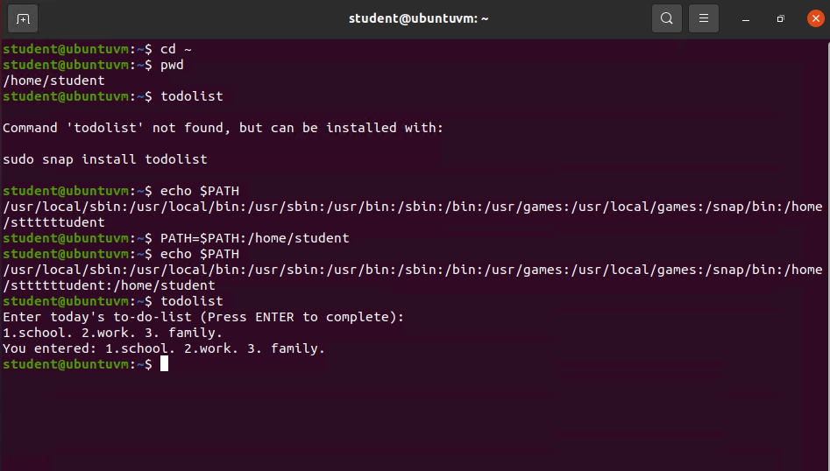
Set the PATH variable
Take a screenshot of the output in Step 6.

Slide 12
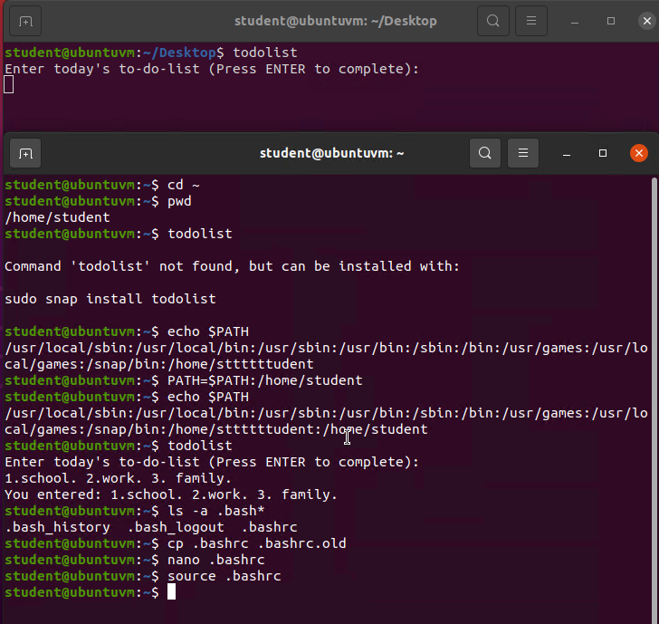
Make the PATH variable permanent

Slide 13
Linux Administrative Task
This demonstration starts with answering a few questions based on the process of adding users and groups.
Then a visual demonstration of testing the user and groups settings.
After I demonstrated adding the user and group by CLI, I also demonstrate adding a user by the GUI.
Finally, an image to represent the removal of the users.

Slide 14
Add users and groups in CLI
1. What does the –m option in the useradd command do?
Answer here: Specifies that a home directory should be created for the user account.
2. What does the -3 option in the tail command do?
Answer here: Shows the last 3 lines of the file specified such as calling the file /etc/shadow prints the last 3 lines of that file to the terminal unless otherwise specified.
3. Which line of the /etc/group file lists members of the “students” group? Copy it here.
Answer here: sudo useradd -m -s /bin/bash mary
References:
1. Page 532 of the book listed in Mindtap for the –m command.
2. Page 109 of the same book for tail.

Slide 15
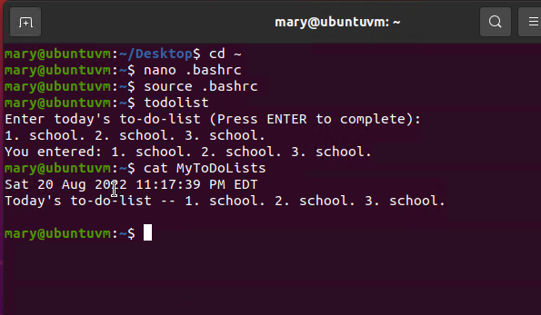
Test user and group settings

Slide 16
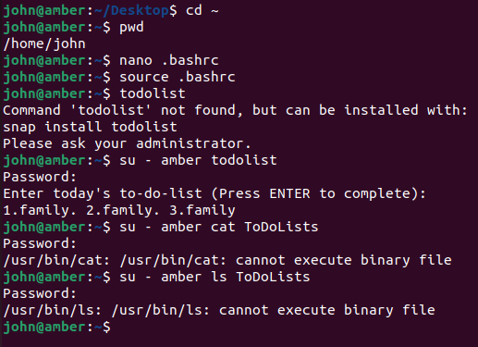
Add users in GUI

Slide 17
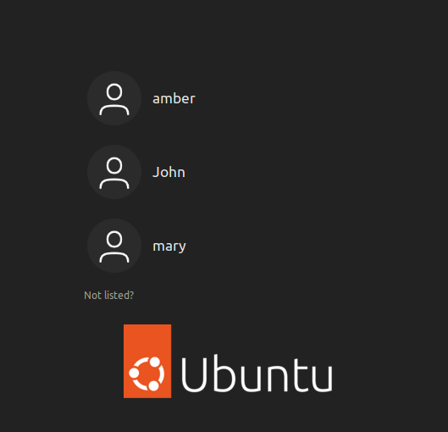
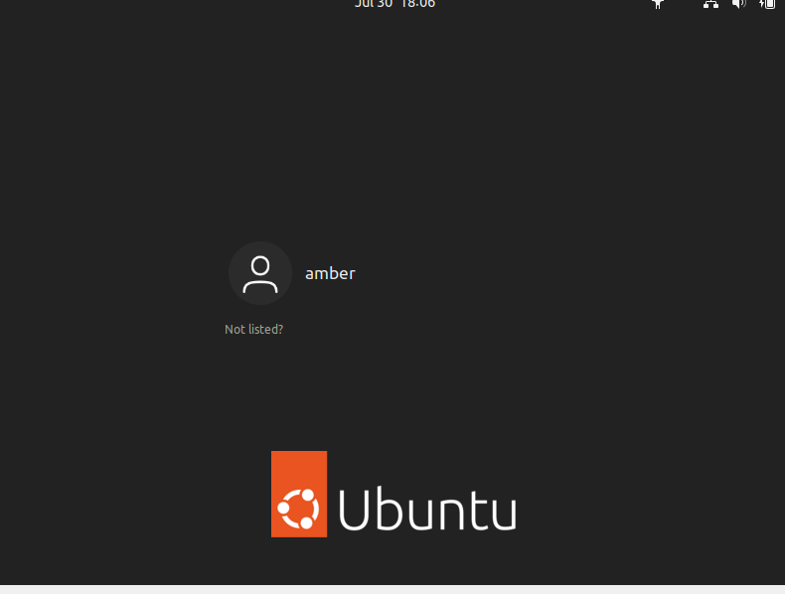

Remove users and groups

Slide 18
Networking
This module starts with answering a few questions about the host ip configurations such as the current ip address of the Ubuntu machine, default gateway, DHCP server, and DNS server. There is an image to support my hypotheses.
To demonstrate a clear understanding of managing network interfaces, I answered a few questions in regards to which messages show in the output of the dhclient command.
Finally a simple image that represents the user network utility configuration.

Slide 19
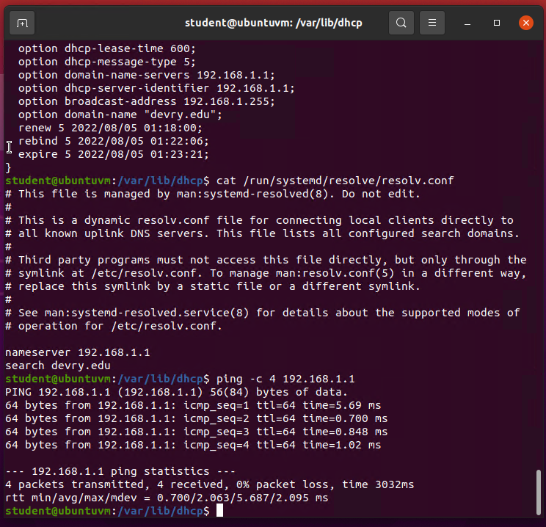
Discover host IP configurations
1. What is the IP address of your Ubuntu machine?
Answer here:192.168.1.104/24
2. What is the IP address of its default gateway?
Answer here:192.168.1.1
3. What is the IP address of its DHCP server?
Answer here: 192.168.1.1
4. What is the IP address of its DNS server?
Answer here: 192.168.1.1

Slide 20
Manage network interfaces
1. Which DHCP message is shown in the output of the sudo dhclient –v –r eth0 command? [hint: the message name is in uppercase.]
Answer here: DHCPRELEASE
2. Which four DHCP messages are shown in the output of the sudo dhclient –v eth0 command? [hint: the message names are in uppercase.]
Answer here: DHCPDISCOVER, DHCPOFFER, DHCPREQUEST, DHCPACK

Slide 21
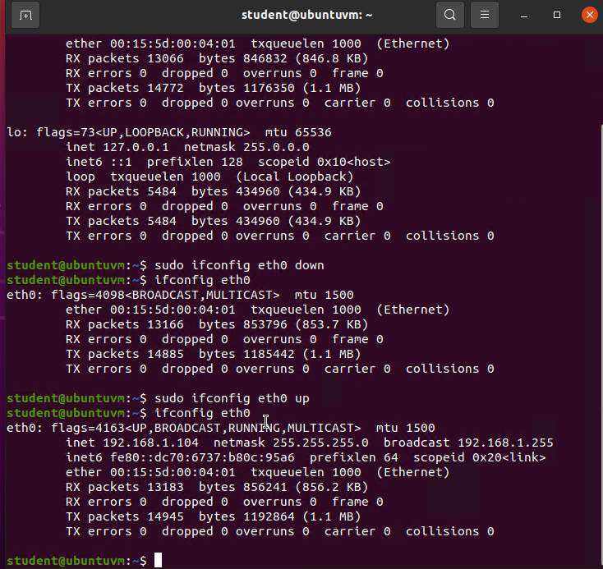
Use network utilities

Slide 22
Security, Troubleshooting, and Performance
The first slide will answer two questions on monitoring Linux processes.
The second slide answers a few questions on monitoring user activities.
The final slide gives a visual image of the monitoring network bandwidth usage.

Slide 23
Monitor Linux processes
1. What is the default action of the 15 SIGTERM kill signal?
Answer here: It closed the calculator app. I searched for calculator again after running 15 SIGTERM and was unsuccessful. So I reopened the calculator and reran the code. It most definitely kills the program.
2. In the System Monitor window, click on % CPU to sort the processes by CPU load. Which process shows the highest percentage of CPU usage?
Answer here: It changes rapidly between gdm, student, and system-r.
References:
1. First page of the project
2.Azure

Slide 24
Monitor user activities
Issue the sudo accton on command to turn on GNC accounting. Run the sudo updatedb command. Enter lastcomm updatedb to check if the updatedb command was executed before. Remember to turn off GNC accounting (sudo accton off) after answering the questions.
1. What flag value is displayed in the output?
Answer here: an S flag, meaning the command was executed by superuser in terminal pts/0 and the process duration lasted for 0.98 seconds.
2. Why is the name of the user who ran the processes shown as root, not student?
Answer here: Because I called the root user using sudo, and entered my root password so the command was ran like I was root.
References:
1.Second page of the project
2. Running the codes from above through Ubuntu

Slide 25
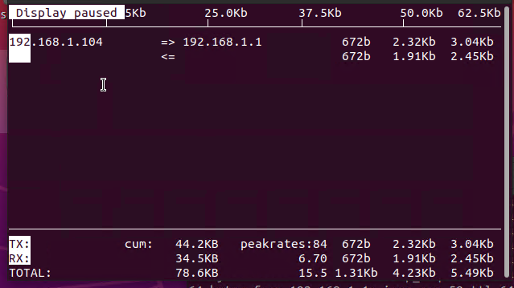
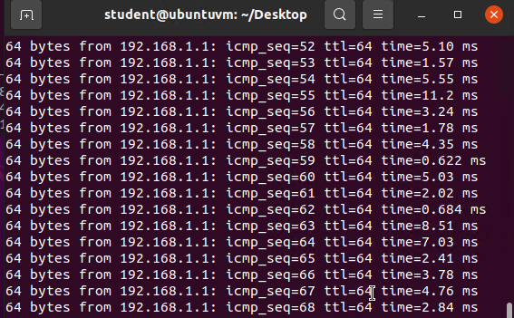
Monitor network bandwidth usage
Take a screenshot of the output in Step 4.

Slide 26
Challenges
Linux being case sensitive caused a few challenges.
I also experienced issues when trying to execute the commands to create a new user and run the todolist program from the CLI. To resolve the issue I switched from my personal virtual machine to Azure Labs machine.
I wasn’t to sure of some of the answers for the DHCP questions, and took re-reading that chapter in the Linux+ book to help break it down a little further. I am very grateful I had that book printed as I have been reviewing a lot of the commands that was called in the class plus some that was not.

Slide 27
Career Skills
Linux is very popular in the corporate environment due to it being a multi-user and multi-operating open-source system.
I gained many Linux administrative skills with the hand on practice demonstrated in this presentation.
I have learned how to make a Linux program by utilizing a text editor such as nano and adding the variable to $PATH.
I am now way more confident with downloading the virtual machine platform, such as virtual box, and then configuring the Linux distro to that machine.
I have a better understanding of why users should only have the permissions needed to access the system and complete the work they are scheduled to do, and how to change those permissions as needed and to add and remove them from groups as needed.

Slide 28
Conclusion
Linux presented many challenges as described in the previous slide, but working through those challenges has built a better comprehension of what task the commands I entered are fulfilling.
I am still studying and putting words to motion, but I plan on taking the Linux+ certification before the end of the year.
After completing this class I feel like I have made the right decision in Information Technology starting out, but has made me realize that I want and need to know more.
Here’s to a new start with exponential possibilities!

